Slide 1
World Bank and Habitat III

Slide 2
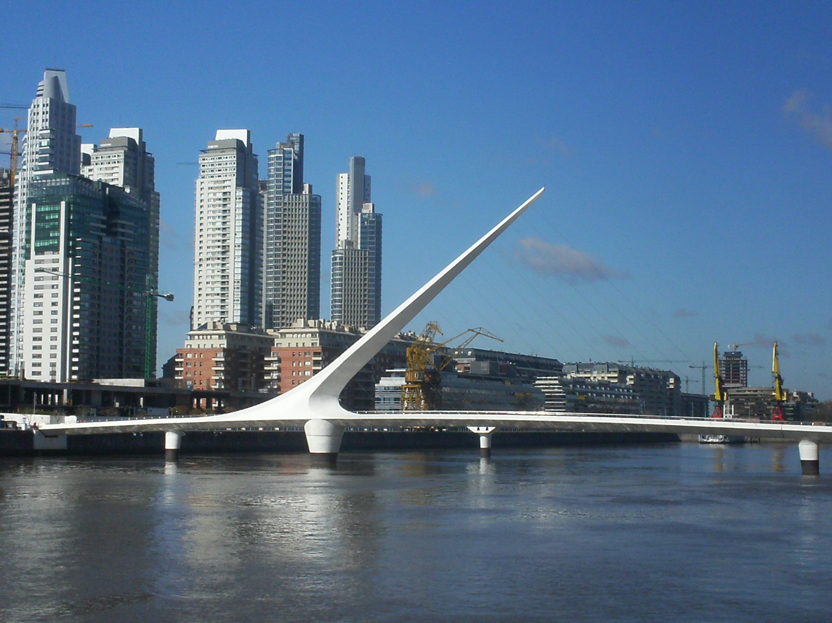
The World Bank and Cities

Slide 3
World Bank and Habitat III
1) Municipal Finance 2) Urban Resilience

Slide 4
The Municipal Finance Policy Group

Slide 5
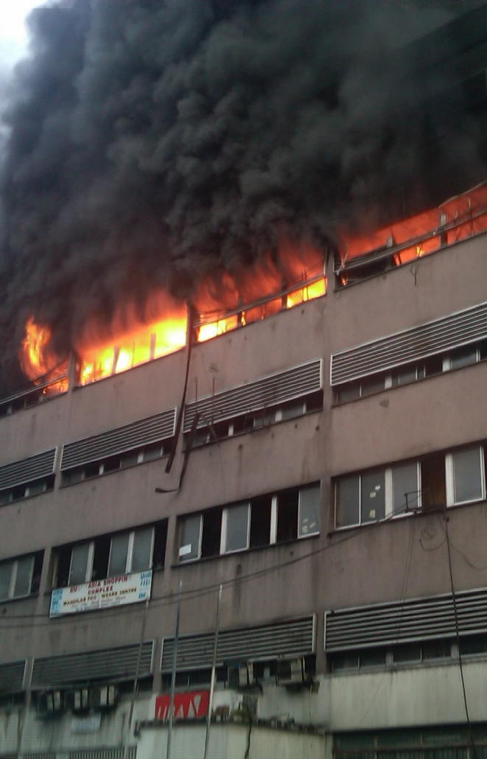
City Resilience Challenges
Growing cities face growing disaster risk
Earthquake
Flood
Fire

Slide 6
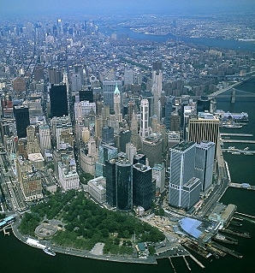
City Resilience
Opportunity – a market waiting to be tapped
Financing public investments to increase resilience to natural disasters
Delivering private equity investments to develop areas with reduced vulnerability to natural disasters and increased access to insurance
As vulnerability to natural disasters is reduced through public investment, land values increase dramatically, enabling high returning investment opportunities
Land values also increase because insurance becomes available, which unlocks additional debt for equity investments to develop real estate

Slide 7
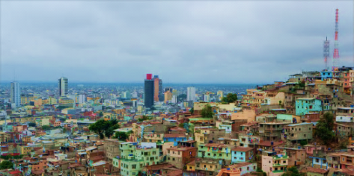
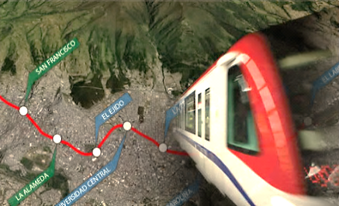
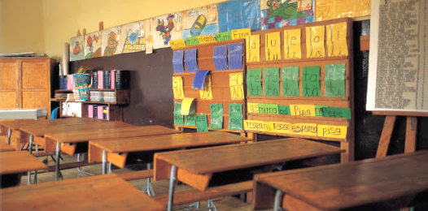
Land Value Capture Instruments
Improved connectivity
EX-POST
Cadaster
Economic Value Assessment
Increased Resilience
To finance new infrastructure
Increased property values
Economic Prosperity
ú
EX-ANTE
Development rights
Impact taxes
Tax Increment Financing
Land value capture
Improved public services
Urban Densification
Urban Transformation
City Operations
Land adjustments

Slide 8
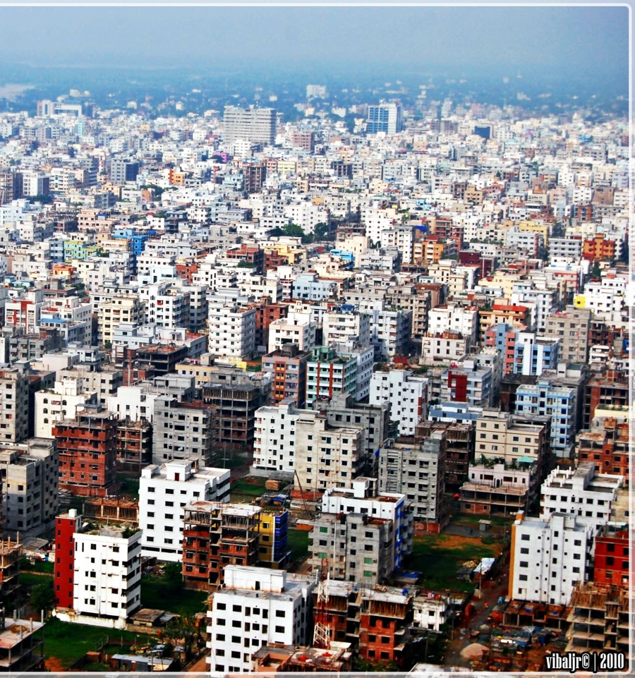
City Resilience Project
Dhaka Eastern Bypass, Bangladesh
Benefits streams:
Increase in value of well planned, flood protected land
Economic benefits of the transport investment
Enabling accelerated economic growth in Greater Dhaka East
Mitigation of flood losses from flood protection infrastructure
Mitigation of climate change induced losses from flood protection infrastructure
Mitigation of earthquake losses from decreased risk of liquefaction caused by cessation of land-filling
Unlocking the economic potential of resilient urban development

Slide 9
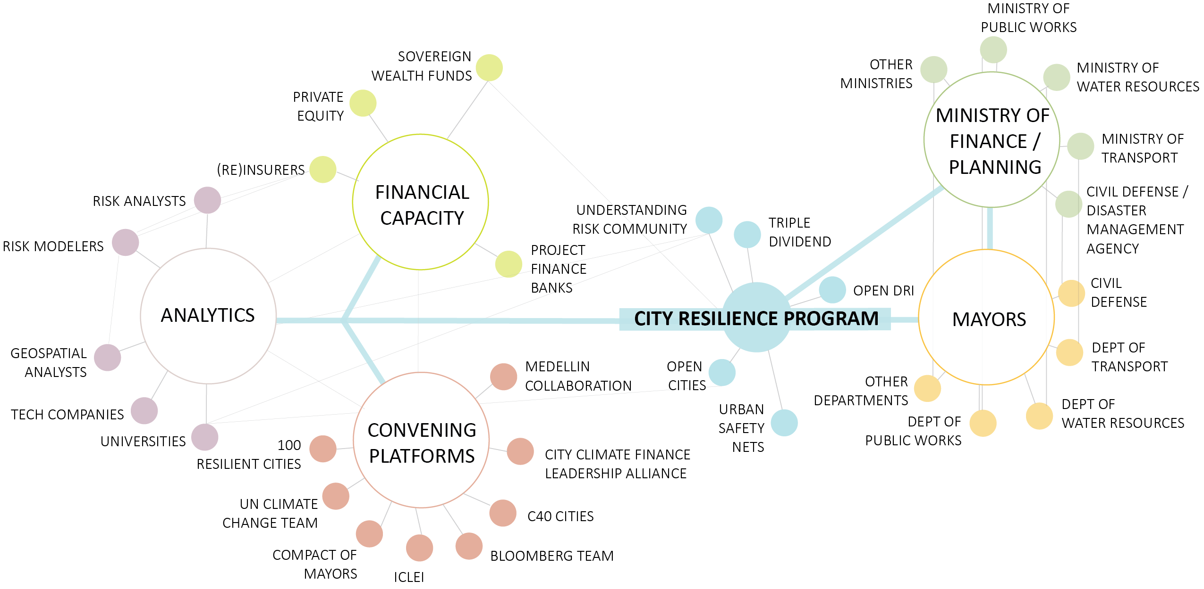
City Resilience Program
Connecting urban policy and decision makers to new ideas and sources of financing to build financial, social and physical resilience

Slide 10
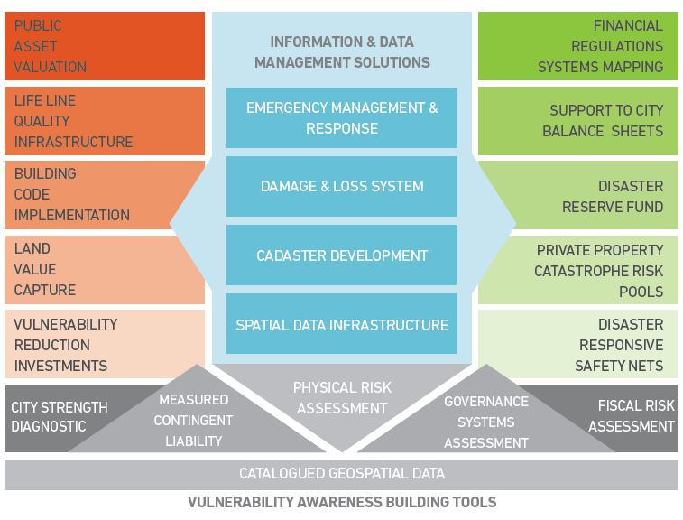
City Resilience Tool Box

Slide 11
Thank you

