Slide 1
SERBIA
Washington DC 04/26/2016

Slide 2
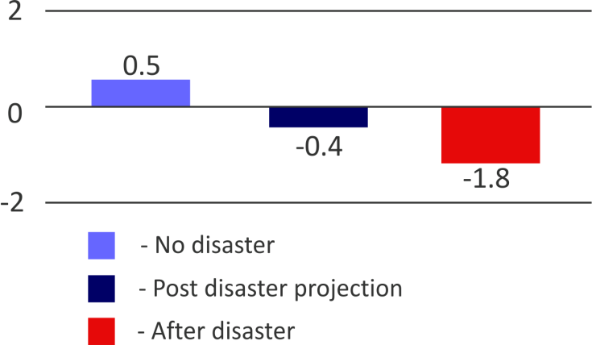
Floods 2014
Floods affected 119 municipalities (out of 165)
22% of total population affected by floods
More than 30 municipalities sustained extensive damage
57 lives were lost
32,000 families were forced out of their homes
Production of electricity decreased by 25%, due to the flooding of an open-pit coal mine, a key source of lignite-based power generation
The disaster caused a recession in the Serbian economy
Serbian economy contracted by 1.8% in 2014, instead of growing by 0.5% as was previously projected
IMPACT OF DISASTER ON SERBIA GDP GROWTH RATE IN 2014
Washington DC 04/26/2016

Slide 3
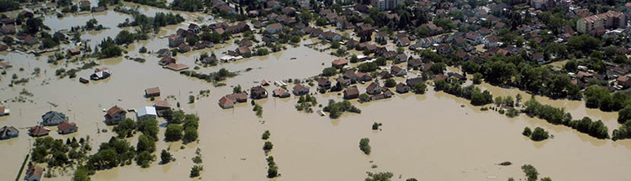
Facts About the Consequences
Total estimated damages exceed EUR 1 billion
Total disaster effects (including losses)
4.8% of GDP (EUR 1.7 billion)
Total needs for recovery and reconstruction are estimated at EUR 1.35 billion
Estimates are based on the Post Disaster Needs Assessment implemented by the Government of Serbia with the assistance of the WB, UN and EU
Washington DC 04/26/2016

Slide 4
Government Response
No adequate system was in place to respond to overwhelming needs in a coordinated fashion
Office for Reconstruction and Flood Relief was established in the midst of floods as an operative (not political) national authority for relief and recovery
Drafting a new set of rules,
law and bylaws
Washington DC 04/26/2016

Slide 5
Government Response
KEY PRINCIPLES OF THE PROCESS:
RESPONSIVENESS
Population affected by floods
TRANSPARENCY
ACCOUNTABILITY
General population and donors
Among other changes, the new Law included a new procurement model, adapted to post-disaster needs and key principles of the process listed above.
Washington DC 04/26/2016

Slide 6
Government Response
KEY RESPONSIBILITIES OF THE
OFFICE FOR RECONSTRUCTION AND FLOOD RELIEF:
Data collection, processing and verification
Drafting of National Recovery Programs by sectors (including detailed information on damages, proposed measures and cost estimates)
Fundraising (Office as the key focal point for donors and lenders)
Coordination of aid disbursement
Supervision of implementation (including public procurement)
Approval of payments
Ensuring transparency through reporting (to the Government, general public and donors)
Washington DC 04/26/2016

Slide 7
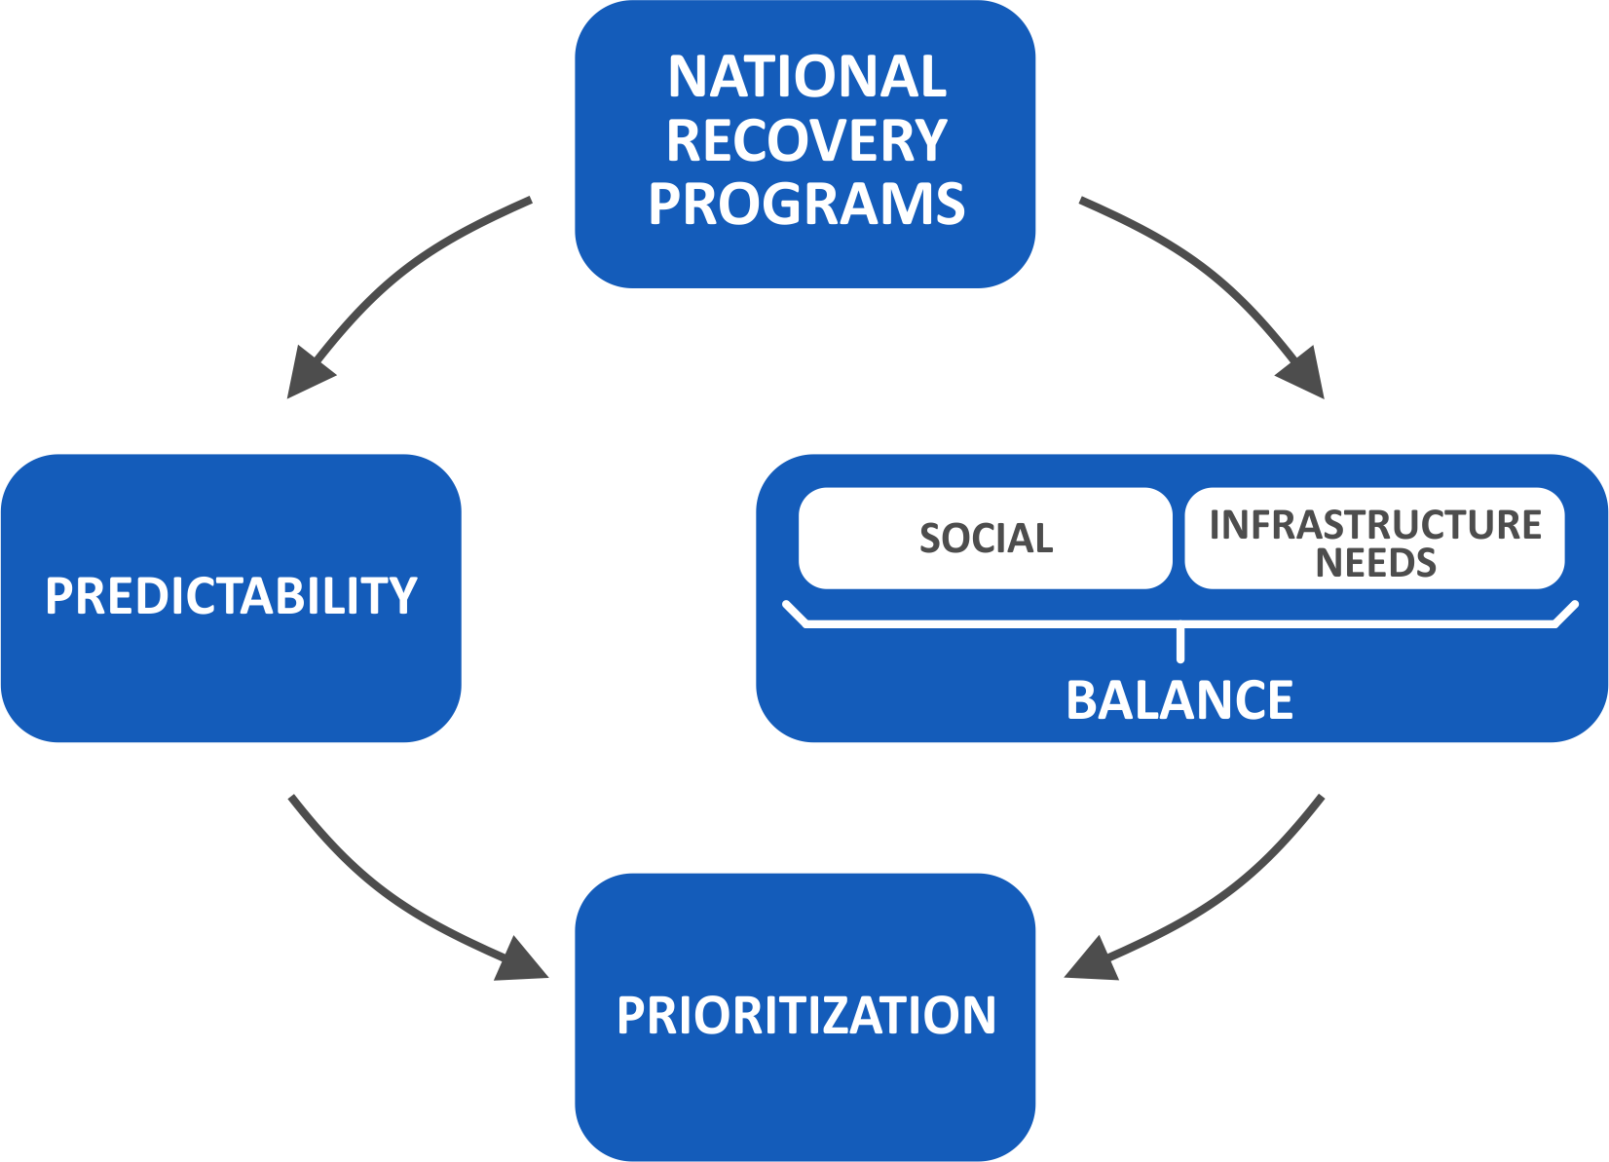
Government Response
MAKE COMPROMISES WITHOUT COMPROMISING THE OVERALL RECOVERY EFFORT
Washington DC 04/26/2016

Slide 8
Key Challenges
PACE OF THE RECOVERY PROCESS
LATE START Delay in delivery
SPEED OF DELIVERY vs. Quality
PRESSURE building up
Limited resources
Prioritization
Political
Humane
Rational
Criteria
Washington DC 04/26/2016

Slide 9
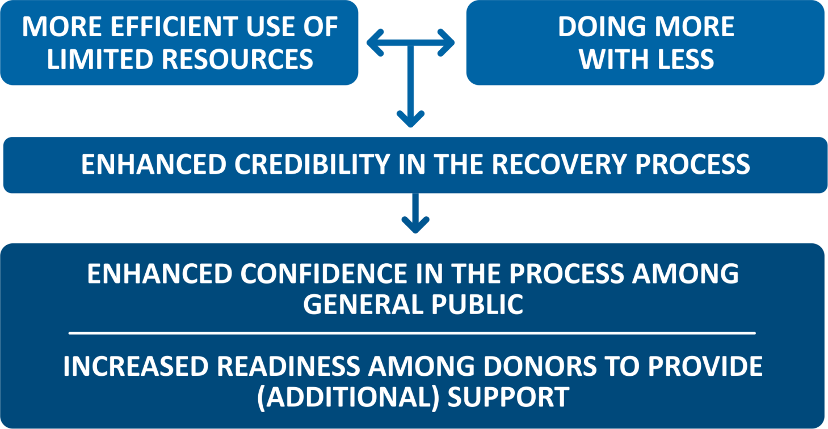
Key Advantages
Washington DC 04/26/2016

Slide 10
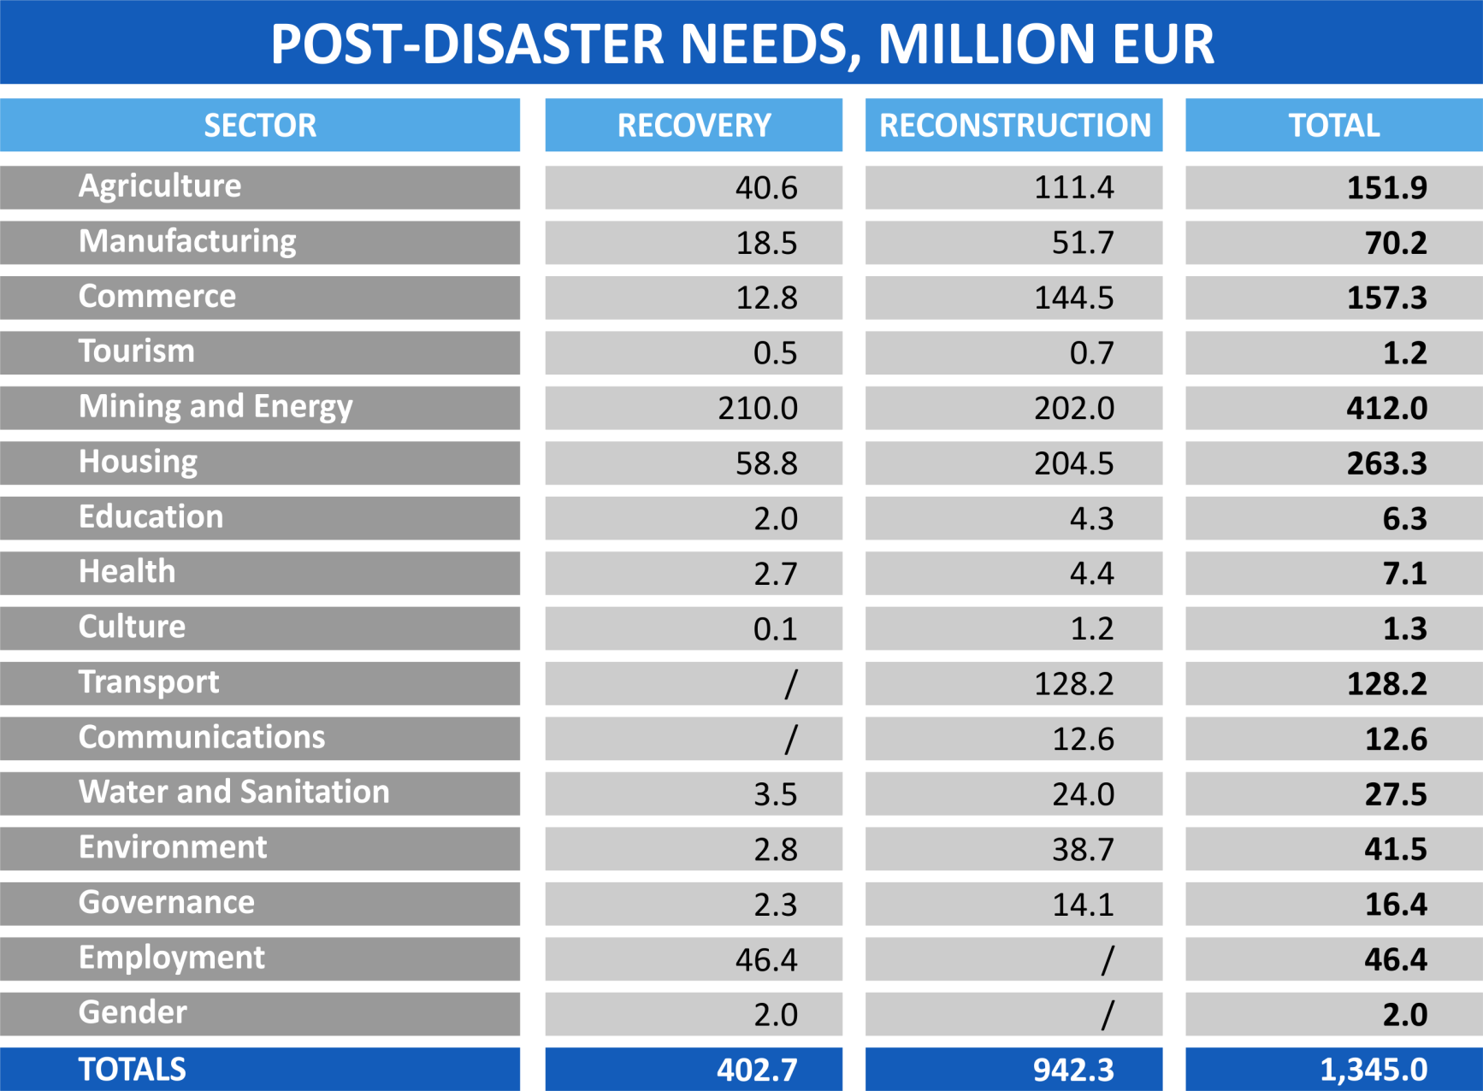
DISASTER EFFECTS

Slide 11
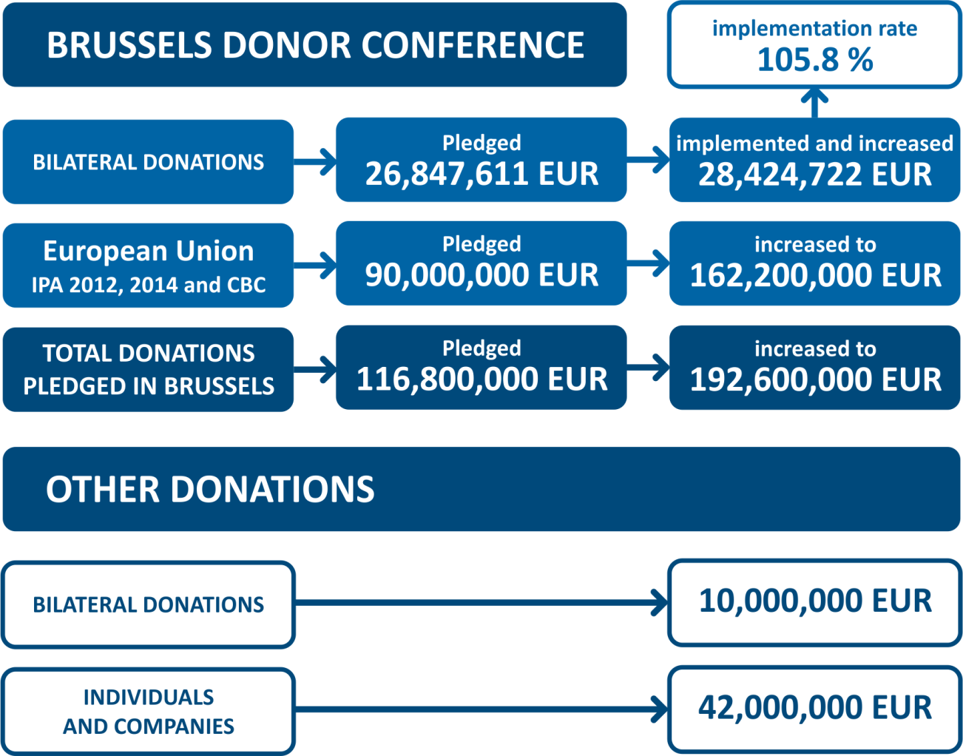
FINANCIAL ASPECT OF RECOVERY
TOTAL FUNDS
461.6 million EUR

Slide 12
RECOVERY PROCESS
Over the past years Serbia and its partners invested considerable resources into the recovery of:
DESTROYED AND DAMAGED HOUSES
FLOOD PROTECTION INFRASTRUCTURE
TRANSPORT INFRASTRUCTURE
PUBLIC BUILDINGS
POWER PRODUCTION AND DISTRIBUTION FACILITIES
AGRICULTURE
SMEs
CRITICAL LOCAL INFRASTRUCTURE
Notes:
DODATI “CRITICAL LOCAL INFRASTRUCTURE”

Slide 13
RECOVERY PROCESS
Government aid of over 40 million EUR provided to 21,049 families.
5 million EUR provided to 2006 SMEs as cash grants.
Aid packages for over 26,000 agricultural households in 29 municipalities affected by floods (saplings, animals, animal feed, equipment etc.)
Cattle breeders financed from the national budget with full replacement value for almost 5000 farm animals and farmers for 16,000 hectares.

Slide 14
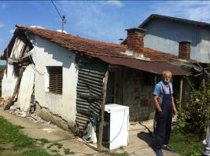
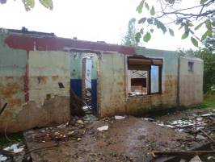
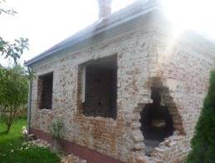
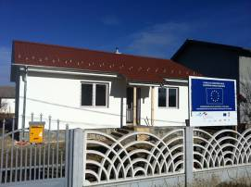
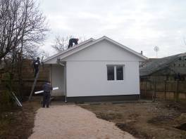
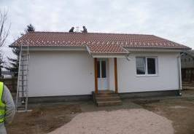
RESILIENT RECONSTRUCTION - HOUSES
Newly built houses
All newly-built houses retrofitted, built on risk-informed principle and situated outside of flood risk zones and landslides.

Slide 15
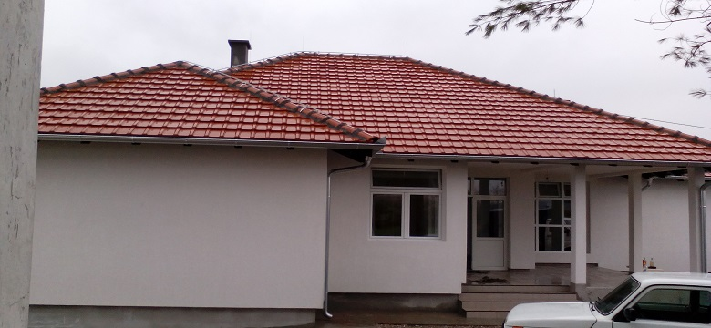
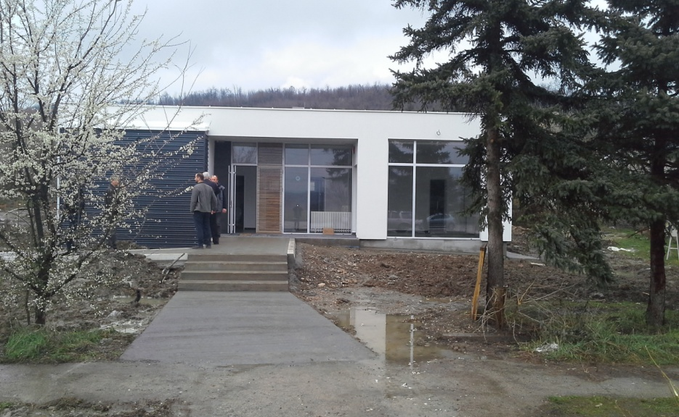
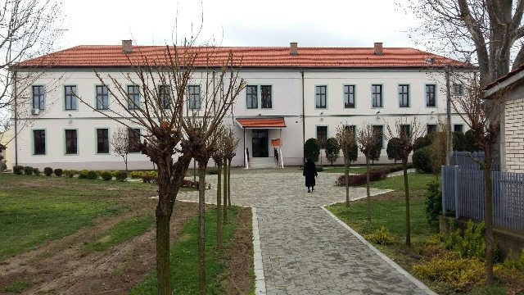
RESILIENT RECONSTRUCTION – PUBLIC BUILDINGS
Public buildings fully reconstructed or newly built to be:
Resilient to floods
Energy efficient – energy passport

Slide 16
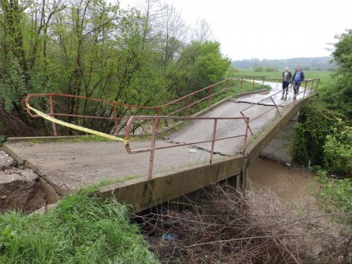
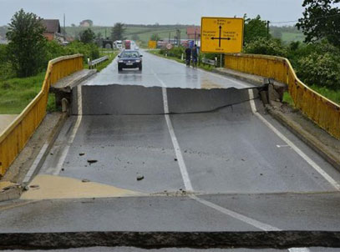
RESILIENT RECONSTRUCTION – LOCAL INFRASTRUCTURE
109 critical infrastructure projects
of reconstruction and retrofitting in 39 municipalities: transport infrastructure, preventive infrastructure, water supply and sewage

Slide 17
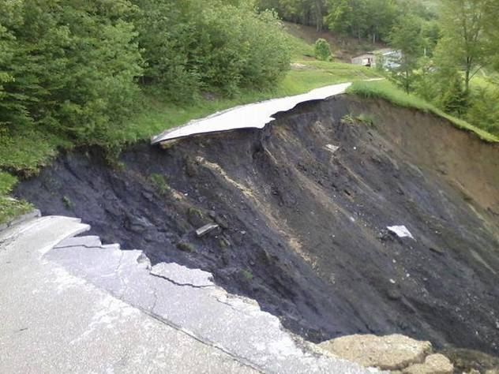
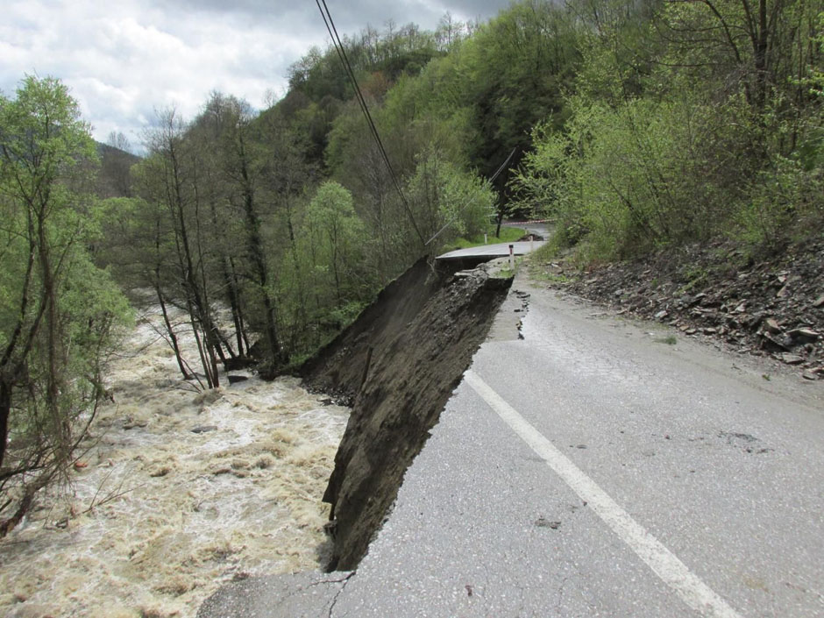
INFRASTRUCTURE – total needs over 200 million EUR
TRANSPORT INFRASTRUCTURE:
Roads
Bridges
Railways
reinstated with
50 million EUR of Government funds
10 million EUR from EU Solidarity Fund
CRITICAL LOCAL INFRASTRUCTURE:
reinstated with more than 10 million EUR from EU Solidarity Fund:
Local transport infrastructure
Water supply and sewage systems
Local flood protection infrastructure

Slide 18
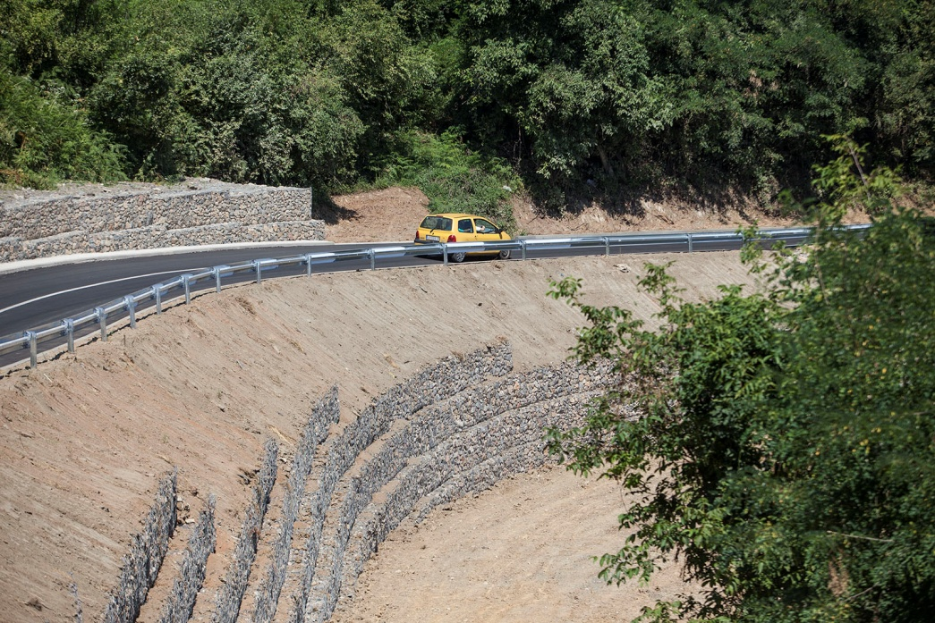
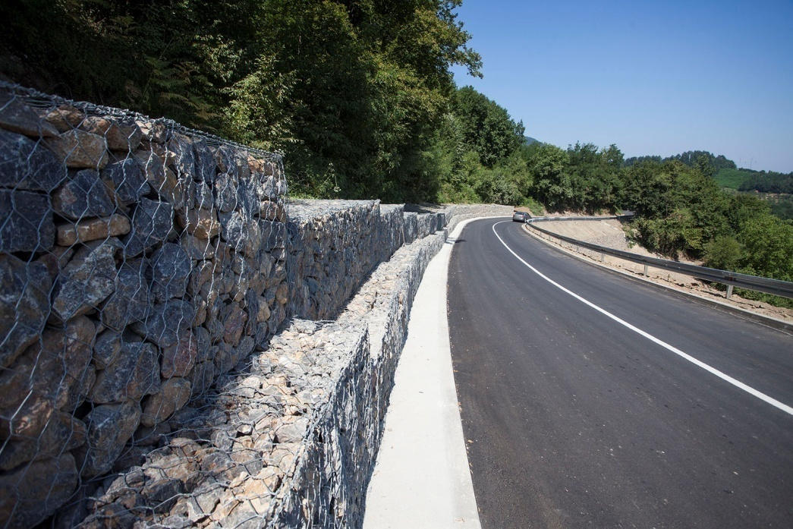
INFRASTRUCTURE – TRANSPORT
Detailed project preparation preceded all new construction
Risk-informed reconstruction
Hydrologic and geomechanical surveys

Slide 19
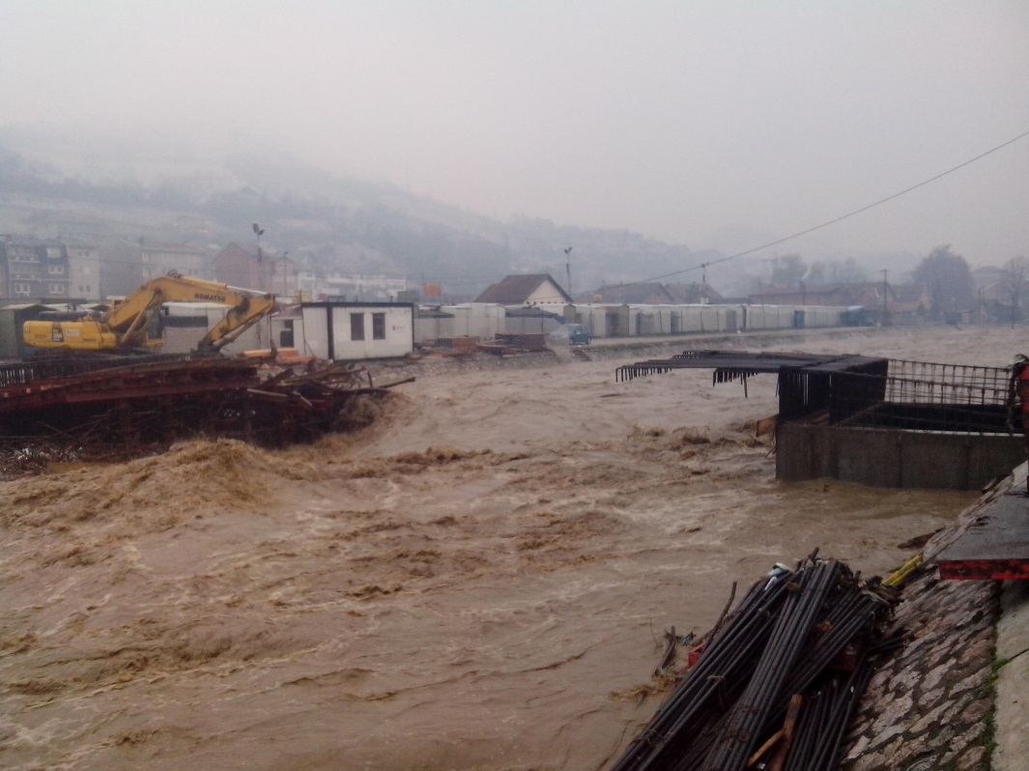
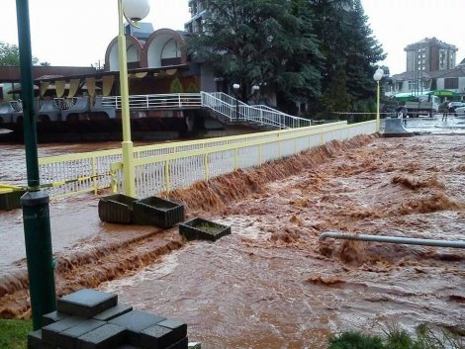
LOCAL INFRASTRUCTURE - BRIDGES BEFORE
BEFORE
Striking examples of risk-creating infrastructure
Massive implementation of standard projects for bridges (cookie-cutter design)
Bridges constructed without hydrologic and geomechanical surveys

Slide 20
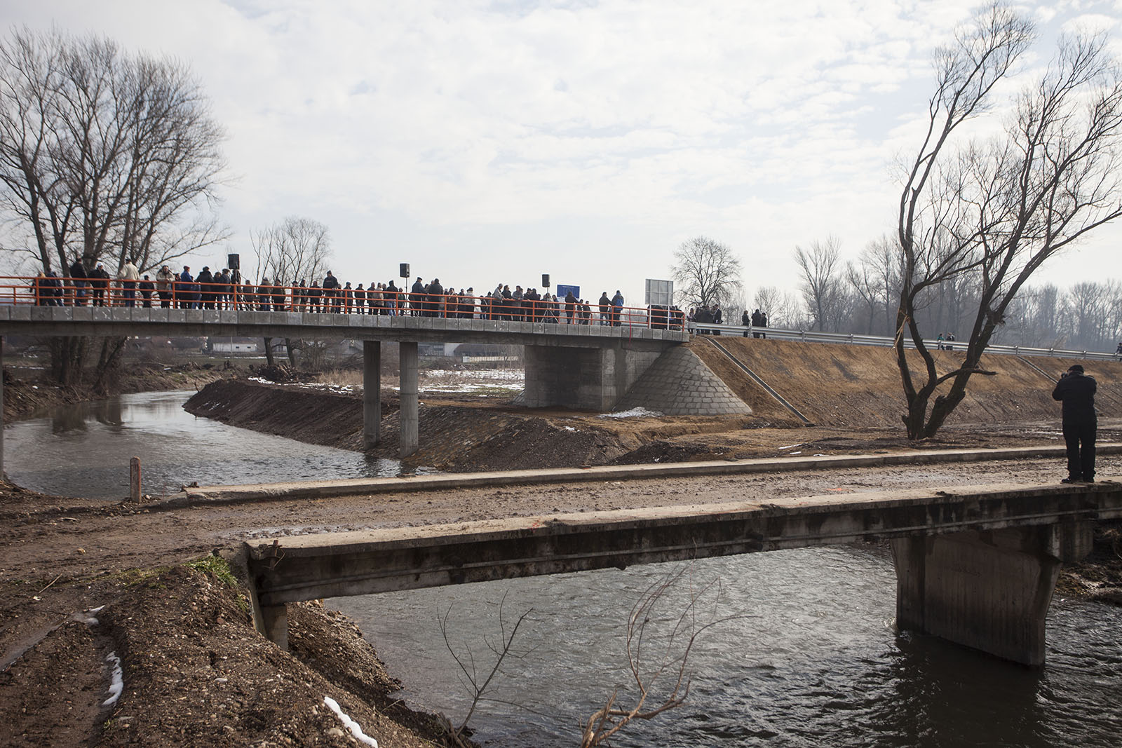
LOCAL INFRASTRUCTURE - BRIDGES NOW
For every bridge constructed, a projects is prepared with the participation of all relevant experts
Risk informed construction
Hydrologic and geomechanical surveys
AFTER

Slide 21
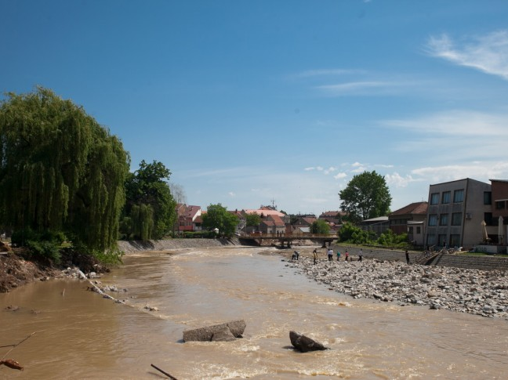
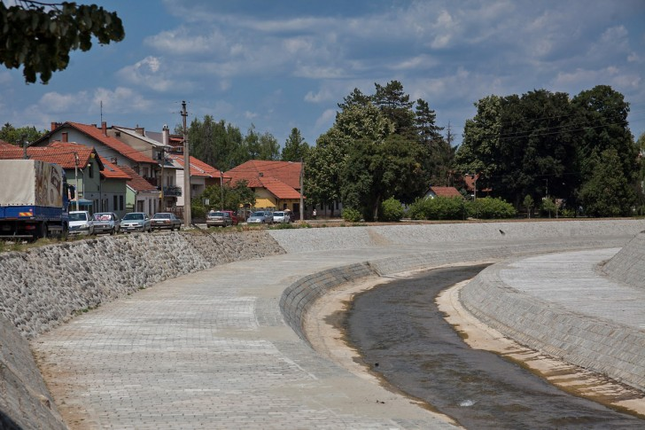
RESILIENT RECONSTRUCTION – FLOOD PREVENTION
Preventive infrastructure designed accordingly to new high water levels (2014)

Slide 22
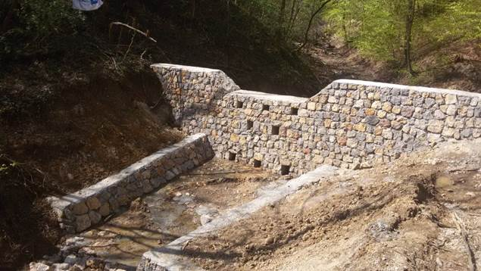
RESILIENT RECONSTRUCTION - FLOOD PREVENTION
So far 70 million EUR raised for capacity building of the disaster risk and crisis management system

Slide 23
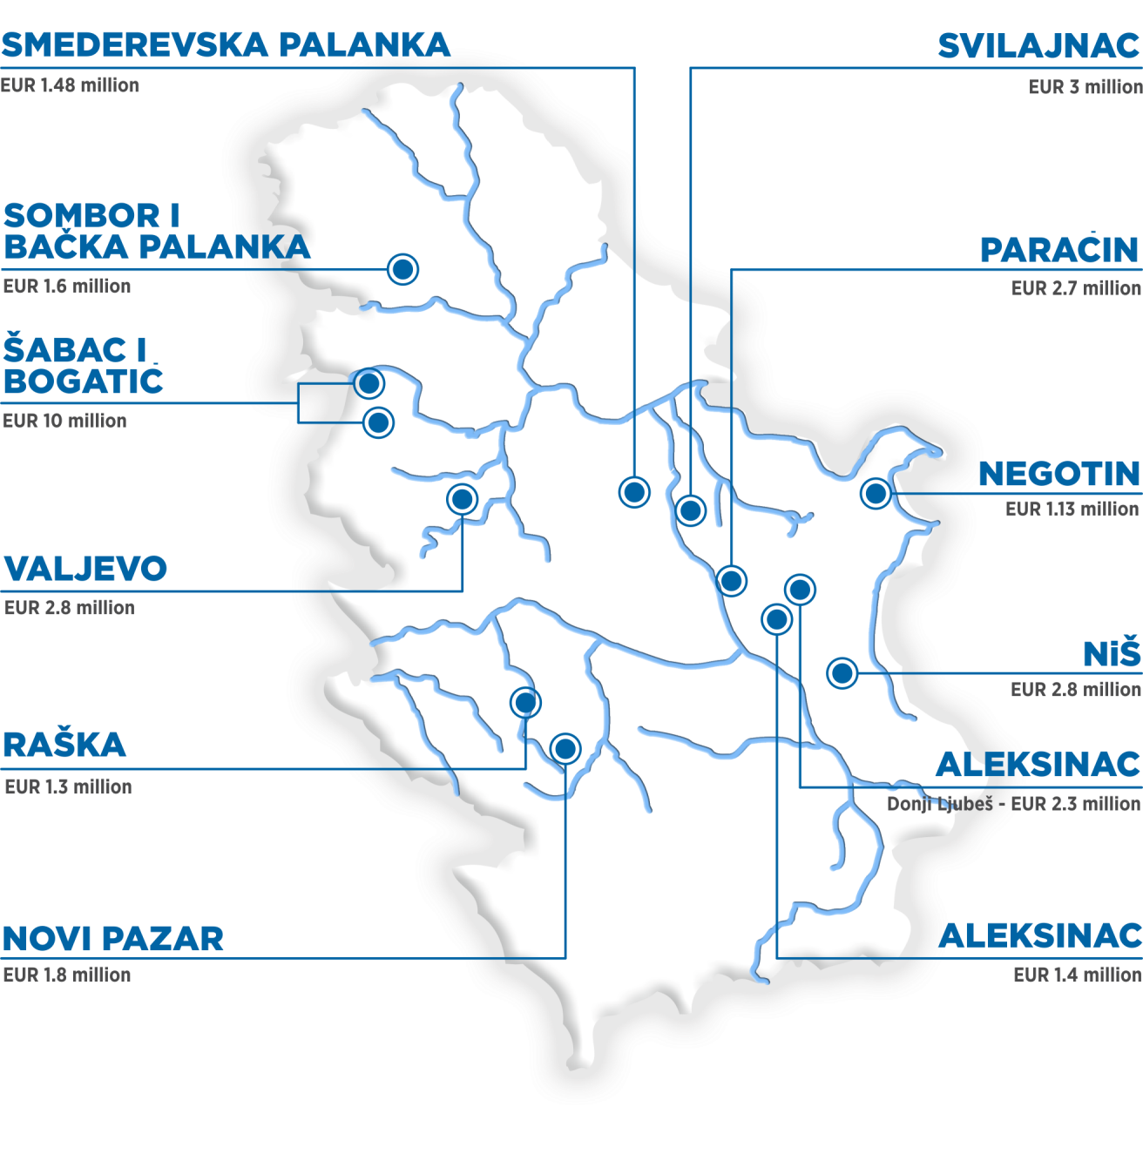
FLOOD PREVENTION – NEW EMBAKMENTS

Slide 24
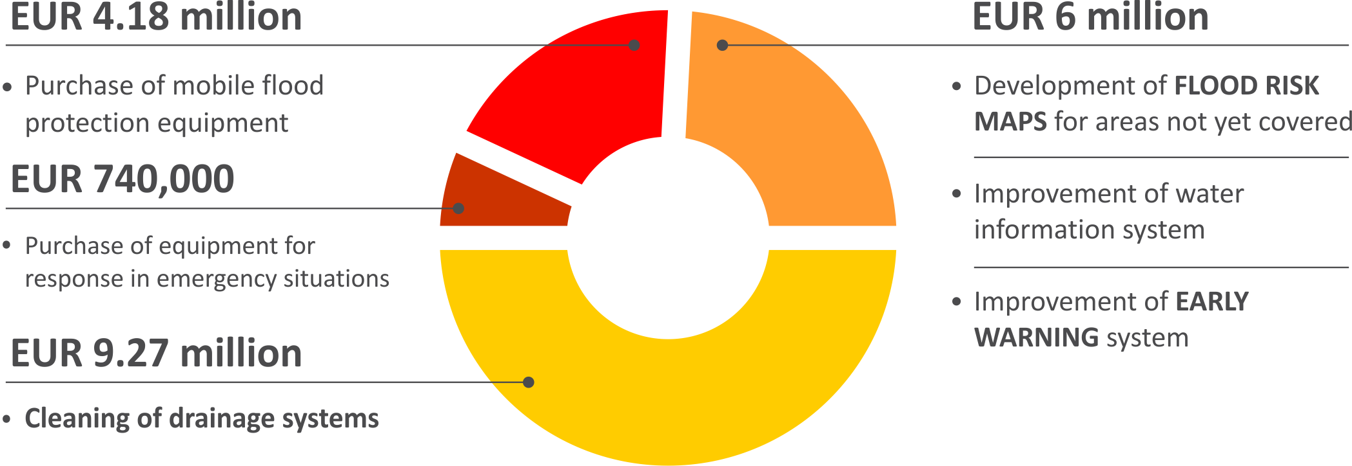
PROJECT ALSO INCLUDES

Slide 25
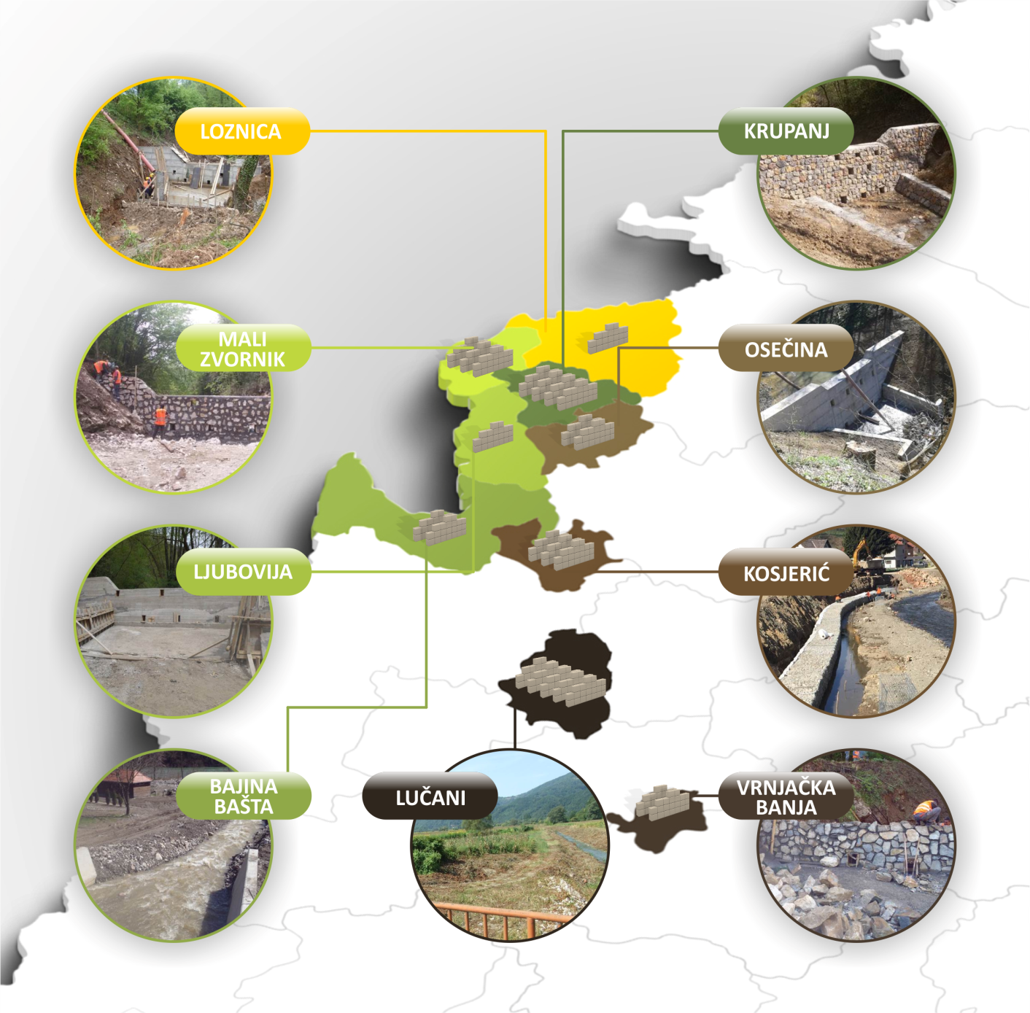
CONSTRUCTION OF TORRENTIAL DAMS
29
NEW TORRENTIAL
DAMS
constructed in
2015

Slide 26
LANDSLIDE CADASTRE
30%
of the territory of Serbia
is under the
risk of landslides.

Slide 27
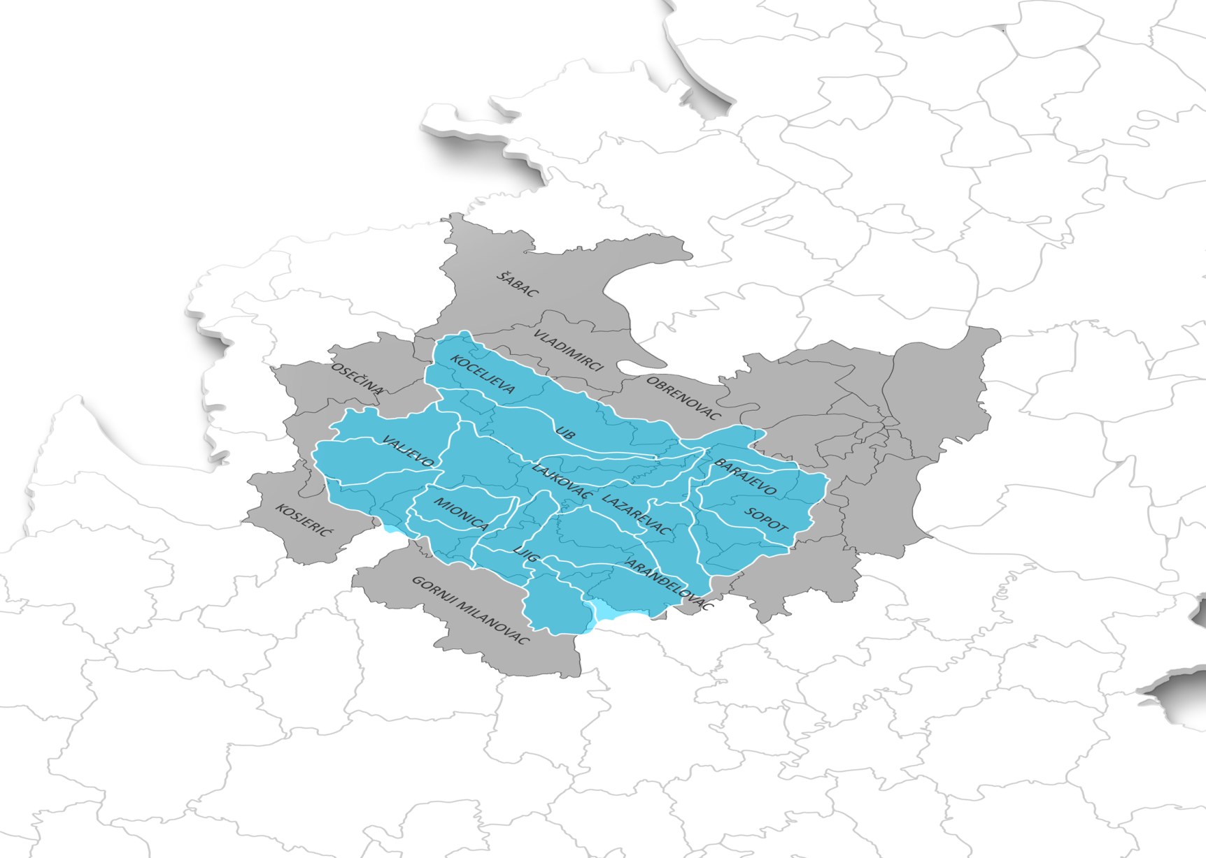
STUDY OF FLOOD PROTECTION IN KOLUBARA RIVER BASIN
KOLUBARA RIVER BASIN IN MAY 2014 SUSTAINED DAMAGE OF OVER
900
Million
EUR
The study will be used to improve safety of citizens and property in Western part of the country.

Slide 28
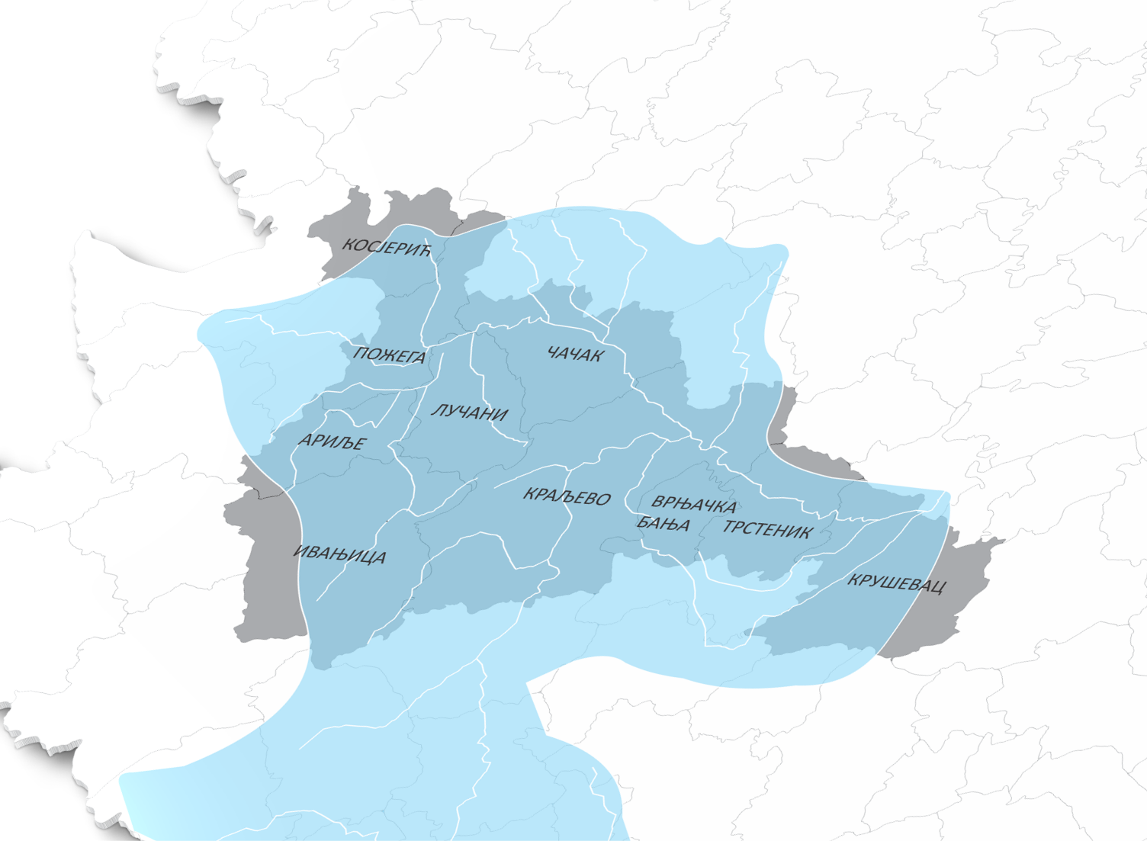
STUDY OF FLOOD PROTECTION
IN ZAPADNA MORAVA RIVER BASIN
ZAPADNA MORAVA RIVER BASIN
The study will be used to improve safety of citizens and property in Western-Central part of the country.

Slide 29
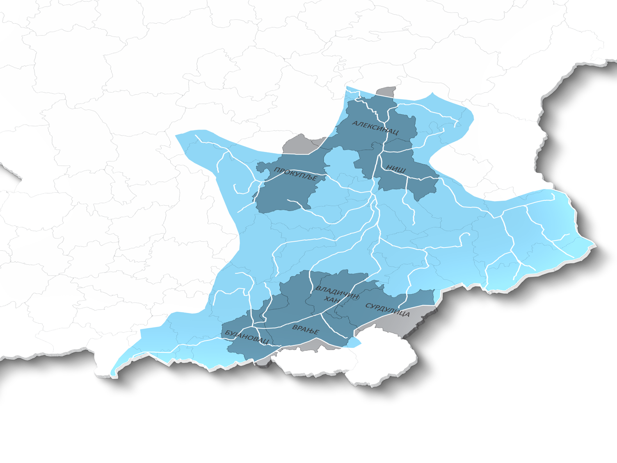
STUDY OF FLOOD PROTECTION
IN JUŽNA MORAVA RIVER BASIN
JUŽNA MORAVA RIVER BASIN
The study will be used to improve safety of citizens and property in Southern Serbia.

Slide 30
LESSONS LEARNED – POLICY INNOVATION
In 7 MONTHS
RECOVERY
PREVENTION
REPUBLIC OF SERBIA NEEDS TO:
Develop a systemic approach towards risk management and reduction
Undertake activities and measures on strengthening prevention
Plan and implement investments based on understanding risk
Ensure the highest possible level of protection of lives and assets from new floods and other natural disasters
Reduce risk and damages of natural disasters
National Disaster Risk Management Program
Adopted by the Government in December 2014

Slide 31
POLICY INNOVATION – 1st STEP
NATIONAL DRM PROGRAM:
The objective is to support the Government of Serbia to build a comprehensive program for disaster resilience.
Program used as an umbrella framework to coordinate, channel funds, and implement activities related to reducing and managing risks in Serbia.
Program relies on improving coordination of activities between existing structures within the Government.
Program developed in partnership with WB, UN, EU and Switzerland.
National Disaster Risk Management Program
Adopted by the Government in December 2014

Slide 32
NDRM PROGRAM STRUCTURE
Steering
Committee
Donors
and
Ministers
NATIONAL
DISASTER RISK
MANAGEMENT
PROGRAM
Facilitating the
establishment
of the Program
Flood Office
Technical
support
Donors
UN (UNDP)
World Bank
Component 1 - Institutional Building
Across component 2-5
Component 2
Risk
Identification
Component 3
Risk Reduction
structural and
non-structural
Component 4
Preparedness Response,
EWS
Component 5
Risk Financing
Strategies
Component 6
Resilient
Recovery
National Institutions Implementing Activities

Slide 33
POLICY INNOVATIONS - DRCM
NDRPM
Disaster Risk and Crisis Management Law*
Action Plan*
New legislative framework developed with support of EU, UN and WB
Systemic approach to the DRCM and recovery process: prevention-response-reconstruction
Key innovations based on global best practices and lessons learned:
Establishment of a new national authority for DRCM
Prevention based on: Risk Assessments - Risk Reduction and Management Plans
Identification of: Areas of increased risk (National authority has the right to restrict/forbid certain activities) and Areas of immediate risk (any activity must be specifically allowed by the Authority, given the very high level of risk)
Establishment of a Risk Registry: electronic database for sharing of all information relevant to prevention, risk reduction and response
Response based on Rescue and Protection Plans
*Serbia aims to be the one of the first countries in the world with legislation
fully aligned with Sendai Framework

Slide 34
POLICY INNOVATIONS - RECONSTRUCTION
NDRMP
Law on Reconstruction*
Law on Post-flood Recovery
Permanent legislation based on the 2014 post-flood recovery lex specialis and lessons learned
Law regulates eligibility criteria for assistance and prescribes procedures for claims
Additionally: Changes introduced in Public Procurement Law to allow for prompt reaction and timely procurement in periods of emergencies
*Serbia aims to be one of the first countries in the world with legislation
fully aligned with Sendai Framework

Slide 35
RISK FINANCING STRATEGIES
FINANCIAL PROTECTION MECHANISMS initiated by the Government of Serbia:
Preparation of a catastrophe deferred drawdown option (Cat DDO) with support of World Bank
Promotion of catastrophe insurance for individuals and activities for boosting private insurance sales under way
Analysis of various budget protection mechanisms with Europa RE ongoing

Slide 36
NEXT STEP - REGIONAL DISASTER CENTER?
All efforts by individual nations and development partners are good, but prove to be insufficient
Setting up the Regional Disaster Center with the role to promote:
Trans boundary (cross border) and regional cooperation on risk management and early warning procedures
Disaster response
Damage remediation and rehabilitation through harmonization of the risk policies, consolidation of the risk response procedures
Education and sharing of skills and know-how
Raising public awareness on potential risks of disasters, including slow onset disasters, community-based DRR
Use and development of new technologies, contributing such to a wide scale of social and economic issues by promoting international cooperation and providing long term sustainability.
RDC would cooperate and coordinate its activities with regional governments, institutions and organizations, as well as with other respective national and international initiatives, international organizations and financial institutions (Sava Commission, Danube Commission, ICPDR, Cross-border cooperation programs, Regional initiatives and national Programs, UN agencies, OSCE, EBRD, EIB, WB…)

Slide 37
POLICY INNOVATIONS – DRCM – AP
NDRPM
Action Plan*
Action plan for the implementation of National Disaster Risk Management Program is for the period 2016 – 2020
Systemic approach to the DRCM and recovery process: prevention-response-reconstruction based on global best practices and lessons learned
With support from WB, EU and UNDP
In cooperation with all line institutions, local self government and NGOs
Completely in line with Sendai Framework for Disaster Risk Reduction 2015-2030
Results-oriented and presents know-how activities with specific budget
Gender-balanced

Slide 38
POLICY INNOVATIONS – DRCM – AP
NDRPM
Action Plan*
AP Matrix
General objective – for the whole document
Specific objectives – for each component
Resources allocated EUR 62,787,040 (budget, international development assistance and loans )
Resources required EUR 1,040,450,520

Slide 39
POLICY INNOVATIONS – DRCM – AP
NDRPM
Action Plan*
Institutional building and development – legal framework, education and training
School programs (elementary education), University MSc and PhD programs,
Improvement for National DRM Training Centre - education and training for the national and local servants based on curriculums in cooperation with Universities
2) Identifying and monitoring disaster risks - data sharing
Through intranet with interoperability (government, local self-governments and public enterprises) – G cloud
Establishment of a Risk Registry: electronic database for sharing of all information relevant to prevention, risk assessment, reduction and response / interactive map in GIS with open data for public purposes

Slide 40
POLICY INNOVATIONS – DRCM – AP
NDRPM
Action Plan*
3) Structural and non-structural measures – risk reduction
All project (ongoing and planed) regarding DRR marked in one document
4) Early warning system and Response
Based on analyses, studies, data sharing, strict procedures and Rescue and Protection Plans
5) Financial strategy – instruments for risk financing and transfer
Establishment of instruments for financing system for disaster risk management planned on the basis of risk assessment
Creation of necessary preconditions for the improvement of disaster risk transfer
6) Resilient recovery - build back better
Establishment of a functional and sustainable disaster recovery system

Slide 41
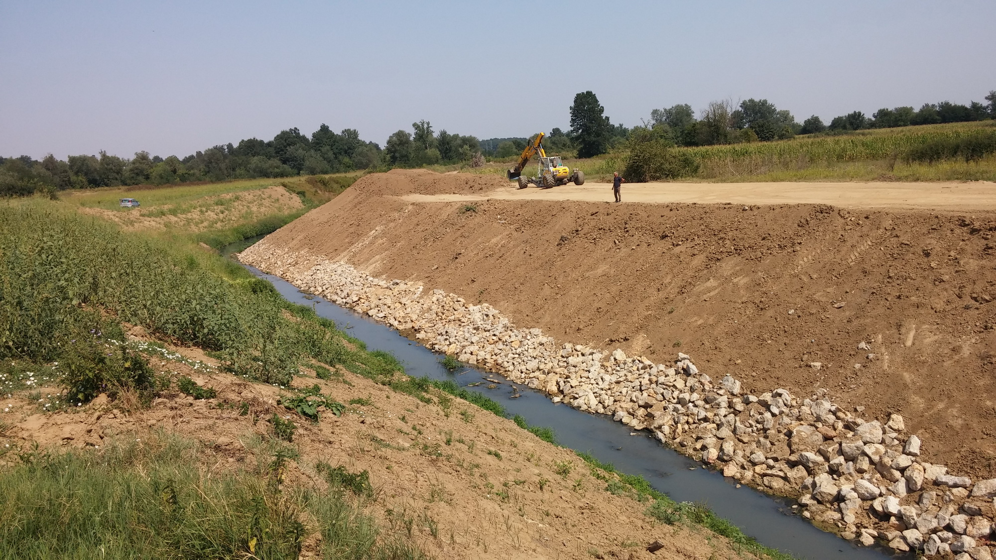
THANK YOU

