Slide 1
INTEGRATED DISASTER RISK MANAGEMENT IN THE PHILIPPINES
Rosalia V. De Leon
WBG Alternate Executive Director - Philippines
17 Meeting of the GFDRR Consultative Group
April 26, 2016

Slide 2
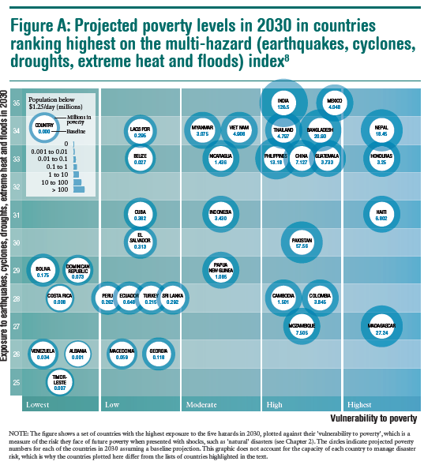
Poverty and Exposure to Multiple Hazards
Source: Shepherd, Andrew., et al. The Geography of Poverty, Disasters and Climate Extremes in 2030. London, England: ODI, 2013. Print.
Notes:
The Philippines is increasingly exposed and vulnerable to natural hazards, which undermines poverty reduction and long-term growth. For instance, Typhoon Yolanda (Haiyan), which struck the country in 2013, is considered to be the strongest typhoon ever to make landfall causing over 6,200 reported fatalities and over 1,700 people missing. As a result of the disaster, an additional 2.3 million people were estimated to have fallen below the poverty line. The total damage and loss from this event was estimated at PHP 571.1 billion (equivalent to USD 12.9 billion) hampering economic growth by about 0.9 % in 2013, and another 0.3 % in 2014. Catastrophe risk assessment for the Philippines shows that losses of this magnitude have an annual occurrence likelihood of three percent. In other words, during the 25-year maturity of a typical World Bank loan, there is an over 50 percent likelihood that such a loss would occur again. And with climate change impacts increasing, the Philippines is facing a growing threat, requiring new approaches to managing these risks.

Slide 3
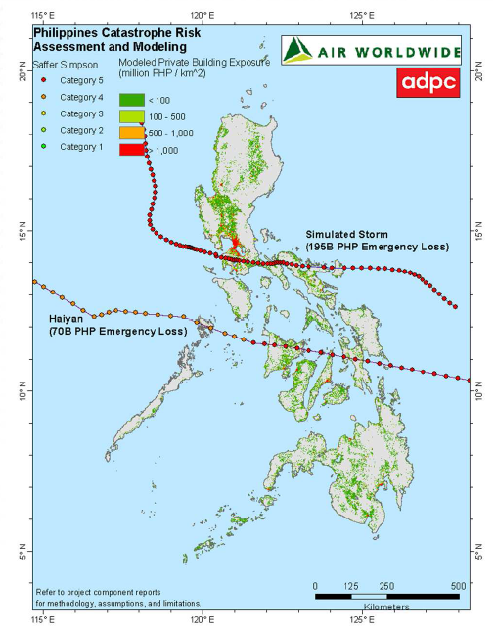
Yolanda-type event: the “new normal”?
Over 6200 reported fatalities, 1700 people missing, and total damage and loss estimated at USD 12.9 billion (5% of 2013 GDP)
Catastrophe risk modeling for the Philippines shows that much worse storms and earthquakes are possible
A Yolanda-like storm closer to Metro Manila could cause losses 2.5 times higher
A M7.2 earthquake in Metro Manila is a likely scenario with catastrophic impact
Source: The Philippines Catastrophe Risk Profile; World Bank/AIR/ADPC on behalf of DOF-IFG, 2014.

Slide 4
Evolution of GFDRR and World Bank Support
Phase 1 2008-2010
Phase 3 2014 -
Phase 2 2011-2013
2009 Manila Floods
TS Ketsana, Parma
2011 Tropical Storm Sendong
2013 Bohol Earthquake,
Super Typhoon Yolanda (Haiyan)
DRM Policy Reforms, Local Government DRRM Capacity Building
Post-Disaster Assessment and Capacity Building
Technical Assistance
(Various Donors thru GFDRR)
Metro Manila Flood Master Plan (US$ 9 BN)
Structural Resilience, Cat Modeling, Disaster Risk Financing Strategy
Post-Disaster Assessment and Capacity Building
Advisory support for DRM Policy Reforms and Investing in Resilience
DRFI Strategy Implementation
Post-Disaster Studies
Cat – DDO DPL 2011
$500M Fully Disbursed after TS Sendong
Outcome rated Satisfactory
Natl CDD Program 2014
$479M
Scaled out for eligibility of 554 Yolanda-affected barangays
2nd Cat – DDO DPL ($500M)
Delivered 22 Dec 2015
WB Lending
Notes:
GFDRR-supported technical assistance has leveraged approximately USD 10.5 BILLION in investments

Slide 5
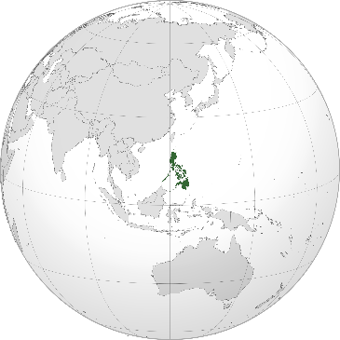
Financial protection – integral to DRM
In 2010, the Philippines passed a new Disaster Risk Reduction and Management Act, which emphasizes the need for a comprehensive, integrated, and proactive approach across different levels of government.
EX-ANTE INSTRUMENTS / POLICIES
DRM FUNDS
US$811m (0.28% of GDP) allocated to NDRRMF for risk reduction, preparedness, and response (2016)
Local governments have own DRM funds
CONTINGENT CREDIT
In 2015, Second Disaster Risk Management Development Policy Loan with a CAT-DDO, amounting to US$500m
Past: Initial WB Cat DDO (US$500m, fully disbursed in 2011) and SECURE contingent credit by JICA (US$500m, fully disbursed)
EX-POST INSTRUMENTS / POLICIES
SUPPLEMENTARY
Unprogrammed Fund for relief operations, rehabilitation and reconstruction works
Only available if total revenue collections exceed original revenue targets
INSURANCE OF PUBLIC ASSETS
Property cover for public assets by Government Service Insurance System General insurance Group (GSIS)
Local government units required by law to purchase insurance for crucial property; only ca. 30% actually covered
INTERNATIONAL ASSISTANCE
As of Jan. 2014, international donors contributed US$663m to relief efforts in response to Typhoon Haiyan
The Philippines
AGRICULTURAL INSURANCE
Available through the Philippine Crop Insurance Corporation
Significant uptake of micro insurance schemes to protect households and farmers
UNDER DEVELOPMENT
Subnational joint catastrophe insurance program, potentially supported with the People’s Survival Fund (PHP 1 BN = 0.3% of GDP)
Property catastrophe risk pool for homeowners and SMEs
Source:
1 ASEAN Report (2012)
2 https://www.fas.org/sgp/crs/row/R43309.pdf
* Preliminary review based on limited information
Notes:
GoP focuses on ex ante financial protection instruments to increase the country’s financial resilience

Slide 6
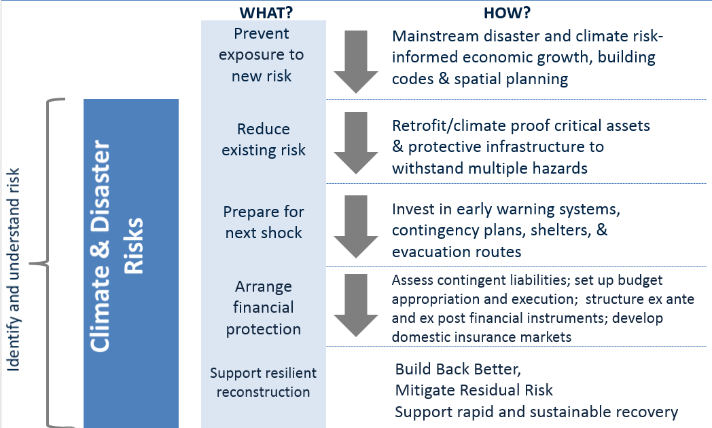
Approach to climate and disaster risk management
Notes:
Comprehensive approach being implemented by the GoP, in which financial protection is an integral pillar

Slide 7
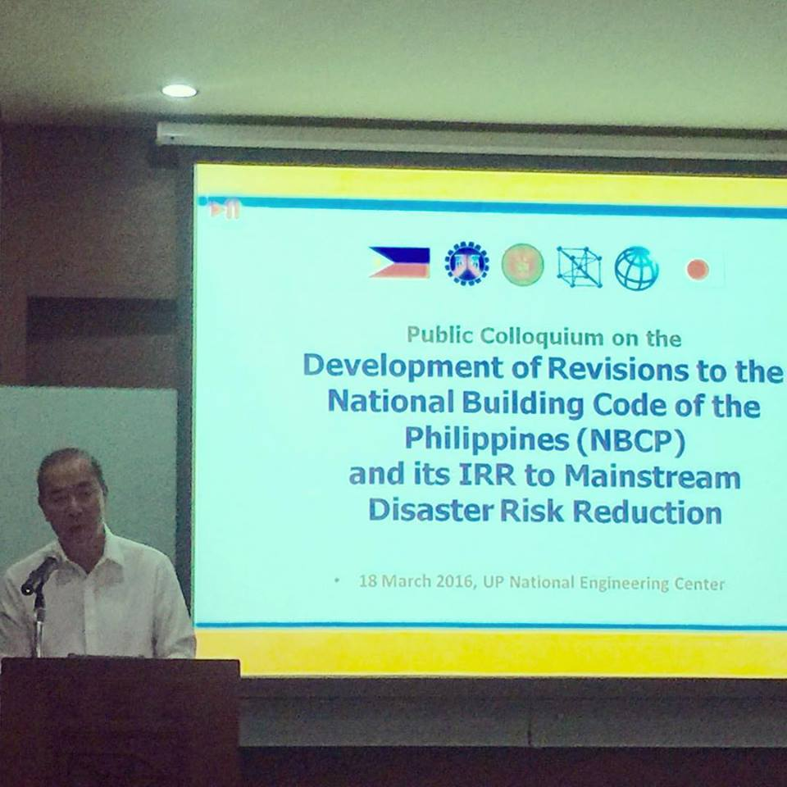
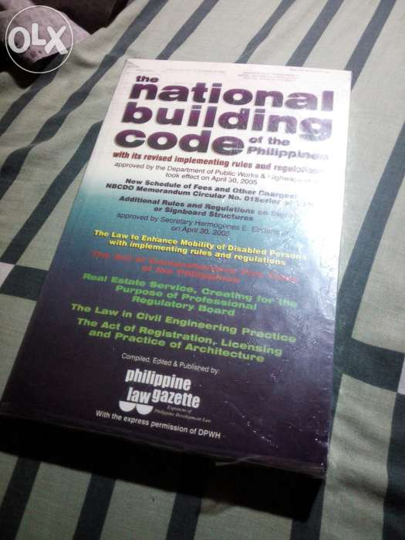
Prevent exposure to new risk
Approach:
1
Mainstream disaster risk reduction and climate adaptation measures in the National Building Code of the Philippines
2
Develop and implement a methodology for risk-informed national development planning
3
Integrate DRR and CCA in Provincial Development and Physical Framework Plans

Slide 8
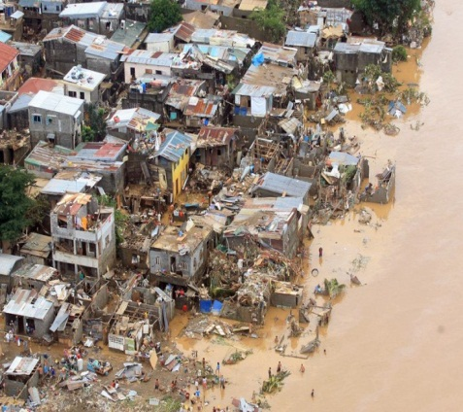
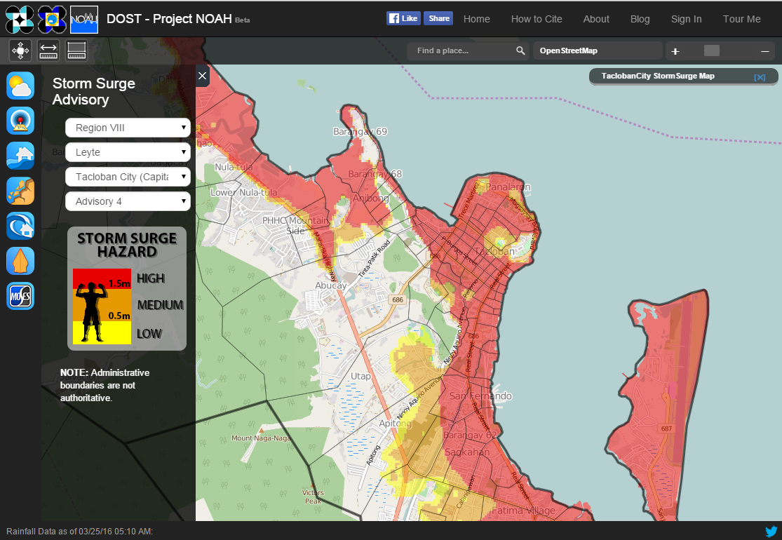
Reduce existing risk
Approach:
1
Develop options for seismic retrofit of public facilities (e.g., schools)
2
Non-structural measures
Dykes and dams river systems
Solutions for urban drainage
Flood forecasting, early warning systems
River basin planning, improved maintenance

Slide 9
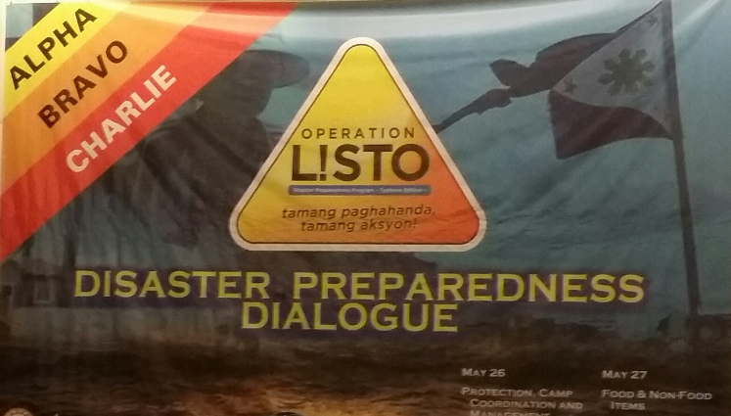
Prepare for the next disaster
Approach:
1
Pre-Disaster Risk Assessments to guide evacuations along real-time forecasts of typhoon tracks
2
Automated rain gauges and water level measuring stations for the 18 major river basins
3
Online communication services, providing open access to accurate, and timely hazard information nationwide

Slide 10
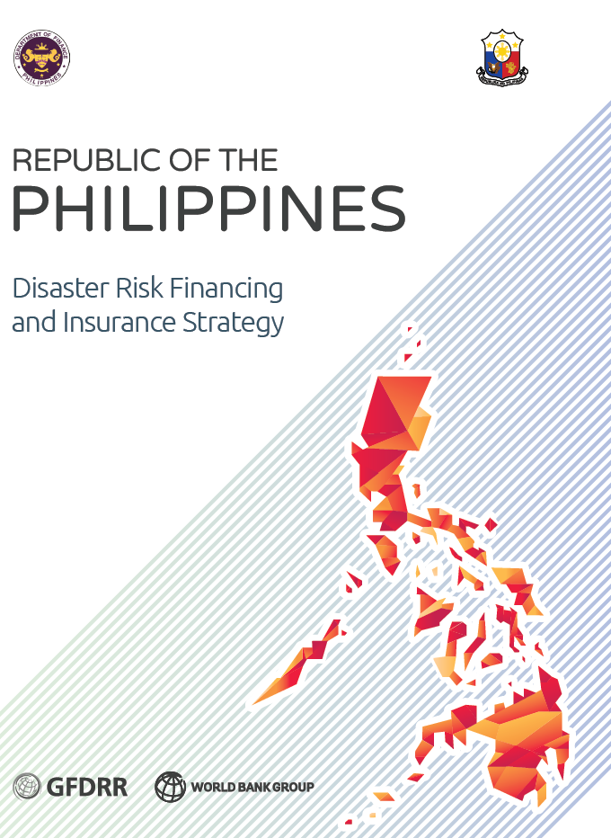
Financial Protection
Development Outcomes
To sustain economic growth and protect gains from natural disaster shocks To reduce impact on the marginalized sector and prevent them from falling into a cycle of poverty.
Three Policy Objectives for Actions by the Government
National Level: Enhancing the financing of post-disaster emergency response, recovery, and reconstruction needs Quantifying and clarifying the contingent liabilities faced by the government. Building up multi-year reserves through annual contributions to a response contingency fund Using risk transfer to access international private reinsurance and capital markets. Local Level: Providing local governments with funds for recovery and reconstruction after a disaster Catastrophe risk insurance facility for local governments Improve Insurance of public assets of LGUs Individual Level: Empowering poor and vulnerable households and SMEs to quickly restore their livelihoods after a disaster Broadening private property catastrophe risk insurance and micro-insurance coverage. Emergency income support program building on the national cash transfer program Broadening agricultural insurance and micro-insurance coverage

Slide 11
Financial Protection – The Vulnerable 20 Group
V20 platform prepares a joint statement on commitment to follow key principles for responsible financial protection against disaster and climate risk (WB/IMF Spring Meetings)
V20 statement at the World Humanitarian Summit - High-Level Roundtable on Natural Disasters and Climate Change (Istanbul, May 2016)
V20 governments (# to be determined) prepare national Financial Protection Strategy that establishes priorities for building financial resilience in line with key principles (by Oct 2016)
V20 platform meets to share national strategies and group countries according to common priorities (WB/IMF Annual Meetings, Oct 2016)
V20 platform presents strategies with associated action/investment plans to international partners for support
Sources: GAR 2015, PCRAFI, CCRIF, World Bank, EM-DAT.
Notes:
The V20 members span many different country contexts in terms of the risks they face. Many of the countries including the Philippines are highly exposure to rapid onset disasters that have significant economic impacts relative to GDP – on an average annual basis the Philippines loses nearly 2% of GDP to typhoon and other disasters. Our other members who face chronic hazards such as droughts have a different challenge where they have a high percentage of their population, sometimes nearly 100%, affected by slow onset disasters such as droughts. These situations require different financial protection solutions, and developing a set of appropriate options for each context is one of the aims of the V20 support.

Slide 12
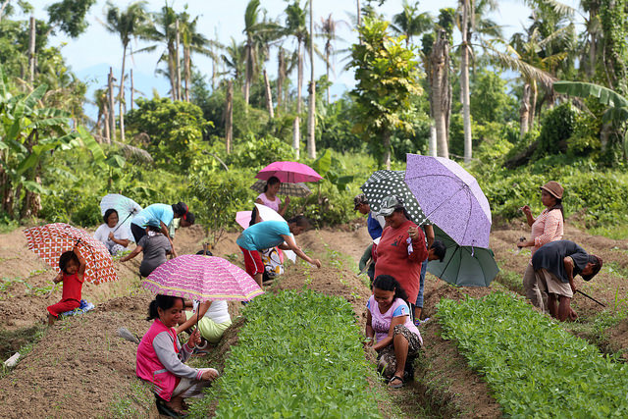
Resilient reconstruction and recovery
Approach:
1
Rapid damage and loss assessment
2
Recovery policies, frameworks and institutions
3
“Build back better” investments, including through the National Community Driven Development program
Notes:
Segue to presentation on National CDD Program and scale-up to render 554 Yolanda-affected barangays eligible for CDD support:
DOF mobilizes financial resources, NCDDP implements on the ground.

Slide 13
Concluding thoughts
Disaster risk management is a long-term agenda that requires political will, technical expertise, and action across sectors and levels of government.
Finance ministries/departments can take the lead in comprehensive, integrated disaster risk management.
International initiatives can enable vulnerable countries to work together to mobilize resources.
Technical assistance supported by GFDRR underpins achievement of the reforms committed to under development policy lending

