Slide 1
NEPAL RECOVERY TO RESILIENCE
Vijaya Rana, Joint Secretary, NRA
Marc Forni, Senior DRM Specialist, World Bank
17 Meeting of the GFDRR Consultative Group
April X, 2016

Slide 2
Nepal – Risk Profile
Vulnerable to a range of natural hazards, particularly earthquakes, flood, drought, and landslides;
Nepal is the 11th most earthquake-prone country in the world;
As a result of the April 2015 earthquake, weakened and destabilized slopes have become even more susceptible to flooding and landslides;
Susceptible to very high losses from disaster, both in terms of mortality as well as economic losses;
The earthquake exposed the high degree of vulnerability of the poverty reduction effort in Nepal.

Slide 3
Engagement prior to the April 2015 Earthquake
GFDRR support prior to the earthquake:
Search and Rescue Equipment and Training
Community based risk reduction in Kosi River Basin
Open Cities Initiative
Strengthening of hydro meteorological services
GFDRR support after the earthquake
PDNA Exercise
Household Damage Survey
Support to Housing Reconstruction Program
Safe Schools Program
Disaster Recovery Framework

Slide 4
April 25, 2015 Earthquake and aftershocks
Almost 9,000 deaths, 22,000 injured, and 9.4 million affected
$6.7 billion in damages and losses, almost 50% of which was housing
Over 500,000 houses rendered uninhabitable, another 270,000 damaged
Manufacturing, trade, ag and tourism were affected; economic growth fell.

Slide 5
Post Disaster Needs Assessment
GFDRR, together with the ADB, EU, JICA and the UN, supported the GoN in preparing the PDNA, which was launched less than a month after the earthquake;
The PDNA was based on the agreed UN-EU-WB methodology;
Based on the PDNA findings, donors pledged US$4.1 billion for reconstruction;
The earthquakes is estimated to push an additional 2.5-3.5% into poverty;
Just finalized Recovery Framework exercise to operationalize PDNA;
Critical exercises for reconstruction planning and allocating pledged reconstruction financing through budget process.

Slide 6
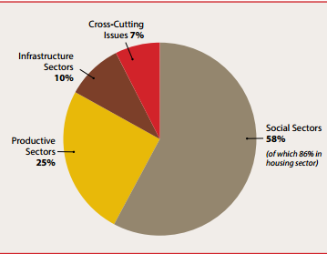
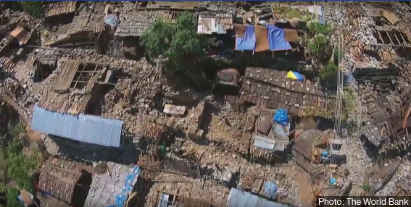
Post Disaster Needs Assessment - findings
Share of disaster effects across sectors:
Housing reconstruction were identified in the PDNA as the largest single need, accounting for almost half of the total reconstruction needs:

Slide 7
Safe Schools Program
19,000 classrooms destroyed and 11,000 damaged
GFDRR’s safe school program carried out a damage assessment of school buildings in the most affected districts
The results of the assessment will be the basis for prioritization of ongoing school reconstruction and retrofitting programs funded by JICA and ADB
The Safer Schools program is producing an investment plan that can be taken up as a project supported by donor/WB financing.

Slide 8
Earthquake Housing Reconstruction Program
Housing was the largest hit sector ($1.2 billion in needs);
GoN’s budget appropriation for its overall reconstruction activities is $900m for FY16, most of which will be allocated for housing;
Earthquake Housing Reconstruction Program ($200m from WB, $100m from JICA and $25.5m Multi-Donor Trust Fund managed by the WB (US, Switzerland, and Canada);
While reconstruction has seen some delay, the first group of beneficiaries have already been enrolled and received the first installment for housing reconstruction;
GFDRR supported the design of the program and is providing technical assistance to the National Reconstruction Authority to develop policies and procedures for the program’s implementation.

Slide 9
Post-Disaster Recovery Framework
This is the first time a Recovery Framework has been prepared following a major disaster;
GFDRR, together with the PDNA partners, supported the GoN in this process;
The report, launched yesterday in Kathmandu, outlines the recovery vision and strategic objectives, the policy and institutional framework, and implementation arrangements that will guide recovery activities.

