Slide 1
URBAN RESILIENCE: Scaling up GFDRR Support
Dr. Joe Leitmann
17th Meeting of the GFDRR Consultative Group
April 28, 2016

Slide 2
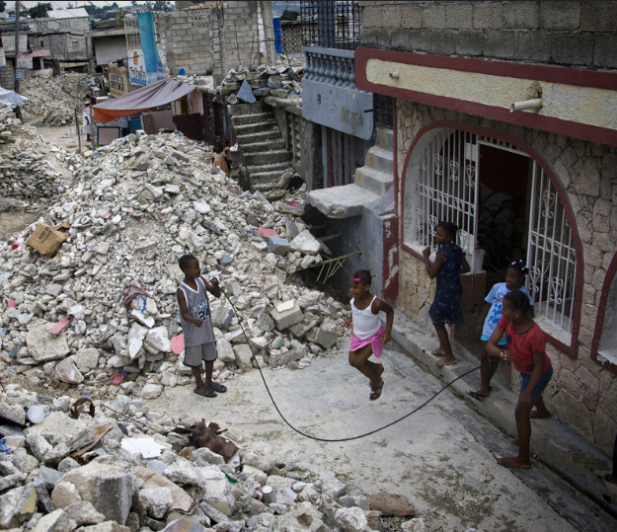
Why scale up our support ?
Trends
The developing world is urbanizing rapidly, with 90% of urban growth expected in Africa and Asia.
Poverty is becoming increasingly concentrated in cities.
Near-term: Expected annual losses from earthquakes, tsunamis, tropical cyclones and river flooding in the built environment are estimated at USD 314 billion.
Longer-term: Sea-level rise and subsidence in coastal cities could result in losses of USD $1 trillion+ by 2050.
Port au Prince, post-2010 Earthquake
(Source: United Nations Photos)
Notes:
Trends: The developing world is urbanizing rapidly, with 90% of urban growth expected in Africa and Asia alone. (UN-DESA, 2014)
Losses: Future expected annual losses in the built environment are estimated at USD 314 billion each year. (UNISDR, GAR, 2015)
From UN Gar: “Enormous volume of capital expected to flow into urban development in the coming decades, particularly in South Asia and sub-Saharan Africa.”
From UN GAR: “As the economy becomes more global, investment tends to flow to locations that offer comparative advantages, including low labour costs, access to export markets, infrastructure and stability. Investment decisions rarely take into account the level of hazard in those locations, and opportunities for short-term profits continue to outweigh concerns about future sustainability. As a consequence, large volumes of capital continue to flow into hazard-prone areas, leading to significant increases in the value of exposed economic assets.” (UNISDR GAR)
The 2011 floods in Thailand serve as one such example, whereby some of the worst flooding in decades flooded factories and led to massive disruptions of global supply chains. From such an event, the Finance Ministry estimated close to USD 2.2. billion in damages and a 0.3% decrease in economic growth forecasts.
http://www.bbc.com/news/business-15285149

Slide 3
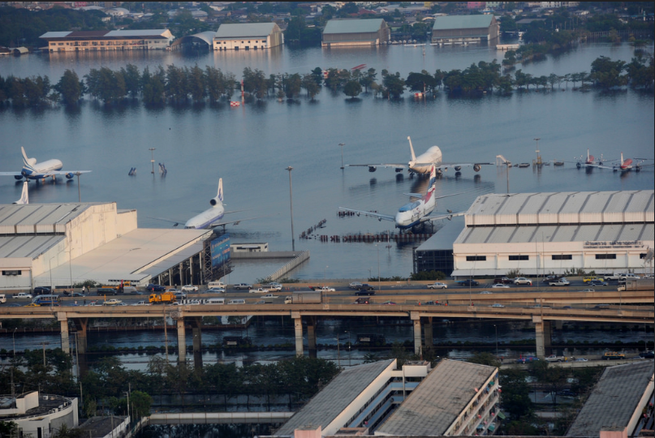
Why scale up our support?
Trends
Enormous capital flows into urban development expected in South Asia and sub-Saharan Africa.
People and investments flowing into cities of the developing world, often into hazard prone areas.
An increase in concentration and exposure of people, valuable assets and global supply chains in cities.
2011 Thailand Floods
(Source: United Nations Photos)
Notes:
Trends: The developing world is urbanizing rapidly, with 90% of urban growth expected in Africa and Asia alone. (UN-DESA, 2014)
Losses: Future expected annual losses in the built environment are estimated at USD 314 billion each year. (UNISDR, GAR, 2015)
From UN Gar: “Enormous volume of capital expected to flow into urban development in the coming decades, particularly in South Asia and sub-Saharan Africa.”
From UN GAR: “As the economy becomes more global, investment tends to flow to locations that offer comparative advantages, including low labour costs, access to export markets, infrastructure and stability. Investment decisions rarely take into account the level of hazard in those locations, and opportunities for short-term profits continue to outweigh concerns about future sustainability. As a consequence, large volumes of capital continue to flow into hazard-prone areas, leading to significant increases in the value of exposed economic assets.” (UNISDR GAR)
The 2011 floods in Thailand serve as one such example, whereby some of the worst flooding in decades flooded factories and led to massive disruptions of global supply chains. From such an event, the Finance Ministry estimated close to USD 2.2. billion in damages and a 0.3% decrease in economic growth forecasts.
http://www.bbc.com/news/business-15285149

Slide 4
A unique opportunity
Opportunity
Promote Safe Structures: An additional 1 billion homes will be required to house a global population expected to double in the next half century – the overwhelming majority of which will be in the developing world
Inform New Development: Nearly 60% of the area expected to be urbanized by 2030 remains to be built offering entry points to ensure safe urban development.
Leverage Best Practice: For low- and middle-income countries, there is significant opportunity to leverage the past experience of peers as well as high-income countries towards more resilient urban development pathways.
Notes:
The impetus for engaging in resilience building measures and policies has often been catalyzed by tragedies resulting from disaster.
In high-income countries, risk-informed planning and policy frameworks as well as development solutions have often arisen out of a progressive history of learning from past disasters, which could have been avoided with sound policies as well as risk-informed planning and engineering solutions.
Opportunity
An additional 1 billion homes will be required to house a global population expected to double in the next half century; the number of dwelling units globally is expected to double by 2030 (Bilham, 2009)
Nearly 60% of the area expected to be urbanized by 2030 remains to be built offering (UNISDR, Global Assessment Report, 2015) offering entrypoints to ensure safe urban development.
For low- and middle-income countries, there is significant opportunity to leverage the past experience of peers as well as high-income countries towards more resilient urban development pathways.

Slide 5
A mandate from global initiatives
Sustainable Development Goal (SDG) 11
Make cities inclusive, safe, resilient and sustainable
UNFCCC Conference of Parties (COP) 21 – Paris, Dec. 2015 – The Paris Agreement
Promote regional / international cooperation to mobilize stronger and more ambitious climate action amongst governments, civil society, the private sector, financial institutions, cities, and other subnational authorities, local communities and indigenous peoples.
Address and respond to climate change, including those of civil society, the private sector, financial institutions, cities and other subnational authorities.
UN Conference on Housing and Sustainable Urban Development (UN-Habitat III) – Quito, Oct. 2016
Rethink the urban agenda by embracing urbanization at all levels of human settlements
Integrate equity in the development agenda
Foster national urban planning and planned city extensions
Decide how relevant sustainable development goals will be supported through sustainable urbanization
Notes:
Sustainable Development Goal (SDG) 11
Make cities inclusive, safe, resilient and sustainable
UNFCCC Conference of Parties (COP) 21 – Paris, Dec. 2015 – The Paris Agreement
Agreeing to uphold and promote regional and international cooperation in order to mobilize stronger and more ambitious climate action by all Parties and non-Party stakeholders, including civil society, the private sector, financial institutions, cities and other subnational authorities, local communities and indigenous peoples.
Welcomes the efforts of all non-Party stakeholders to address and respond to climate change, including those of civil society, the private sector, financial institutions, cities and other subnational authorities.
UN Conference on Housing and Sustainable Urban Development (UN-Habitat III) – Quito, Oct. 2016
Rethink the urban agenda by embracing urbanization at all levels of human settlements
Integrate equity to the development agenda
Foster national urban planning and planned city extensions
Decide how relevant sustainable development goals will be supported through sustainable urbanization

Slide 6
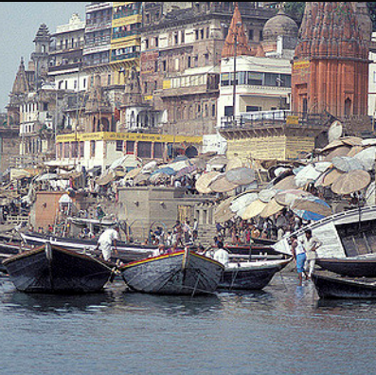
GFDRR comparative advantages
Linking to WB access and experience:
Urban development and urban poverty
Disaster risk management
Climate change
Leveraging global resources and knowledge:
WB mandate to increase climate finance
Global knowledge base: staff, partnerships, convening power
Capacity to work across sectors
Building on existing GFDRR-supported City Resilience Program, CityStrength methodology and Building Regulations work
(Source: World Bank Flickr)
Notes:
The comparative advantage of the World Bank is its direct access to ministries which often make the nation-wide budget and planning decisions which directly impact municipalities.
The World Bank is further able to leverage its 70+ years of accumulated global knowledge and expertise – particularly through the initiatives above listed.
The City Resilience program is the umbrella under which the World Bank offers a host of technical assistance and advisory services. These include:
CityStrength Diagnostic: The City Strength diagnostic methodology facilitates a dialogue among stakeholders about risks in their city and the performance of urban systems. It further helps identify priority actions or investments that will enhance the city’s resilience as well as transform planned or aspirational projects into projects that will also help to build resilience. Implemented first in Can Tho, Vietnam and Addis Ababa, Ethiopia, this diagnostic tool is now being implemented in other cities, including Accra, Ghana.
Understanding Risk Forum: Serving as a platform – Understanding Risk represents a global community of experts and practitioners with interest in the field of disaster risk identification, specifically risk assessment and risk communication. Having completed 7 UR events since the its first forum in 2010, the next planned forum will be in May 2016 in Istanbul.
City Risk Transfer Program: Need info.
Sustainable Cities Integrated Approach Platform: Need info
The Bank is further able to provide financing through IBRD loans and IDA credits as well as various IFC financial products. MIGA offers guarantees while the World Bank Treasury has served as an effective intermediary in enabling country clients to access reinsurance markets (need to confirm this). In addition, the Global Facility for Disaster Reduction and Recovery serves as a multi-donor trust fund administered by the World Bank and which provides grant financing for technical assistance activities related to disaster risk reduction and climate change adaptation – many of which are in cities of the developing world.

Slide 7
Partnerships
External
100 Resilient Cities (Rockefeller Foundation)
Bloomberg / City Creditworthiness Initiative
C40 Cities
City Climate Finance Leadership Alliance
Compact of Mayors
Medellin Collaboration for Urban Resilience / Cities Alliance
Internal (examples)
Pilot Program for Climate Resilience (PPCR)
Global Environment Facility (GEF) Sustainable Cities
IFC EDGE; ESMAP Building Efficiency Program
Finance and Markets (F&M) Disaster Risk Financing Initiative
Notes:
With relation to partnerships, the Resilient Cities program at the World Bank aims to connect urban policy and decision-makers to new ideas and sources of financing to building financial, social and physical resilience.
Key partner organizations with whom we share knowledge and experience as well as collectively engage with country clients include the above.

Slide 8
City Resilience Program
Objective
To assist city-level decision-makers to better plan for, and unlock new sources of financing for, resilience-building investments.
This can be achieved by providing a customizable set of solutions, tools, measures, and strategies that enable a better understanding of and response to the social, financial and physical aspects of urban risk posed by various hazards.
Main Points of Contact
Ministries of Finance and Planning; Mayors
Services
Increase the financial capacity of clients to withstand economic shocks by utilizing and leveraging sovereign wealth funds, private equity and re(insurers)
Provide policymakers with decision-support through robust risk and geospatial analytics and modelling in partnership with universities and leading tech companies
Offer convening service of client governments, development partners as well as non-governmental and private sectors.
Notes:
Our program as it currently stands is multi-faceted, involving every aspect of disaster risk management and climate change adaptation in the urban built environment – be it related to risk information, risk reduction, preparedness, risk finance and insurance as well as resilient recovery.

Slide 9
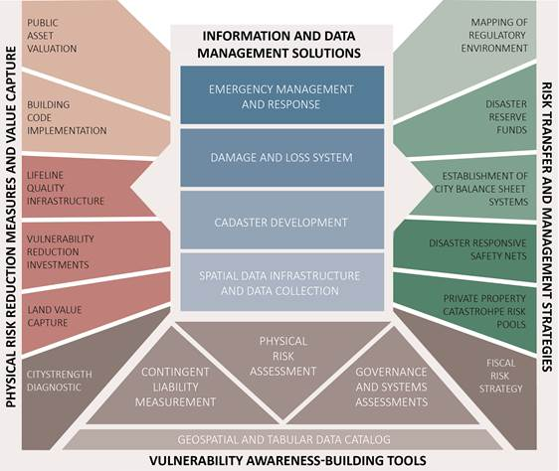
City Resilience Program framework
Notes:
The framework within which we work is comprehensive and is detailed in the diagram above.

Slide 10
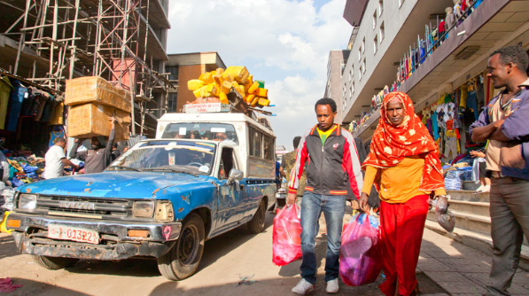
CityStrength diagnostic
Approach
A rapid qualitative risk assessment that facilitates dialogue among stakeholders on risks, resilience, and the performance of urban systems.
Identify priority actions and investments that enhance city resilience.
Structured around sectoral modules
Urban Development, DRM, Water and Sanitation, Transport, Social Protection, Education, Energy, Environment, Health, ICT, Municipal Finance, Solid Waste Management.
Completed Diagnostics
Can Tho, Vietnam (June 2014)
Addis Ababa, Ethiopia (February 2015)
Planned Diagnostics
Colombo, Sri Lanka
Accra, Ghana
Ethiopia secondary cities
Central American cities
Notes:
Approach
A rapid qualitative risk assessment that facilitates dialogue among stakeholders (e.g. government, civil society, residents, academia and the private sector) about risks, resilience, and the performance of urban systems.
Helps identify priority actions and investments that will enhance the city’s resilience and increase the resilience-building potential of planned and aspirational projects.
Structured around sectoral modules (i.e. Community and Social Protection, DRM, Education, Energy, Environment, Health, ICT, Municipal Finance, Solid Waste Management, Transport, Urban Development, and Water and Sanitation.
Completed Diagnostics
Can Tho, Vietnam (June 2014)
Addis Ababa, Ethiopia (February 2015)
Planned Diagnostics under a new TF include:
Colombo, Sri Lanka
Accra, Ghana
Ethiopia secondary cities
Central American cities

Slide 11
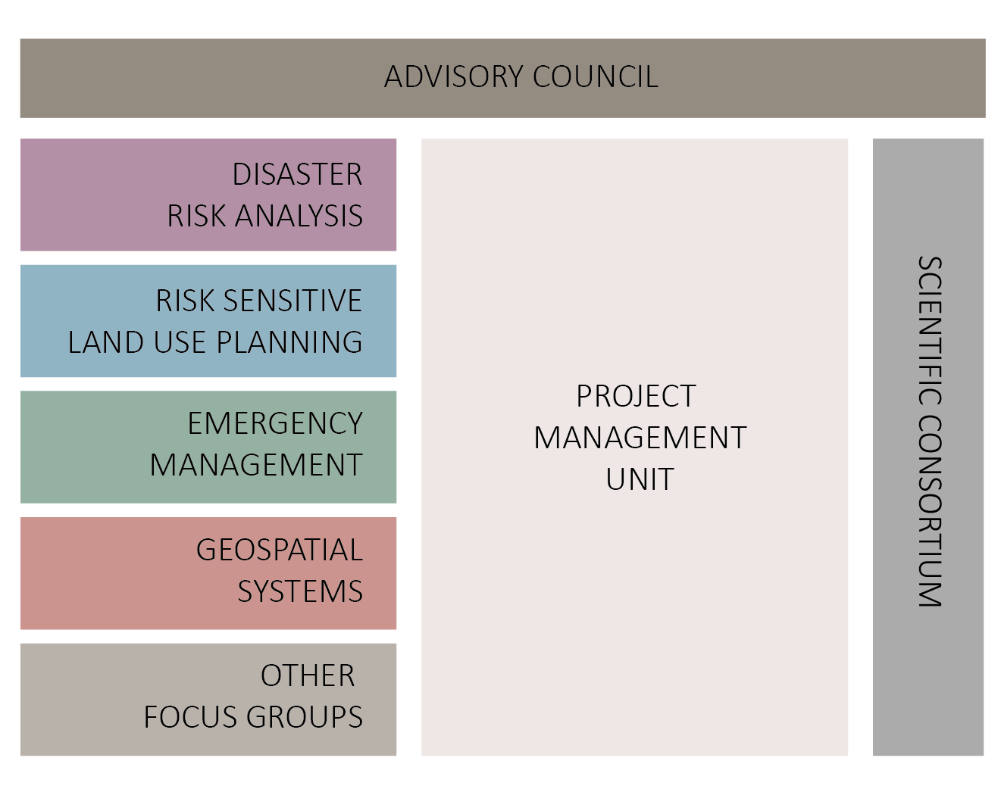
CityStrength diagnostic approach
Notes:
Convening multiple line ministries, departments and agencies with academic institutions. Identifying opportunities to reduce disaster and climate risk through hard (e.g. infrastructure) and soft (e.g. policy) measures, and integrate systems oriented solutions into national and local development planning.

Slide 12
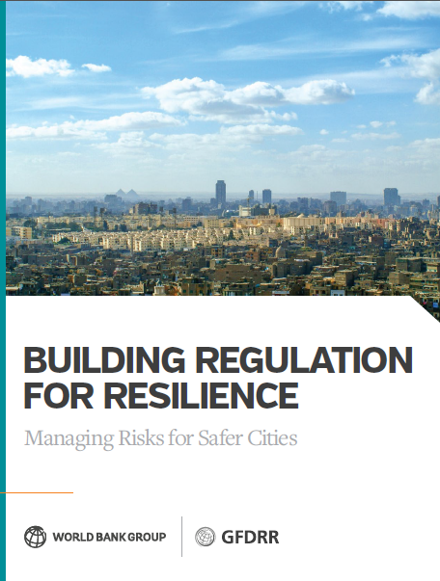
Building Regulation for Resilience
Building Regulation for Resilience Scale-up
Timeline: April 2016 Launch
Current Donors: GFDRR MDTF, Japan World Bank Program for Mainstreaming Disaster Risk Reduction
Objective: To initiate a new building policy and regulatory strategy for the World Bank Group, by developing and promoting a new stream of regulatory capacity building activities for health, safety and disaster risk reduction in the built environment.
Components
National Level Legislation and Institutions
Building Code Development and Maintenance
Local Implementation
Knowledge Sharing and Measurement
Notes:
In an effort to initiate a new building policy and regulatory strategy across the World Bank Group, this program seeks to leverage good-practice in building regulation into effective chronic and disaster risk reduction strategies, thereby setting developing countries on track toward effective reform and long-term resilience. The development objective is to limit the creation of new risks and reducing existing risks in the built environment in low and middle income countries.
Comprised of four components, the program agenda seeks to pursue engagements at the national, municipal and international levels through (a) developing the national enabling legal and administrative framework for the establishment and enforcement of land use and building regulations; (b) setting out minimum requirements for safe construction of new buildings and retrofit of existing buildings; © supporting the introduction of building code implementation mechanisms; and (d) contributing to international efforts to promote knowledge of good practice and support measurement of risk reduction in construction.
In its first phase, the program is developing an assessment methodology meant to assist policymakers, governments and international development practitioners seeking to better understand where key gaps and opportunities for improvement lie in a country’s building codes and regulatory framework. This assessment methodology will then be applied to actual country contexts (i.e. Ethiopia).
Success of this initiative will be heavily based upon the exchange of knowledge and good practice. To this end, the program seeks to involve and galvanize a wide range of partners, with comparative strengths and expertise in developing regulatory processes which are capable of impacting all building types and typologies. The guiding framework for knowledge exchange will be to build partnerships amongst champions sharing a goal to reduce human and economic losses by avoiding the creation of new risks and reducing existing chronic risks in the built environment.
Partners will include governments, international development agencies as well as key institutions specific to the building sector e.g. professional associations and societies related to codes of practice; leading academic institutions in engineering, architecture, urban planning, construction and building technology; accredited training institutions for construction labor force; bodies responsible for licensing procedures for building professionals; and, implementers of quality control processes for building materials.
For reference:
Building Regulations for Resilience (P158953) under the Resilient Cities Programmatic Approach (P146714)

Slide 13
Scaling up
Approach
GFDRR should help the World Bank and its partners to scale up urban resilience lending and technical assistance in low- and middle-income countries, while leveraging the lessons learned from peers and high-income countries.
Focus on what we know best – which is addressing disaster and climate risks, while expanding this methodology to include other risks (other natural hazards, technological risks, socio-economic shocks and stresses)
Actions
Expand to work in 50 cities through the City Resilience Program
Prepare flagship paper on “Investing in Urban Resilience” for Habitat III
Roll out the CityStrength methodology in more pilots and update
Expand the City Risk Transfer and Building Regulations for Resilience programs
Leverage and expand World Bank lending in urban resilience

Slide 14
Proposed GFDRR FY17 work program
Roll out City Resilience Program and provide project preparation support in five cities ($3.5 million)
Scale up the Building Regulations for Resilience Program in five countries ($3 million)
Apply the CityStrength Diagnostic Tool in five new cities and countries ($1.6 million)
Expand the City Risk Transfer Program to five new cities in partnership with the Rockefeller 100 Resilient Cities initiative ($1.2 million)
Prepare a flagship report on “Investing in Urban Resilience” as an input to the Habitat III conference in partnership with the Global Program for Sustainable Cities ($0.15 million)
Strengthen the Medellin Collaboration to advance the urban resilience agenda following Habitat III ($0.7 million)

Slide 15
Thank you
Key Contacts:
Niels Holm-Nielsen, Global Lead and Lead Disaster Risk Management Specialist (Resilient Cities Program) (nholmnielsen@worldbank.org)
Marc Forni, Senior Disaster Risk Management Specialist (Resilient Cities Program) (mforni@worldbank.org)
Luis de la Plaza Bringas, Lead Financial Officer (City Risk Transfer Program) (ldelaplaza@worldbank.org)
Maria Angelica Sotomayor, Lead Urban Specialist (City Strength Coordinator) (msotomayor@worldbank.org)
Xueman Wang, Senior Carbon Finance Specialist and Coordinator for Cities and Climate Change (Sustainable Cities Integrated Approach Platform) (xwang5@worldbank.org)
Joshua Gallo, Senior Municipal Finance Specialist (City Creditworthiness Initiative) (jgallo@worldbank.org)
Joe Leitmann, Lead Disaster Risk Management Specialist and Team Leader for Resilient Recovery and Urban Resilience (GFDRR) (jleitmann@worldbank.org)

Slide 16
Colombia:
Addressing risk at the municipal and national levels
Colombia Disaster Risk Management Development Policy Loan with a Catastrophe Risk Deferred Drawdown Option (CAT-DDO)
Timeline: Dec 2008 – Jan 2012 / Total Envelope: USD 150 Million
Objective: To strengthen the Government’s program for reducing risks resulting from adverse natural events.
Key Outcomes and Lessons
Hazard monitoring network (e.g. seismic, volcanic, hydromet) expanded
Resettlement of people living in high hazard zone of the Galeras Volcano
Successfully developed local DRM plans for 338 municipalities; Government of Colombia subsequently made plans to reach a total of 790 municipalities in its 2010-2014 National Development Plan
A CAT-DDO serves as a valuable financial instrument, which reassures both financial markets and the population, by reducing the negative effects on markets of the declaration of national states of disaster.
Notes:
In Colombia, the damages and losses associated with natural disasters came to represent a growing portion of the national budget, posing a serious threat to the fiscal sustainability of the state. Responsibilities had come to increase with each progressive disaster, setting higher precedents for the government for reconstruction and recovery efforts.
To this end, the Government of Colombia sought a way to better manage its disaster risk with a Development Policy Loan with a Catastrophe Risk Deferred Drawdown Option (or a DPL with a CAT-DDO). As one of the first countries to sign on to a CAT-DDO, Colombia aimed to (a) improve the Government’s capacity to manage risk resulting from adverse natural events and (b) reduce the fiscal vulnerability of the state to natural disasters. To this end, a combination of activities were pursued, including expansion of the hazard monitoring network and resettlement of people living in the high hazard zone surrounding the Galeras Volcano. In addition, as it was clear that part of the government’s vulnerability to disaster stemmed from the lack of local DRM plans at the municipal level, the DPL was an appropriate instrument to enable the government to implement these poverty-reducing policy reforms. In addition, the emergency contingent line of credit offered by the CAT-DDO further ensured access to quick liquidity in the time of a disaster.
The success of the instrument was demonstrated in its ability to reduce the impacts of disasters on citizens through enhanced early warning and resettlement as well as enable the needed institutional reforms at the municipal level. The project further represented a major breakthrough for the national government by offering the quick liquidity needed when a state of emergency was declared in December 2010 due to floods associated with La Nina.
For reference:
DRM DPL with a CAT-DDO (P113084)

Slide 17
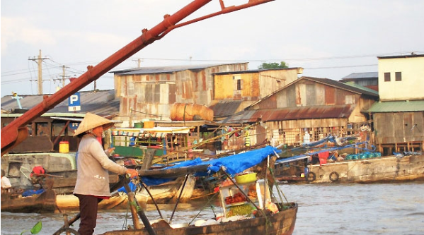
Vietnam:
Partnering with donors in financing
Can Tho Urban Development and Resilience Project
Pipeline: March 2016
Total Envelope: USD 312 Million
Objective: To reduce flood risk in the urban core area, improve connectivity between the city center and the new low risk urban growth areas, and enhance the capacity of city authorities to manage disaster risk in Can Tho City.
Partnership: Includes USD 10 million in SECO co-finance
Components:
Flood Risk Management and Environmental Sanitation
Urban Corridor Development
Management Systems to Improve Spatial Planning, Flood Risk Management
and Transport
Notes:
In Vietnam, an initial City Strength Diagnostic implemented in June 2014 informed the design and preparation of the Can Tho Urban Development and Resilience Project – a USD 310 million pipeline operation expected to go to Board in March 2016. This project has further leveraged US$10 million in SECO co-finance. Projects such as these represent a partnership between World Bank and donors, while demonstrating a pathway for leveraging donor finance towards urban resilience operations.
For reference:
Can Tho Urban Development and Resilience Project (P152851)

Slide 18
Sri Lanka:
From technical assistance to resilience lending
Metro Colombo Urban Development Project
Timeline: Mar 2012-Dec 2017
Total Envelope: USD 213 Million
Objective: To support the Borrower to (i) reduce flooding in the catchment of the Colombo Water Basin, and (ii) strengthen the capacity of local authorities in the Colombo Metropolitan Area (CMA) to rehabilitate, improve and maintain local infrastructure and services through selected demonstration investments.
Informed by TA: GFDRR-financed flood models (Lidar and modeling) informed the technical specifications of the project.
Components:
Flood and Drainage Management
Urban development, infrastructure rehabilitation and capacity building for Metro Colombo local authorities
Notes:
With the end of the civil war in 2009, Sri Lanka was seeking to promote competitive and dynamic cities to reach its aspiration of becoming an upper-middle-income economy and a global hub by 2016. A country of little more than 20 million people, Sri Lanka has a nominal gross domestic product (GDP) of $2,400 per capita. Increasing this to above $4,000 by 2016, as envisioned in the Government of Sri Lanka’s (GoSL’s) medium-term development plan (the Mahinda Chinthana, or MC), requires that economic growth exceed 8 percent per year over the next 5 years, and that total infrastructure investments be 35 percent of GDP—up 10 percentage points from the current level of 25 percent. As per the MC, such investments are needed to transform Sri Lanka into a regional naval, aviation, commercial, and energy hub—and a knowledge link between the East and West. The MC envisions such a profound economic transformation being achieved by 2016 through (i) strengthening cities and improving urban job opportunities, (ii) reducing the share of rural employment from two-thirds to half by 2016, and (iii) increasing the share of the urban population from 25 percent to 35 percent. With the end of civil unrest, Sri Lanka is on a path of rapid urbanization and cities must become more productive and their job markets more competitive.
FYI: (Significant portion is undisbursed, with implementation progress considered MS)
For reference:
Metro Colombo Urban Development Project (P122735)

Slide 19
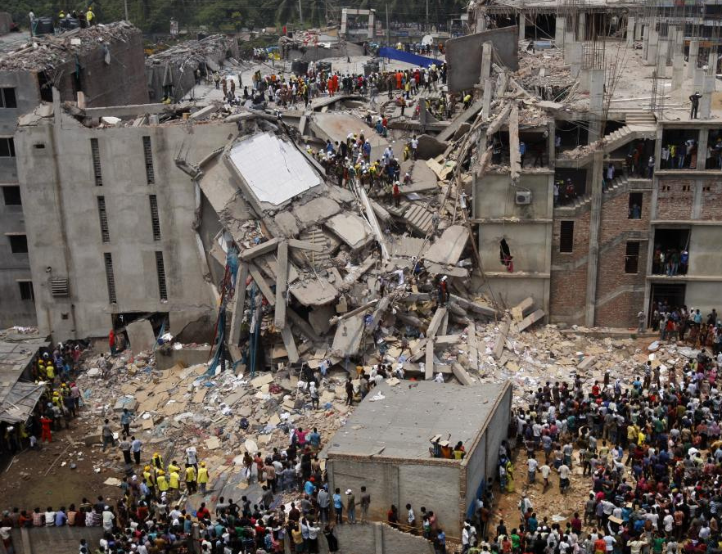
Bangladesh:
From technical assistance to resilience lending
Bangladesh Urban Resilience Project
Timeline: March 2015 – June 2020
Total Envelope: USD 182 Million
Objective: To strengthen the capacity of the Government of Bangladesh to respond to emergency events and to strengthen systems to reduce the vulnerability of future building construction to disasters in Dhaka and Sylhet.
Technical Assistance: A 2 year technical assistance engagement built consensus on the need to improve resilience, leading to the preparation of a broader operation.
High-profile Event: The Rana Plaza collapse (April 2013)
Rana Complex Collapse (April 2013)
(Source: United Nations Photos)
Notes:
Understanding that a significant portion of urban risk is driven by weak emergency response capacity as well as unsafe building practices, the Bangladesh Urban Resilience Project pursues a comprehensive approach of addressing risk through national capacity development, vulnerability assessments of existing public structures, risk-informed development planning as well as promotion of safe construction practices and building code enforcement.
This project, in addition to another JICA project, have included aspects of reducing the vulnerability of future building construction due to the tragic collapse of the Rana Plaza (April 2013), which is considered the deadliest garment-factory accident in history as well as the deadliest accidental structural failure in modern human history -- killing 1,130 people and injuring approximately 2500.
It is important to underscore that the Bangladesh URP was made possible through the US$1.7 million urban resilience TF engagement that was in place for 2 years to build consensus on the need to improve resilience, which led to the lending operation. This TA essentially landed the project and, in absence of this TA, there would be no project.
For reference:
Bangladesh Urban Resilience Project (P149493)

Slide 20
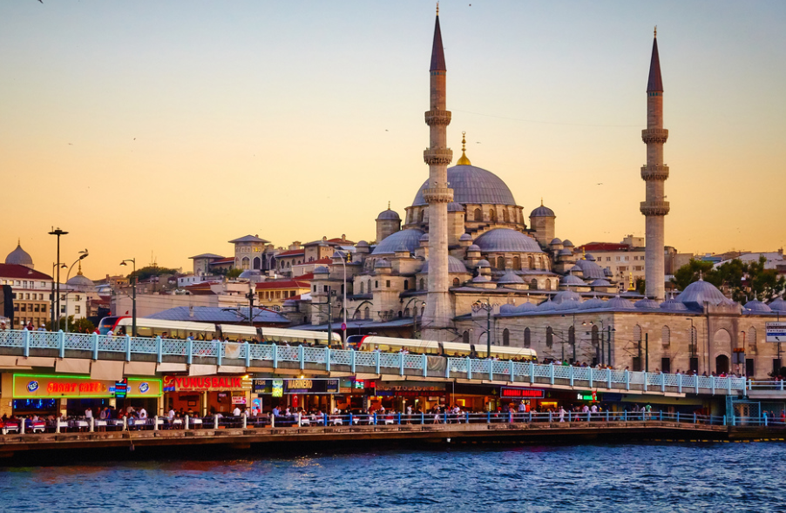
Turkey:
Promoting safe construction and buildings
Istanbul Seismic Risk Mitigation Project
Timeline: May 2005 – Dec 2015
Total Envelope: USD 400 Million
Objective: To assist the Borrower improve the city of Istanbul's preparedness for a potential earthquake, through enhancing the institutional and technical capacity for disaster management and emergency response, strengthening critical public facilities for earthquake resistance, and supporting measures for better enforcement of building codes.
Istanbul Waterfront (April 2013)
(Source: Moyan Brenn, Flickr)
Notes:
Recently closed in December 2015, the Istanbul Seismic Risk Mitigation project has reduced earthquake vulnerability of public buildings through retrofitting or reconstructing 806 schools, hospitals, dormitories, and other high priority public buildings.
ISMEP has enabled 1,133 buildings at Istanbul to be safer which serves for 1.4 million direct beneficiaries. Based on the engineering experience, the project has developed a guideline for better implementation of the Earthquake Code. The
project also supported developing a GIS based inventory of cultural heritage buildings and prepared retrofitting and renovation designs for three major cultural heritage assets: Mecidiye Kiosk at Topkapi Palace Compound, Archeological Museum, and a world heritage Byzantian church; Aya Irine.
Importantly, the project has leveraged an additional 1.5 billion Euro from other international financing institutions including the European Investment Bank, Islamic Development Bank, Council of Europe Development Bank and Reconstruction Credit Institute of Germany.
Other outcomes:
Document management was system established;
Building permit process optimized (automated, efficient and transparent);
Municipal call centers established;
3,631 engineers trained.
806 public buildings retrofitted/reconstructed;
Vulnerability assessments of selected cultural heritage buildings were completed.
The new communication system is operational and in daily use;
Emergency response units were equipped;
920,300 volunteers trained;
Public awareness campaigns reached estimated 5.5 million Istanbul residents. All systems established tested through a simulation exercise and emergency response drill with participation of all stakeholders.
For reference:
Turkey Seismic Risk Mitigation Project (P078359)

Slide 21
Ghana:
Promoting urban resilience with partners
Enhancing Urban Resilience in the Greater Accra Metropolitan Area
Timeline: Dec 2015 – Apr 2017 / Technical Assistance
Partners: 100 Resilient Cities
Objective: To support the local governments in Accra in strengthening its resilience against natural hazards and other shocks and stresses, including the challenges associated with metropolitan management, including inter-jurisdictional coordination issues.
The technical assistance will provide implementable actions on key legal, institutional and investment areas. It will also take into account the resilience issues emanating from the recent work for disaster risk management in Accra, resulting from the June 3 flooding.
Notes:
The task will have three core components: (i) Strengthening Resilient urban development, (ii) Improving Land Use and Planning and (iii) Planning and Budgeting for City Resilience: Resilience Plan and Capital Investment Plan for Resilient Cities. Component 1 of the TA will utilize the CityStrength Diagnostic tool in order to ensure a multi-sectoral approach for addressing the issues described. The tool, developed with the support of GFDRR, will allow the Government and its partners to identify a spectrum of risks facing the greater Accra area across multiple sectors. The assessment process is inclusive, ensuring the involvement of government counterparts and a broad set of stakeholders, including government's development partners and beneficiary communities.
For reference:
Enhancing Urban Resilience in the Greater Accra Metropolitan Area (P156514)

