Slide 1
GFDRR Work Plan 2017-2019
April 27, 2016
Luis Tineo
17th Meeting of the GFDRR Consultative Group
Washington, D.C.

Slide 2
What is the FY17-19 Work Plan?
A three year plan that outlines:
Strategic objectives
Prioritization
Outputs and monitoring

Slide 3
What are our strategic objectives?
Mainstreaming DRM
Bringing resilience to scale
Enabling partnerships

Slide 4
Prioritization
Geography – risk and vulnerability
Contribute to policy frameworks and engagements
Donor priorities
Program targets
Ability to provide specialized support
Mobilize World Bank and in-country partner resources

Slide 5
OPERATIONAL MODEL

Slide 6
Program Structure
Three vehicles and a partnership with World Bank:
Multi-Donor Trust Fund:
Technical assistance
Specialized knowledge
Global policy engagement
Two Special Programs:
The ACP-EU Program
Africa, Caribbean and Pacific
South Asia
Japan-World Bank Program:
Global
Knowledge Program
Notes:
Note: CREWS is an additional special program

Slide 7
Common Framework
Grant making system
Planning and reporting
Monitoring and Evaluation
Four SFDRR Priorities for Action
Five GFDRR Pillars of Action
Common set of output/outcome indicators
Communication and outreach

Slide 8
Our Role and that of Our Partners
GFDRR
Analyze demand
Assess gaps in knowledge and expertise
Mobilize resources and grant making
Aggregate knowledge and best practices
World Bank and Countries
Engage, conceptualize, and implement activities
Leverage investment resources
Create/apply in-country knowledge
In-country visibility and outreach for GFDRR

Slide 9
Capacity to Implement
40+ GFDRR technical staff
GFDRR offices in Brussels, Paris, and Tokyo
100+ World Bank DRM staff across six regions
DRM hubs in Geneva, Singapore, Sydney, Vienna
100+ country offices in member countries
$3 billion+ leveraged from GFDRR projects in FY15

Slide 10
WORK PLAN FY17

Slide 11
How does GFDRR implement the Work Plan?
Country Program: activities across risk identification, risk reduction, preparedness, financial protection, and resilient recovery activities
Eight Thematic Programs: Underpin the Country Program with technical expertise, global knowledge and partnerships
Partnerships and global policy engagement
Activities include TA, capacity building and analytical work

Slide 12
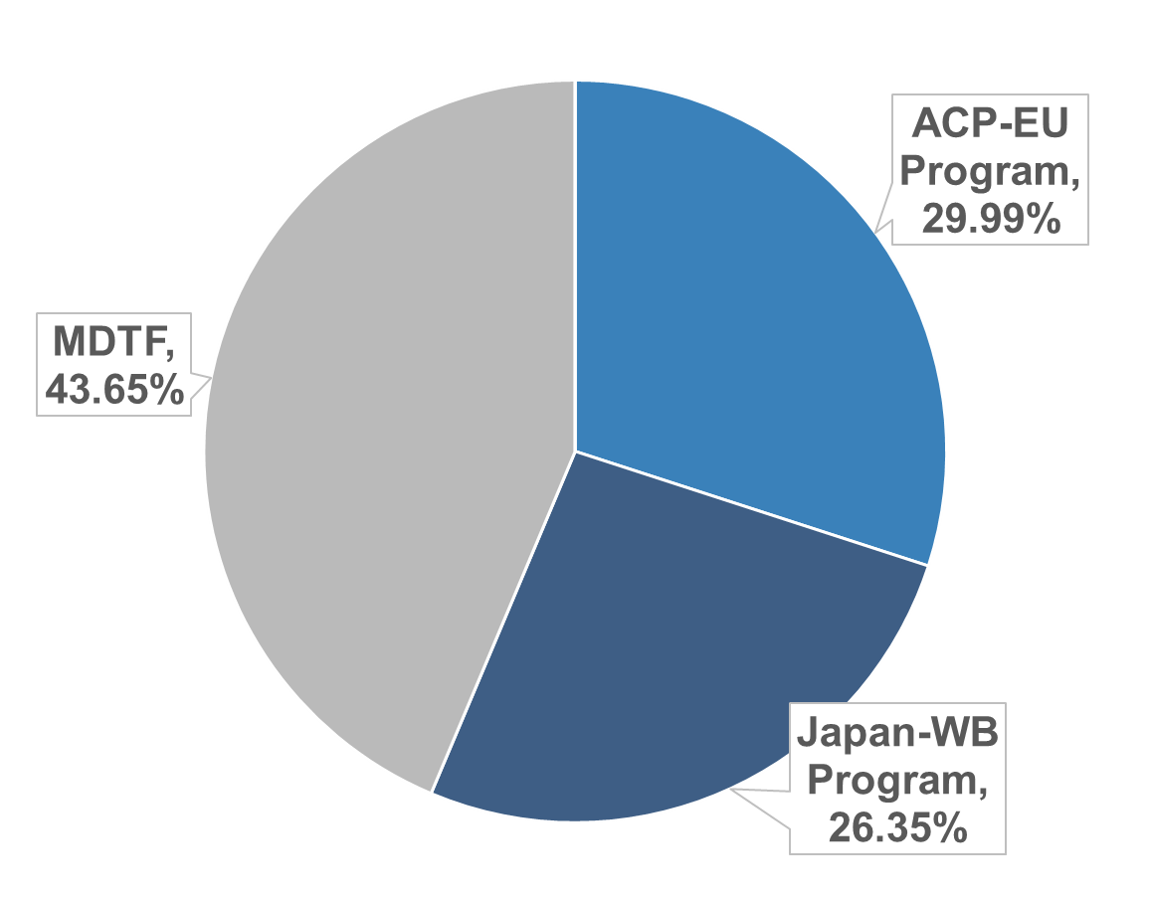
How are we doing in FY16?
$57 million allocated from $80 million planned for FY16 (71%)
Nearly 100 projects approved in over 40 countries
$255 million active portfolio of 274 projects in 50+ countries
Notes:
Disbursement rate: 45%

Slide 13
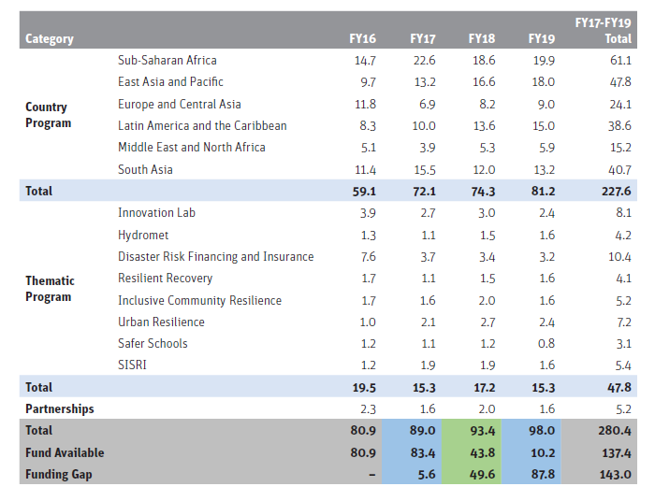
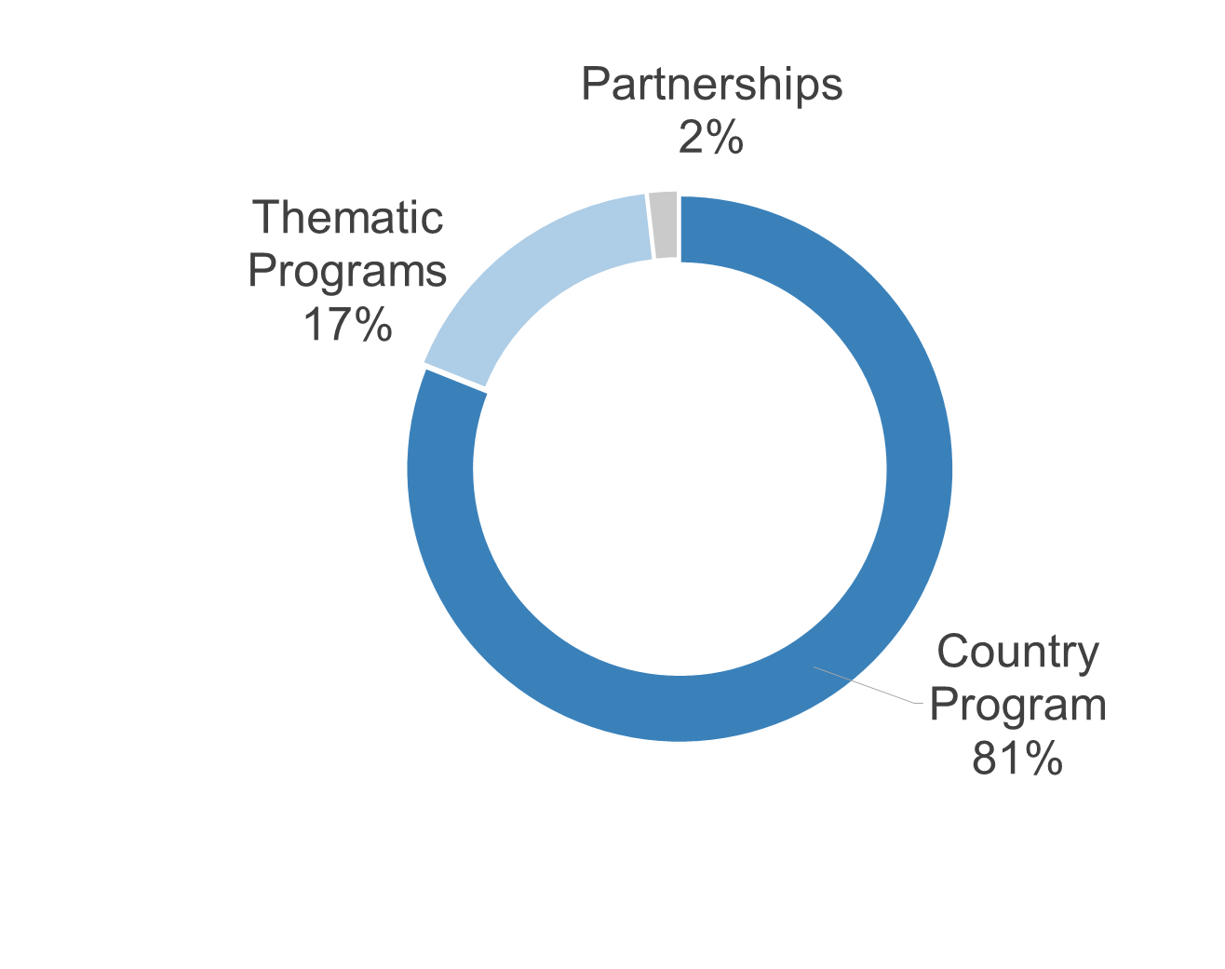
FY17 Overall Program Allocations
GFDRR will aim to commit $90 million
10% greater than FY16
Notes:
22% increase in funding is primarily due to: increased demand/proposed activities in AFR, SAR, and EAP
63% of regional programs proposed are supported by thematic programs
Increased interventions in a number of areas, such as:
providing technical assistance to support countries in Sub-Saharan Africa in managing the current and expected impacts of El Nino; and,
strengthening forecasting and early warning systems globally through a regional approach
ICR - examples

Slide 14
FY17 Profile: Expected Results
Priorities for Action | Pillars of Action | # of target outputs by project in FY17: | Share of expected outputs
Priority 1: Understanding Risk | Pillar 1: Risk Identification | Hazard mappings | 27%
 |  | Risk assessments
 |  | Data platforms established
Priority 2: Strengthening Disaster Risk Governance to Manage Disaster Risk AND Priority for Action 3: Investing in Disaster Risk Reduction for Resilience | Pillar 2: Risk Reduction | Policies and frameworks strengthened | 37%
 |  | Building codes strengthened
 |  | Land-use planning systems strengthened
 |  | Risk reduction investment strategies developed
Priority 3: Investing in Disaster Risk Reduction for Resilience | Pillar 4: Financial Protection | Sovereign disaster risk financing strategies strengthened | 5%
 |  | Catastrophe risk markets strengthened
Priority 4: Enhancing Disaster Preparedness for Effective Response and "to Build Back Better" in Recovery, Rehabilitation and Reconstruction | Pillar 3: Preparedness | Forecasting services strengthened | 29%
 |  | Early warning systems strengthened
 |  | Contingency planning and emergency preparedness strengthened
 | Pillar 5: Resilient Recovery | Post-disaster assessments/recovery frameworks developed | 2%

Slide 15
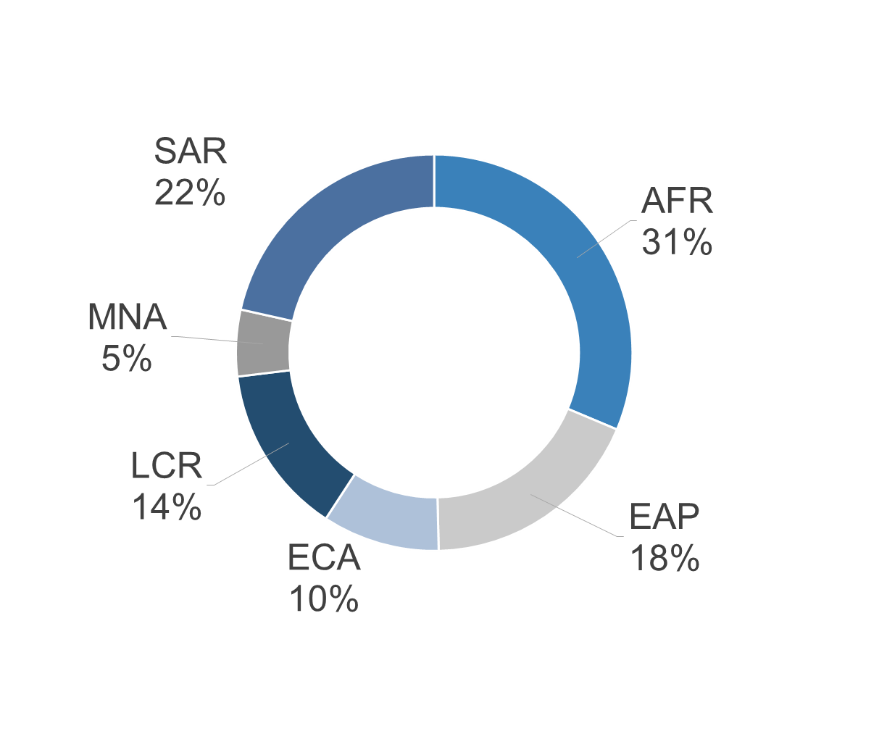
FY17 Profile: the Country Program
$72 million (81%) allocation across six regions
Majority of resources will be allocated to AFR, EAP, and SAR
Project highlights include:
Engagement in infrastructure resilience
Strengthening risk-informed urban planning
Enhancing community resilience
Notes:
10% increase in funding is primarily due to: increased demand/proposed activities in AFR, SAR, and EAP
63% of the country program proposed are supported by thematic programs
This is increased demand is mainly due to: AFR, SAR, and EAP (give examples/rationale)
Increased interventions in a number of areas, such as:
providing technical assistance to support countries in Sub-Saharan Africa in managing the current and expected impacts of El Nino; and,
strengthening forecasting and early warning systems globally through a regional approach
ICR - examples

Slide 16
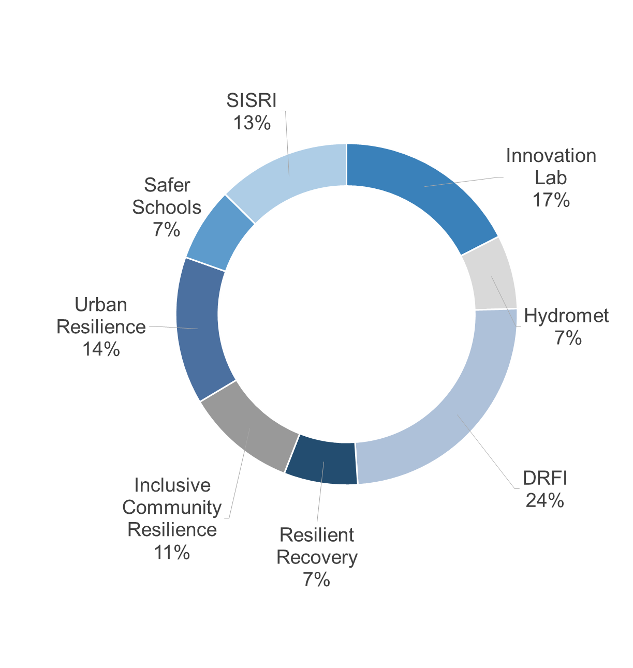
FY17 Profile: Thematic Programs
$15 million (17%) allocation to support technical expertise and global programs
Thematic programs support 63% of Country Program activities
Highlights include:
Developing innovative risk information tools
Supporting disaster risk finance for scalable social protection
Strengthening forecasting and early-warning systems
Notes:
10% increase in funding is primarily due to: increased demand/proposed activities in AFR, SAR, and EAP
63% of regional programs proposed are supported by thematic programs
Increased interventions in a number of areas, such as:
providing technical assistance to support countries in Sub-Saharan Africa in managing the current and expected impacts of El Nino; and,
strengthening forecasting and early warning systems globally through a regional approach
ICR - examples

Slide 17
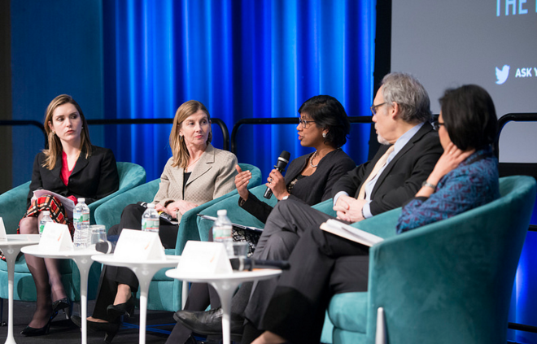
FY17 Profile: Partnerships and Policy Engagement
$2 million (2%) allocation to activities that:
Engage partners on, and inform, the resilience agenda
Develop new and innovative knowledge
Highlights include:
Support implementing SFDRR, the Paris Agreement, and SDGs
Engagement at UR, WHS, Habitat III, Global Platform for DRR
Continue the Resilience Dialogue series
Analyses on economic benefits of investing in DRM, links between disasters and poverty.
Notes:
Informing upcoming policy discussions: Habitat III, Resilience Dialogue series, Global Platform for DRR)
Develop new knowledge products – ex: analyses on economic benefits of investing in DRM and links between disasters and poverty)

Slide 18
Monitoring and Reporting
In progress:
Refined grant M&E, including:
Climate and gender reporting in proposal templates
Intermediate outcomes in reporting
Online grants database available
Commissioned 2016 evaluation
Consolidates findings from past two evaluations
Proposes Action Plan to address recommendations

Slide 19
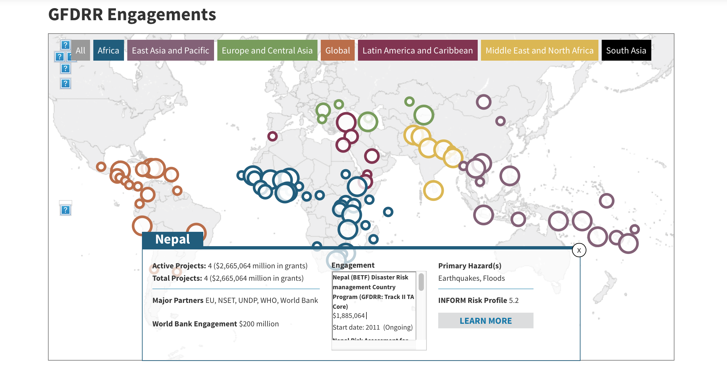
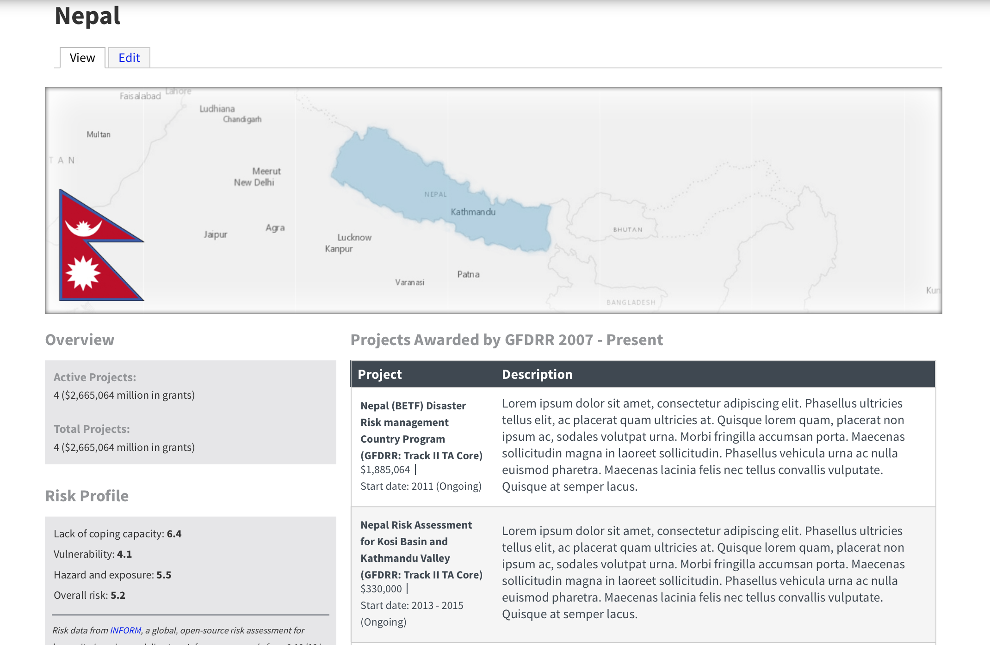
Web-based Database
Providing real-time reporting
Searchable online platform of all GFDRR grants
Showcases results at the global, country, and grant level

Slide 20
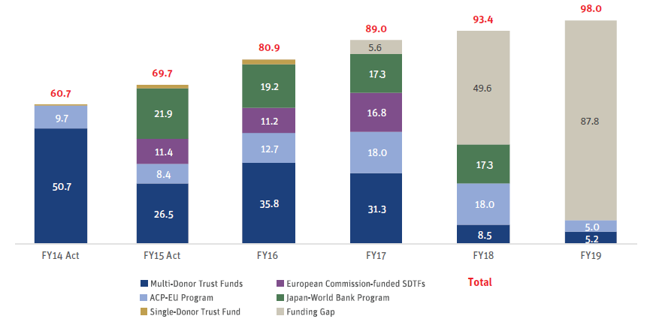
FY17-FY19 Resources Required
5%+ annual increase in resources required
Resource base decline post-FY17
$5.6 million funding gap for FY17; $143 million estimated over 3 years

Slide 21
