Slide 1
Adaptive Social Protection Updates
Jehan Arulpragasam
17 Meeting of the GFDRR Consultative Group
April 27, 2016

Slide 2
Adaptive Social Protection
Motivation
Increased frequency and duration of major covariate shocks (e.g. natural disasters; pandemics; conflict and violence).
Need to think about how national social protection can be made “shock responsive”, “scalable” or “adaptive”.
Linked to broader debates
On development solutions for climate change
On development solutions for displacement
On development solutions to shoulder chronic humanitarian caseload

Slide 3
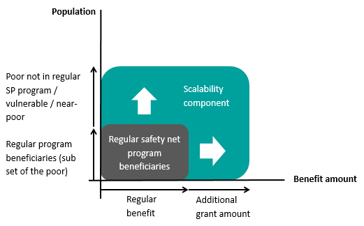
Adaptive Social Protection (ASP)
Social protection helps poor households to manage risks.
Adaptive Social Protection has the potential to better enable poor households to manage shocks by scaling up
Adaptive Social Protection can result in faster, cost effective, and more efficient delivery of assistance to affected households

Slide 4
Adaptive Social Protection (ASP)
The agenda is gathering interest and momentum at the Bank; among partners; and clients
A side-event during the 3rd UN WCDRR in Sendai, Japan
Topic of the Annual Ministerial Round-Table on Safety Nets at the World Bank 2016 Spring Meetings
Core commitment of the World Bank’s Climate Action Plan
Key messaging for the World Humanitarian Summit
Adaptive Social Protection; Cash Transfers
Focus of 7th Social Protection South-South Global Learning Forum
Increasing demands to operationalize ASP at country level…….

Slide 5
Adaptive Social Protection (ASP)
GFDRR is supporting the agenda of operationalization of ASP in select country cases
Philippines
Jamaica
Fiji / Tonga
Dominica /Grenada

Slide 6
Adaptive Social Protection (ASP)
There is demand from other countries as well……
Ethiopia, Kenya, Uganda, Rwanda, Mozambique, Tanzania
Bangladesh, Pakistan, India
Vietnam, Nepal, Myanmar
Chile, Mexico, El Salvador, Haiti
Sahel – Burkina Faso, Chad, Mali, Mauritania, Senegal, Niger
Other small island states – Caribbean; Pacific

