Slide 1
CG GFDRR Briefing on the World Humanitarian Summit 27 April 2016
23 – 24 May 2016 Istanbul, Turkey

Slide 2
WHS Consultation Process …
440+ written submissions
23,000+ people
consulted
5,500+ comments
received online
151 countries
from which participants added their voices
8 regional consultations

Slide 3
The SG’s Report and Agenda for Humanity
Launched on 9 February 2016
Builds on consultations and presents 5 core responsibilities
Provides the framework for the High-Level Leaders’ Rountables and Leaders’ Segment

Slide 4
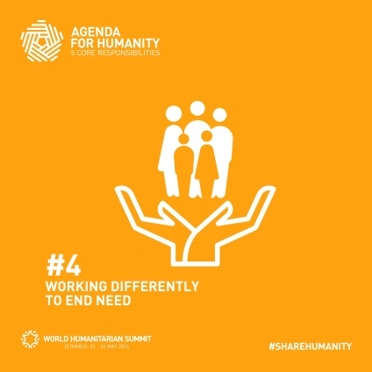
5 core responsibilities & 7 roundtables
RT 1 - POLITICAL LEADERSHIP TO PREVENT AND END CONFLICTS
RT2 - UPHOLD THE NORMS THAT SAFEGUARD HUMANITY
RT3 - LEAVING NO ONE BEHIND: A COMMITMENT TO ADDRESS FORCED DISPLACEMENT
RT6 - CHANGING PEOPLE’S LIVES: FROM DELIVERING AID TO ENDING NEED
RT7 - HUMANITARIAN FINANCING: INVESTING IN HUMANITY
RT4 - WOMEN AND GIRLS: CATALYSING ACTION TO ACHIEVE GENDER EQUALITY
RT5 - NATURAL DISASTERS AND CLIMATE CHANGE: MANAGING RISKS & CRISES DIFFERENTLY

Slide 5
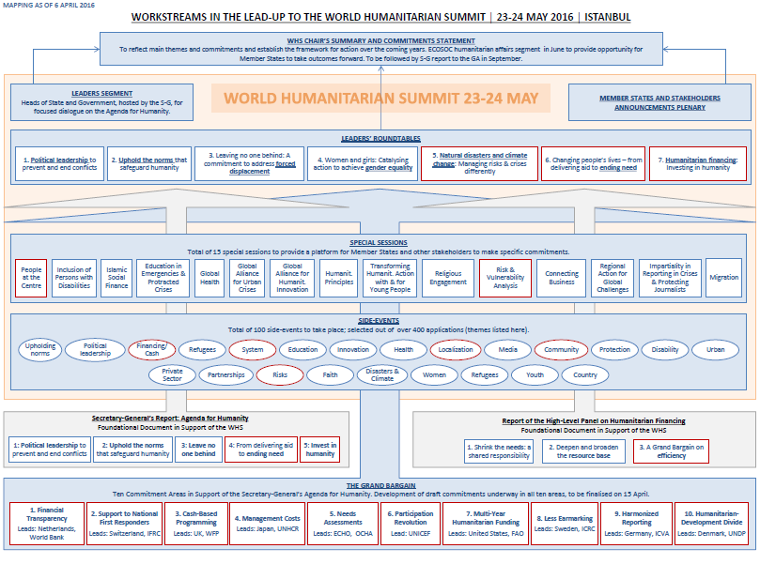
The Grand Bargain and the WHS

Slide 6
Roundtables
Key opportunity for leaders to announce substantive, transformative pledges to action
Two hours long with 30 to 50 speakers
Short interventions focused on commitments.
SG/DSG will serve as moderators
Two or more co-Chairs

Slide 7
Making commitments
Two types of commitments
1) Core commitments: intentions to work in a new way, to strengthen an area of work, visionary in nature
2) Individual or joint commitments (including by regions or groups): Concrete, measurable actions

Slide 8
Disasters & Climate Change
Natural hazards are having major impacts on lives, livelihoods and economies.
Improvements have been made in recent years in building peoples’ resilience.
Climate change, urbanization….will increase the frequency and intensity of disasters.
Accelerate Sendai, SDGs and COP agreements to reduce and adapt to disaster risk.
Ensure events don’t spiral out of control: invest in national & local preparedness.

Slide 9
Three major shifts
Anticipate, don’t wait for crises.
Take collective action.
Reinforce, don’t replace, national and local systems.

Slide 10
RT5: Disasters: Core commitments
Commitment 1: Commit to accelerate the reduction of disaster and climate-related risks through the coherent implementation of the Sendai Framework for Disaster Risk Reduction 2015-2030, the 2030 Agenda for Sustainable Development and the Paris Agreement on Climate Change, as well as other relevant strategies and programs of action, including the SIDS Accelerated Modalities of Action (SAMOA) Pathway.
Commitment 2: Commit to reinforce national and local leadership and capacities in managing disaster and climate-related risks through strengthened preparedness and predictable response and recovery arrangements.
Commitment 3: Commit to improve the understanding, anticipation and preparedness for disaster and climate-related risks by investing in data, analysis and early warning, and developing evidence-based decision-making processes that result in early action.

Slide 11
Disasters: Core commitments (Cont..)
Commitment 4: Commit to increase investment in building community resilience as a
critical first line of response, with the full and effective participation of women.
Commitment 5: Commit to ensure regional and global humanitarian assistance for disasters complements national and local efforts.

Slide 12
Examples of individual & collective commitments
Commit to support the OCED DAC in rapidly completing the work to have arrangements in place to track official finance flows to disaster risk reduction and preparedness, with a view to setting a target for increased investment at the next Global Platform for Disaster Risk Reduction.
Commit to join a new coalition to strengthen the resilience of 1 billion people by 2025.
Commit to strengthen national and local emergency management systems for natural disasters, and accelerate this initially in the most at-risk countries, so they reach a minimum level of readiness by 2020. (Global Preparedness Partnership)

Slide 13
Post-Summit
Commitments need to be implemented and lead to genuine change in the way we deliver assistance and reduce risk and vulnerability for millions of people.
All commitments registered for a Roundtable will be reflected in the Commitments to Action document.
After the Summit, there will be an expectation that States and stakeholders who have made commitments will want to report on their implementation. A process is being developed to track progress on implementation. Further information will be provided in due course.
There will also be a number of inter-governmental and non-intergovernmental opportunities to take forward the outcomes of the Summit and the recommendations of the Secretary-General in his next report to the General Assembly.

Slide 14
Post-Summit opportunities
ECOSOC Humanitarian Affairs Segment: 27-29 June
President of the General Assembly events, including High-Level Thematic Debate on Human Rights and Humanitarian Affairs: 12-13 July
Annual General Assembly omnibus humanitarian resolution: Fall 2016
General Assembly Summit on Addressing Large Movements of Refugees and Migrants: 19 Sept.
Quadrennial Comprehensive Policy Review (QCPR) negotiations: Fall 2016
Global Platform for DRR (May 2017)

Slide 15
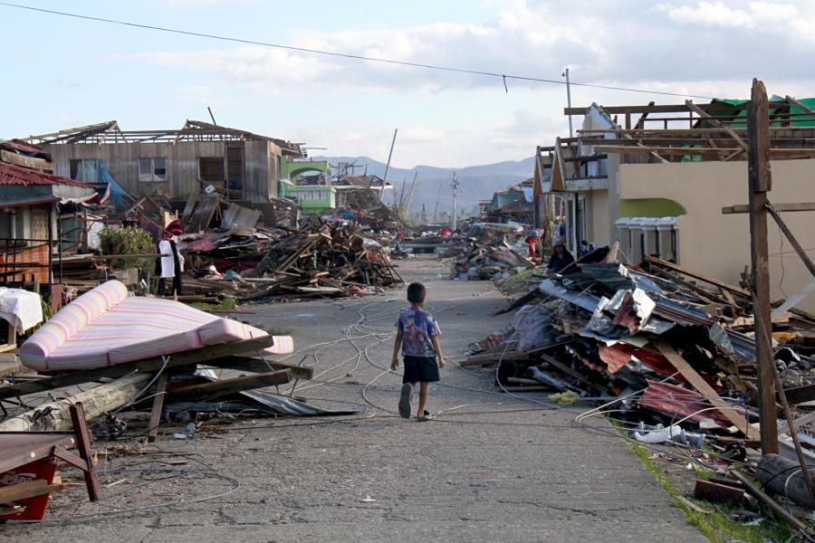
Any Questions?

