Slide 1
GREATER IRBID MUNICIPALITY
JORDAN

Slide 2
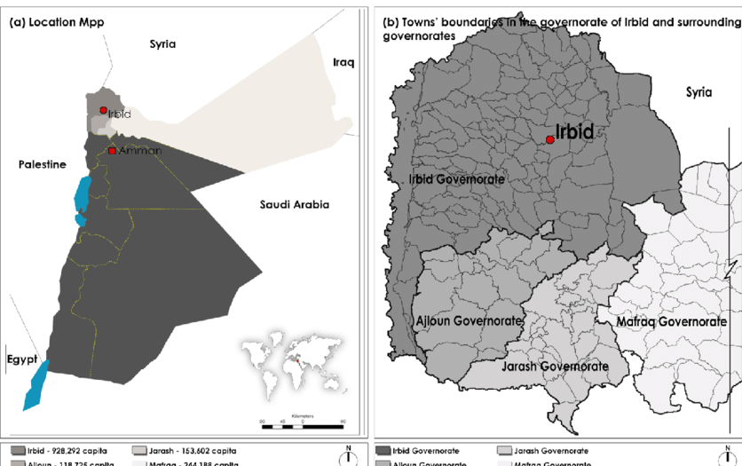
Resilient Urban Initiative
IRBID URBAN CITY CENTER DEVELOPMENT
IRBID
Is the second largest city in Jordan with an urban population of 1,000,000 inhabitants , 25% are refugees.
Notes:
Credit: Flaticon.com

Slide 3
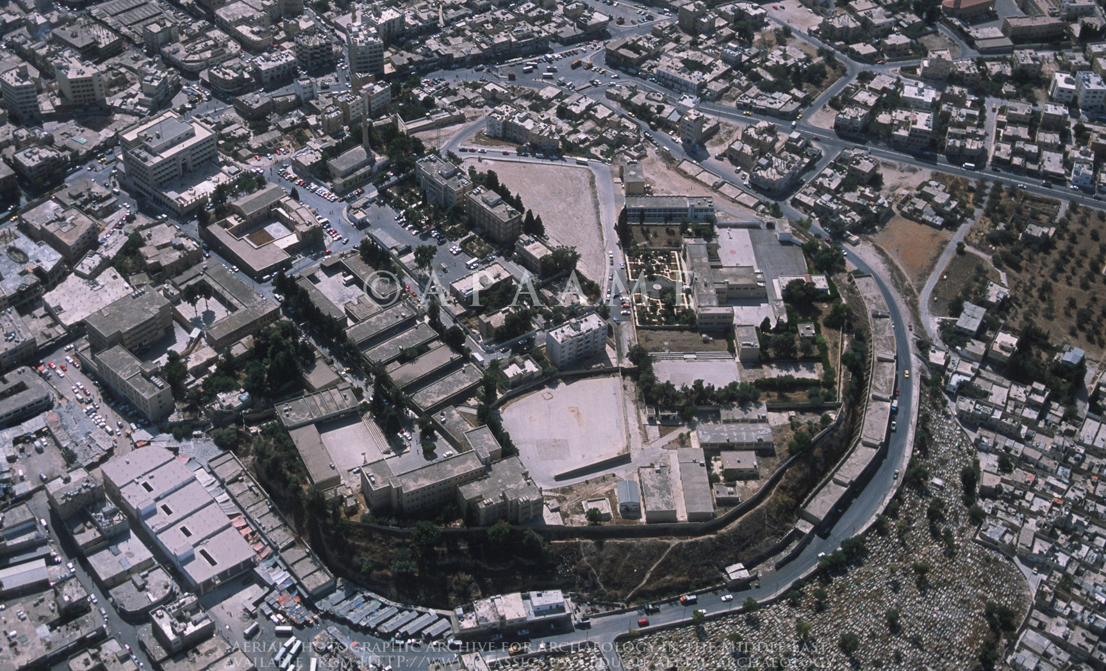
IRBID CITY CENTER
IRBID CITY CENTER

Slide 4
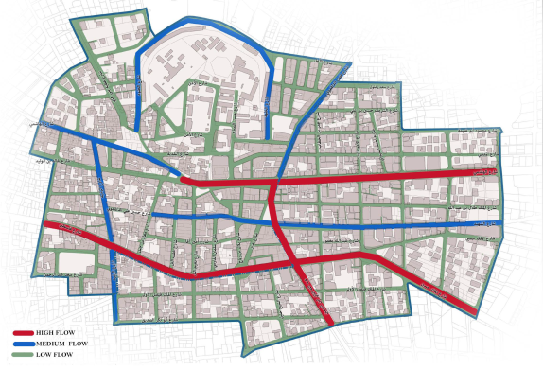
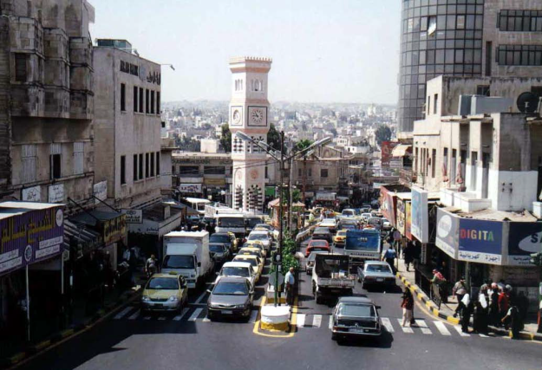
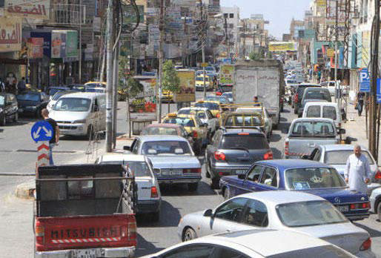
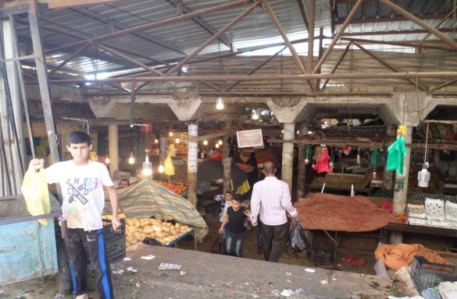
CHALLENGES
No Parking
Lack of Green Areas
Insecurity
Environmental Problems
Accessibility Problems
Traffic Jam/ Congestion

Slide 5
Irbid Urban Transformation Authority
Energy and Water Savings
Solid Waste Management
Public Transport
Land Redevelopment
Cross-cutting: smart city initiatives

Slide 6
Risks | Mitigations
Demand Risk | Minimum Guarantee Revenue
Cost of Production | Change the price
Low ratio of usable waste | Minimum Guarantee Revenue

Slide 7
Risks
Pillar | Cost | Revenue/Year
Energy and Water Savings | $10 M | $1M
Solid Waste Management | $16M | $2M
Public Transport | $3M | $0.5M
Land Redevelopment | $25M | $1.5M

