Slide 1
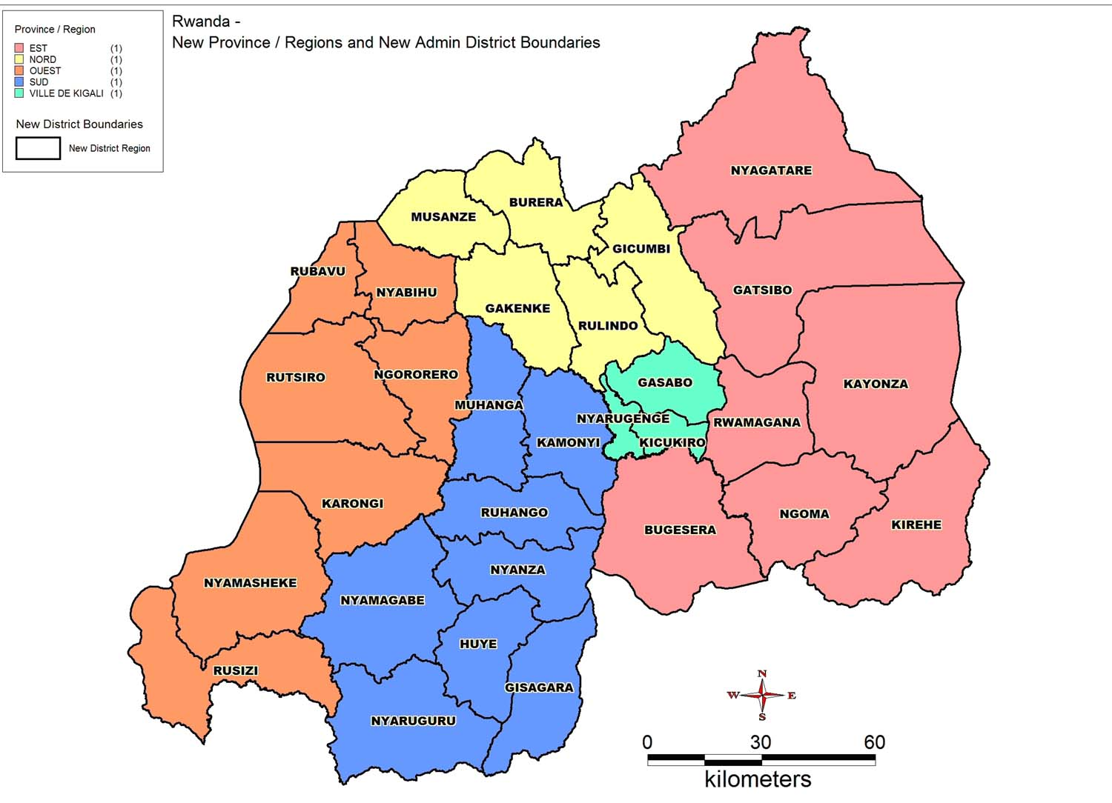
City of Kigali
Solid waste management (Land fill)
Project proposal

Slide 2
Solid waste management is an issue.
Presenting a project proposal under Public Private Partnership model
Problem statement.
Kigali generates about 100 tons of solid waste on daily basis which is collected through a private operator appointed by the Kigali City Council. However, the City does not have an appropriate facility for treatment and disposing the waste, which is expected to increase as the population and City development increase.
2. Key needs for the project intervention (for >28million US$) are:
Project design / study
Infrastructure development
Review the existing Solid waste collection method and
Modernize the Land Fill management system
Notes:
Credit: Flaticon.com

Slide 3
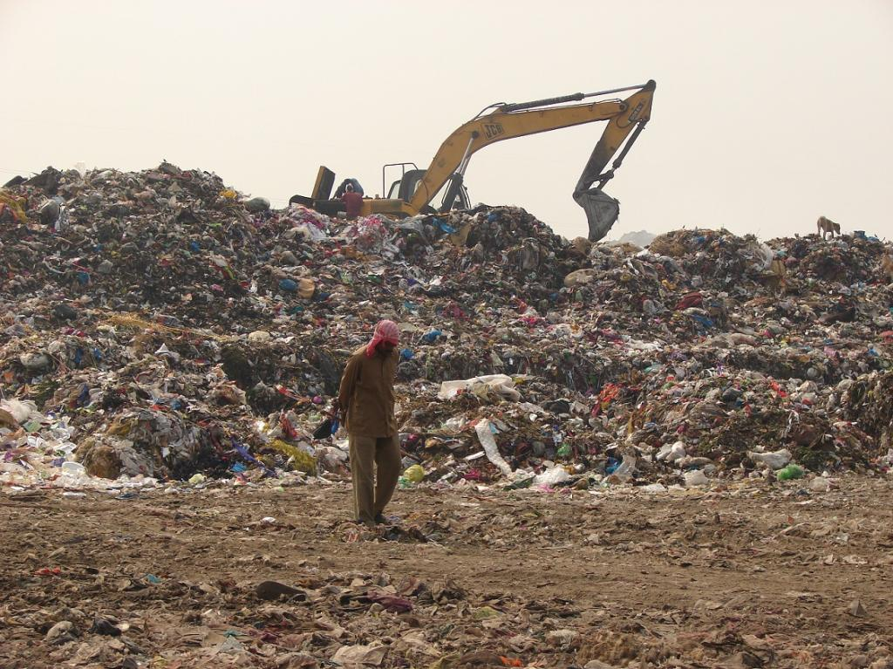
Existing damping site

Slide 4
The construction of the Land fill will solve solid waste related issues
City of Kigali
The Public Private Partnership (PPP) would carry out a reliable Study/Design-Financing-Building-Operating and Transfer mechanism.
The return on investment and expenses will be widely covered by a proper management income.
The auto-financing aspect of the project will meet the principles of City Resilience Program, by generating revenue to our City
The environmental protection, welfare of residents and visitors, employment…

Slide 5
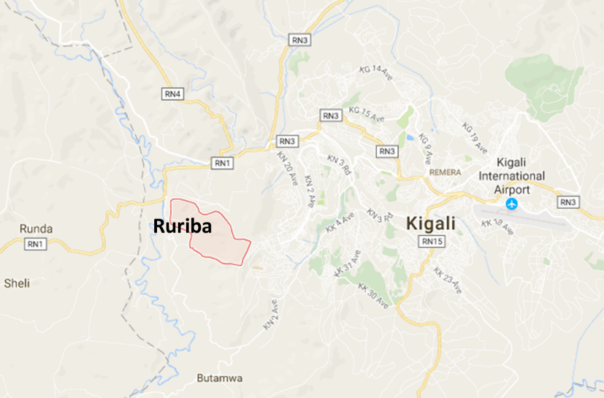
Location of the proposed project

Slide 6
Private capital opportunities
City of Kigali
PPP Track Record | Regulatory Frameworks | Procurement Capacity | Government Co-Financing
Volume of waste;
Number of Population;
Development of City
This investment requires huge Capital,
No competition,
Return on investment granted
Redesigning the existing waste collection and waste managegement mechanism.
Real Estate Market Capacity | Land Use Regulations | Land Cadaster / Land Data Management | Security of property rights | Local Fiscal Powers | LVC track record

Slide 7
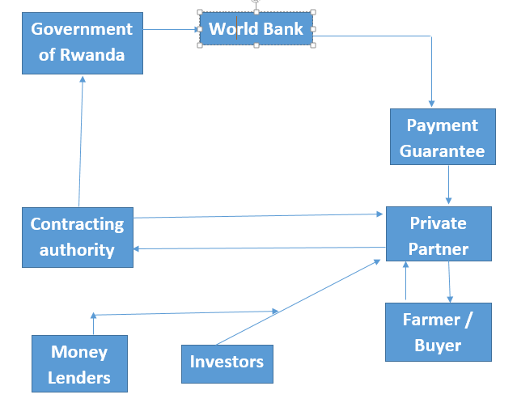
Financing cycle

Slide 8
City of Kigali
We are looking forward to see you work with us on this passionate and resilient project
THANK YOU
FOR
YOUR ATTENTION

