Slide 1
Saida By-Pass Road Project (Turnpike)
Project Proposed for PPP

Slide 2
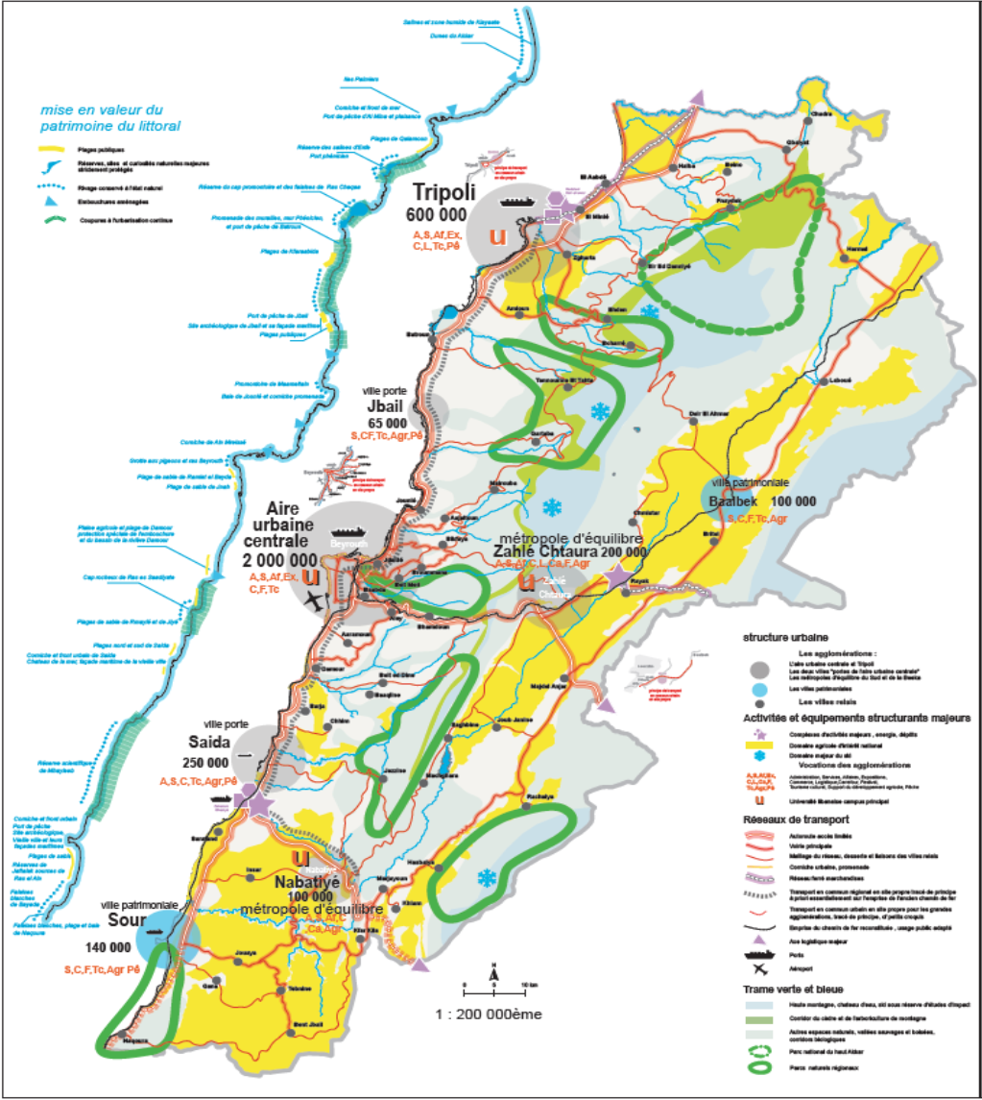
SAIDA CITY AT THE NATIONAL
LEVEL
Located on the coastal line at 40 Km South of Beirut;
250,000 Inhabitants;
Capital of South Lebanon;
Administrative, commercial, services (health, education, culture…) important role;
Market of the country side products (agriculture);
Cultural Heritage Assets (old town, tangible and intangible heritage).

Slide 3
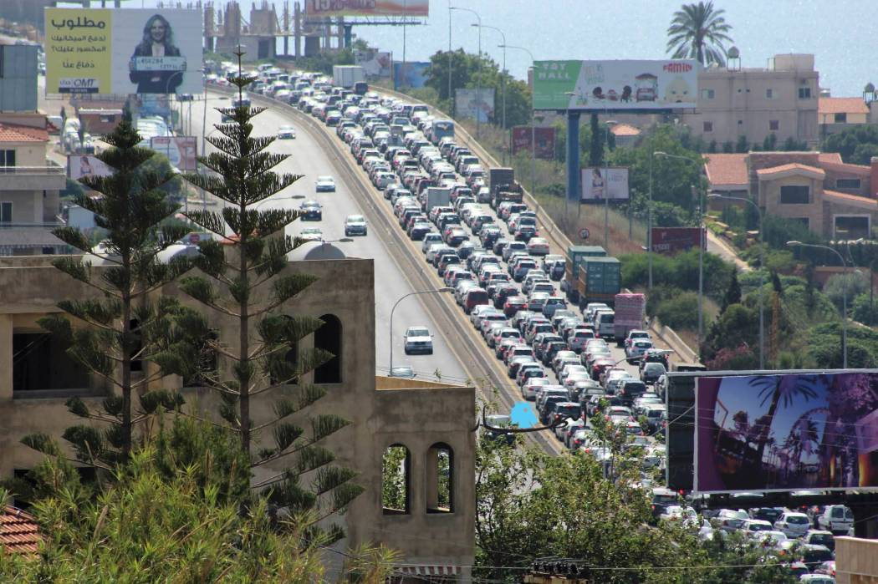
Problem and Challenges
The peak congestion carrying people from Beirut to the South through Saida brings more than 10,000 vehicles per hour to the very center of the city. The completion of the southern highway represents the main challenge for the traffic study

Slide 4
Objective and Solutions
The by-pass road is proposed to relieve the traffic pressure on the city and free the sea boulevard for re-development as a tourist and ecological asset
Improve the linkages of the City to its surrounding region;
Physically demarcating the expansion of the Greater Saida;

Slide 5
Risks and Mitigations
Risks | Mitigations
Institutional and Political | Participatory approach at the first phase of the feasibility study in order to have the validation of all concerned stockholders
Land Expropriation / acquiring private lands | Equitable indemnities and resettlement action plan
Topography of land | The design will have to take in consideration
Negative environmental impact | Environmental Impact Assessment study will be elaborated in parallel with design

Slide 6
Brief Description of the project, cost and cost recovery
Description | Cost Recovery
Length: 9 to 10 Km (including 3 bridges and 3 tunnels) | Direct Taxes: toll highway
Weight: 2 x 3 lanes (without central aisle) | Indirect Taxes: enhancement of local taxes due to upgrading of local economy
Total Cost: 90 Million US Dollars

Slide 7
Thank you

