Slide 1
Bamako
Logistics hubs

Slide 2
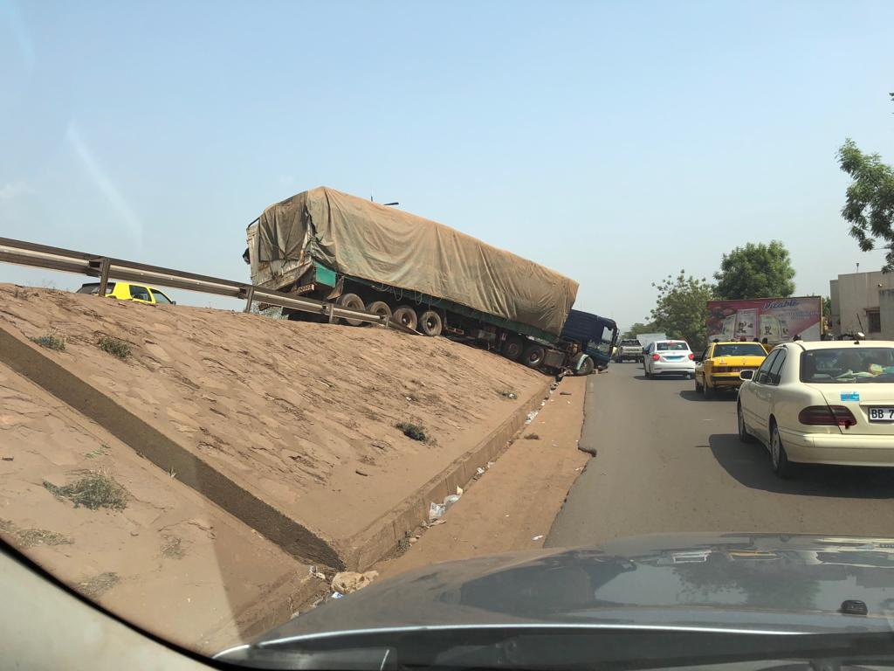
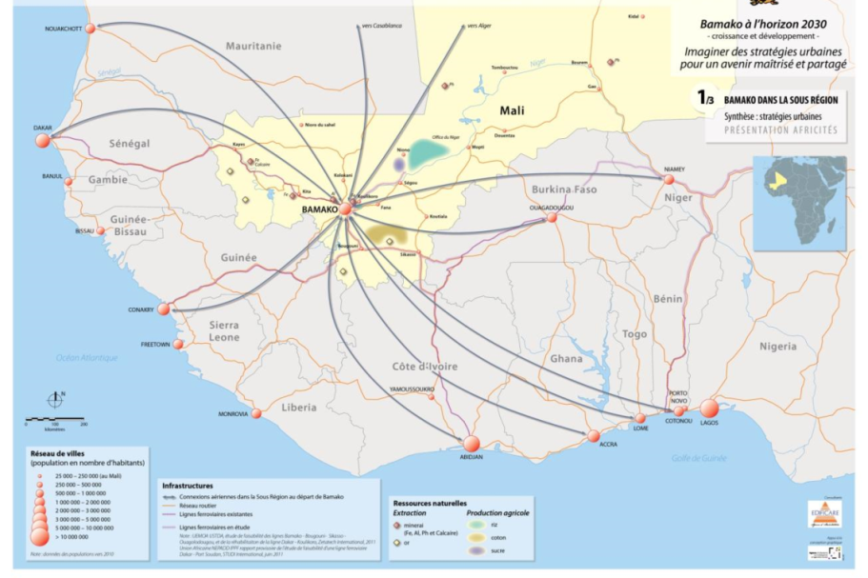
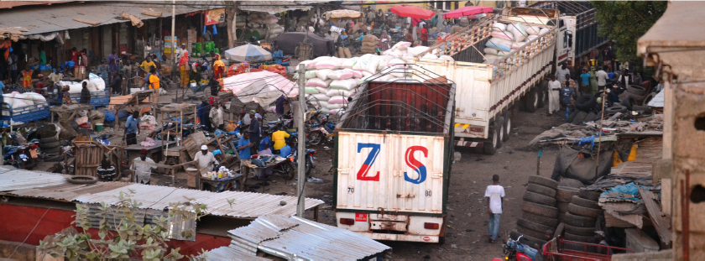
Logistics is an issue…
Bamako
Mali: 17 million people
40% of all goods pass through Bamako
500 large trucks per day
3 →13 million people!
15% of the population – 34% of GDP
Notes:
Credit: Flaticon.com

Slide 3
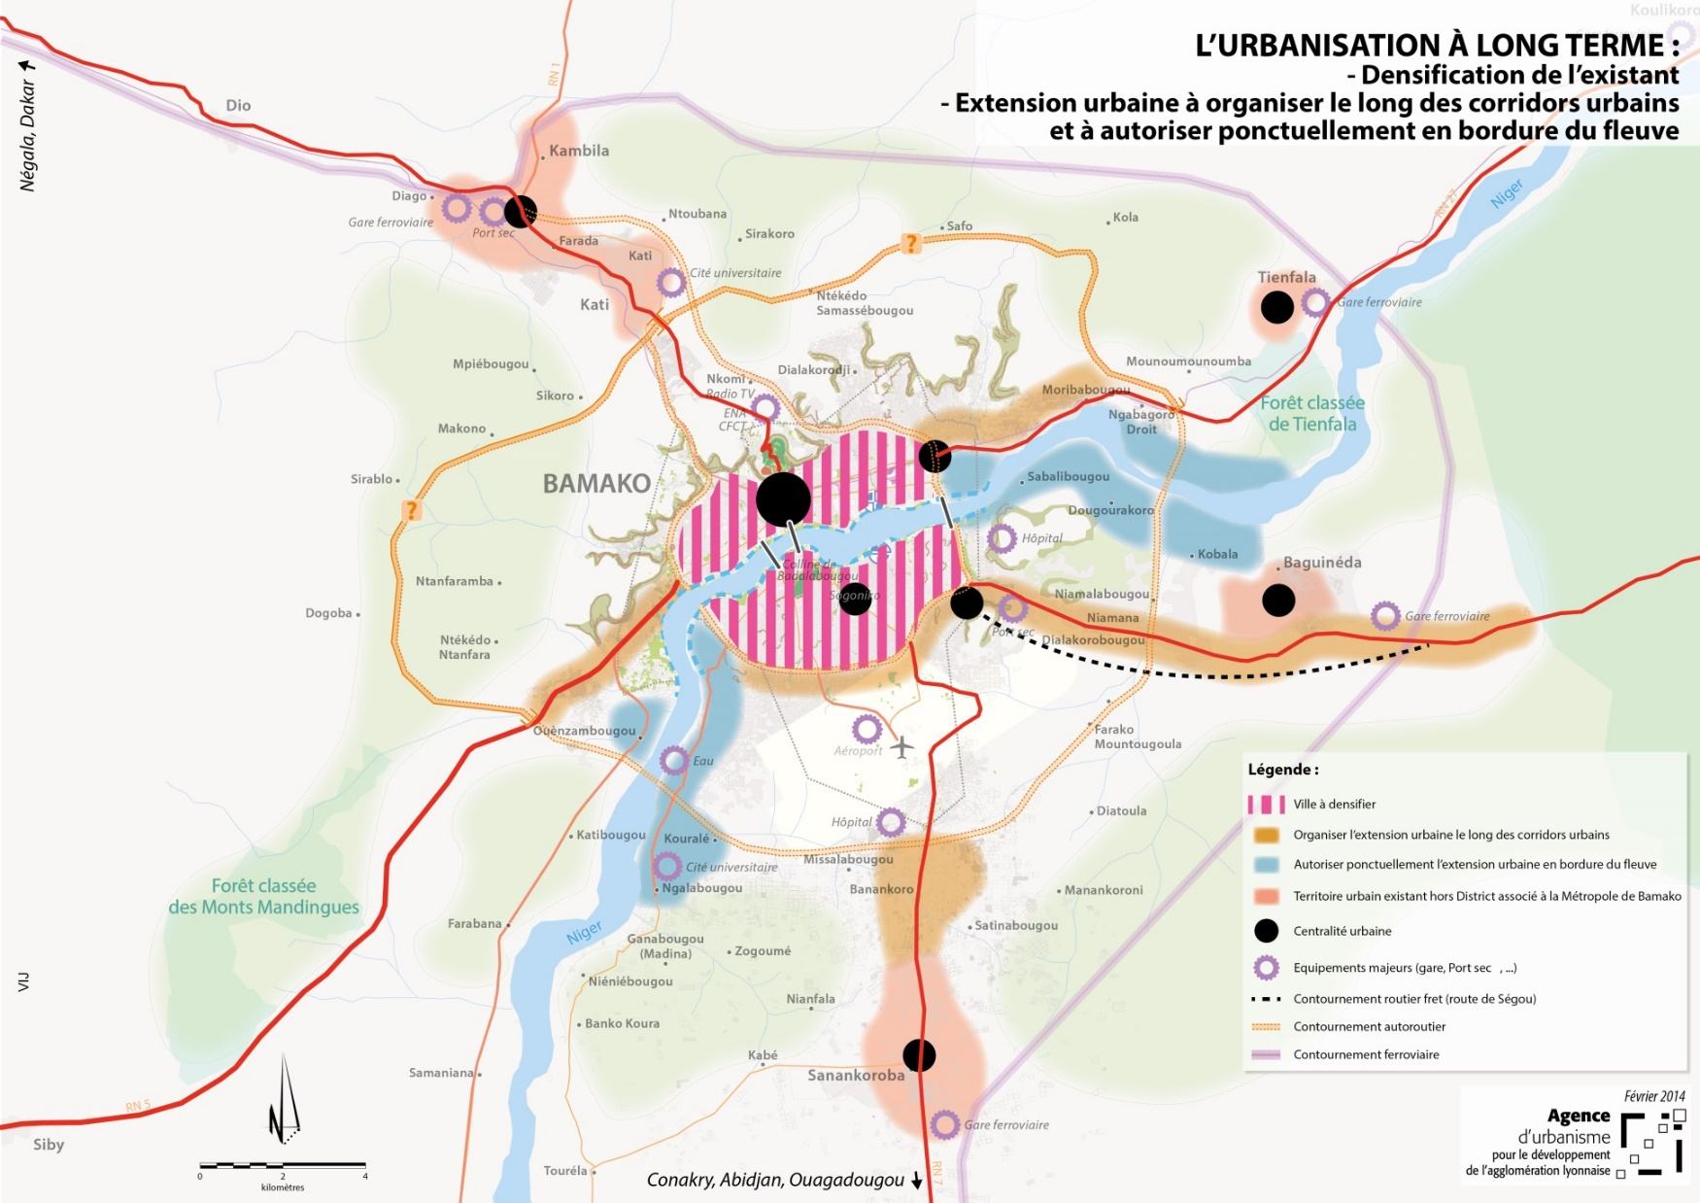
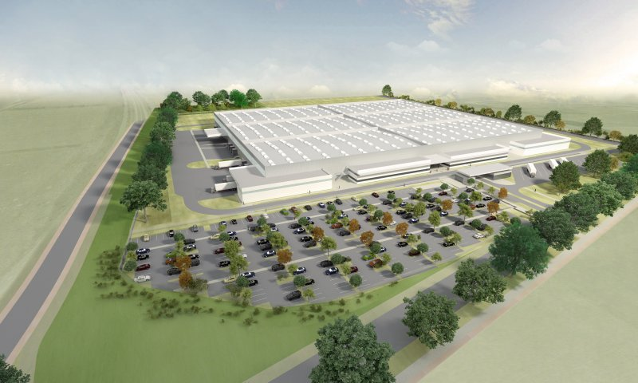
…. but we can solve it!
Bamako
Four logistics hubs:
Parking
Loading and unloading
Other economic activties
Inclure une carte de votre zone d'intervention pilote

Slide 4
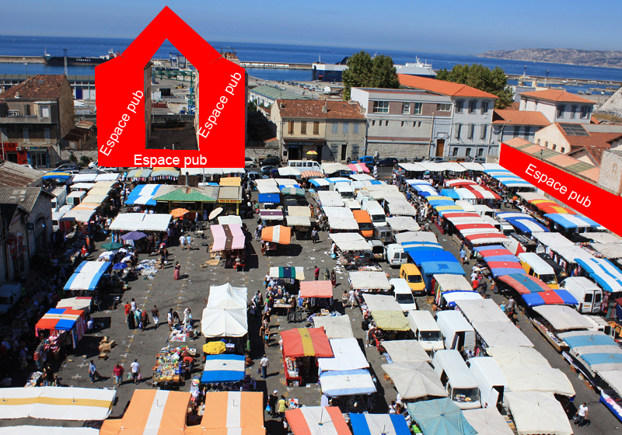
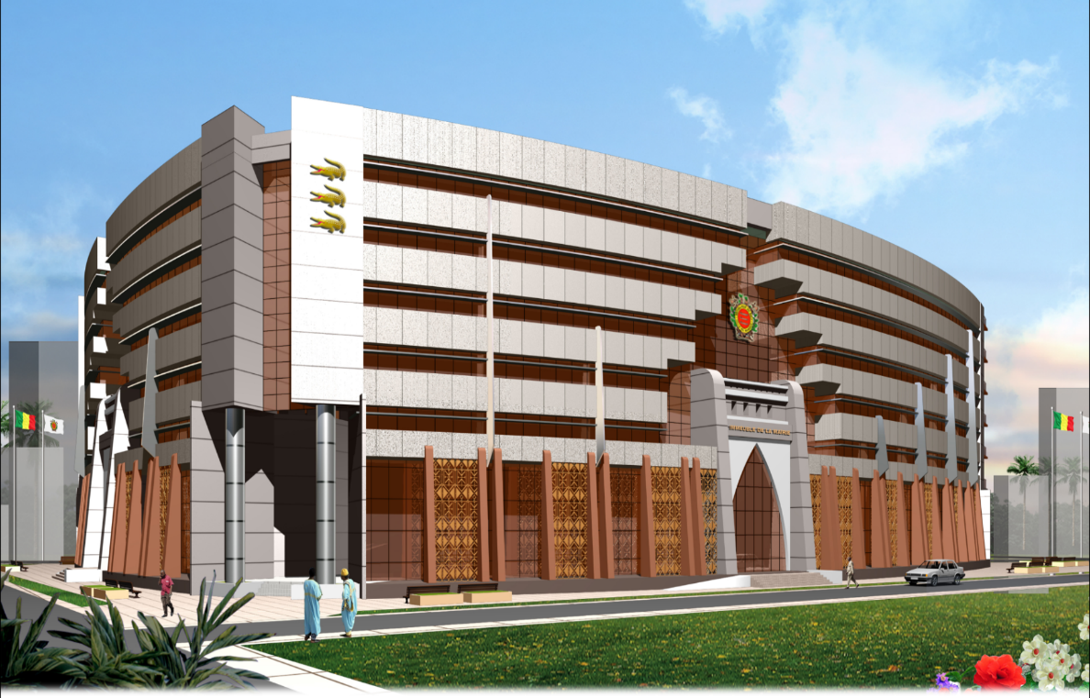
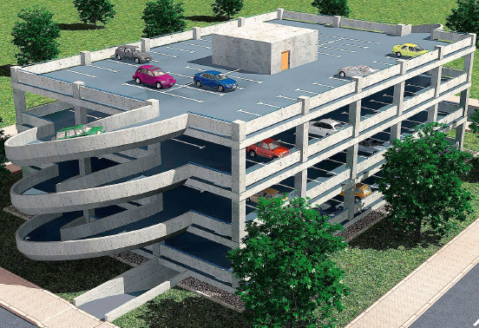
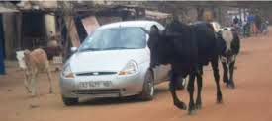
Private capital opportunities
Rapid Capital Assessment
Bamako
Financing
Land value capture
Tax collection
Good regulatory framework
Strengthening city’s technical support
Pipeline portfolio of PPP projects
PPP Track Record | Regulatory Frameworks | Procurement Capacity | Government Co-Financing
Real Estate Market Capacity | Land Use Regulations | Land Cadaster / Land Data Management | Security of property rights | Local Fiscal Powers | LVC track record

Slide 5
Our Project, Our Numbers
Bamako
Phase 1 : 2 X 80 M$
Phase 2 : 2 X 80 M$
Financing sources:
Local government, local land owner
Investor risk:
Parking
Termination of contract
→ IDA Private Sector Window Guarantee
Return on investment: 20 %
Pay-back period: 5 years
Deferred dividend to other investors
COME BOOT WITH US
20+ YEARS

