Slide 1
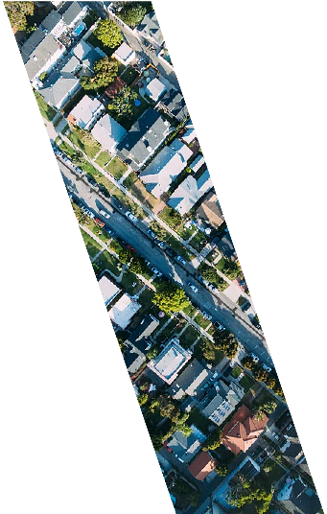
Douala
A cutting-edge project to unlock the city’s economic potential

Slide 2
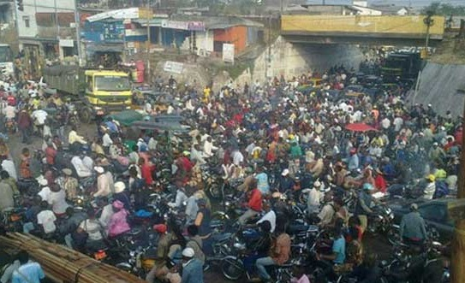
Urban mobility is an issue…
Douala
Douala is Cameroon’s main economic hub and port of entry:
  32% of national GDP
  5.5% annual population growth.
  2.7M -> 4M inhabitants in 2025
Congestion is the main bottleneck of city’s competitiveness (World Bank report: Cameroon City Competitiveness Diagnostic)
Public Transport is mainly informal, inefficient, pollutant
  83% of motorized trips are done by public transport, out of which 40% by moto taxis
  Low individual motorization rate, high dependency of the population to public transport
Notes:
Douala est le poumon economique du Cameroun avec une croissance qui ne se dement. 32% du PIB, 5.5% de croissance / an pour atteindre 4M hab en 2025. Potentiel enorme
Une analayse de la Banque Mondiale a montre que la congestion etait le frein principal a son development.
Les gens dependent du systeme de transport colletifc qui se revelent inffeicace et dominie par des modes informels et dangereux (moto-taxix)
Nous, GoC, CUD avec l’appui des donneurs (WB+AFD) avons decide de s’ attaquer au probleme pour liberer le potential de la ville.
On a developpe une veritable strategie de dvts des TC qui s’ integer dans une vision integree amanegement/transport.
Douala is 2.8M -> 4.0 in 2025, 5%/an. Economic capital of Cameroon. 32% du PIB national. +5% GDP growth
Need to unlock the competitiveness: solve the mobility issue
The city comes with a plan to restructure the urban pt network.
We the help of the WB and other donors (AFD), we are preparing a masisve prioject that will change the face of the city, unlock its potential: build mass-ytrasnit systems (BRT) and raise opportunities
MINDHU, CUD all stakeholders engaged
Strategies already approved and agreed.

Slide 3
…. But we can solve it!
Douala
Government of Cameroon, Douala Urban Council with the help of donors (World Bank, Agence Française de Développment, etc) have started the preparation of a WB-financed project
Comprehensive transport strategy in an integrated land use and public transport vision :
  Mass transit corridors with segregated lanes (Bus Rapid Transit or BRT)
  Bus public transport network restructuring
  Taxis fleet renewal
Project status
  Lots of preliminary studies
  Preliminary design for identified BRT corridors
  High ridership potential
Private investors have already shown interest for BRT
Existing successful best practices worldwide for fleet renewal leasing mechanism
Notes:
Nous, GoC, CUD avec l’appui des donneurs (WB+AFD) avons decide de s’ attaquer au probleme pour liberer le potential de la ville.
On a developpe une veritable strategie de dvts des TC qui s’ integer dans une vision integree amanegement/transport.
Cette strategie repose sur des
axes de TC et
une restructuration
Renouvellement de la flotte existante
des etudes prelimnaires ont montre le potentiel de plusieurs coridors (10 000 ppphpd) et du design prelimnaire
Des partenaires prives ont manifeste leur interet spontane et mene les etudes. Nous GoC souhaitons engager une procedure PPP transpaarente
Des precendetes experiences ont prouve , acteur public en place
Pictures: BRT corridors. Restructuring the PT network to serve the cities
pre-feasibility studies to be refined
More studies
Agreement

Slide 4
…. But we can solve it!
Douala
Government of Cameroon, Douala Urban Council with the help of donors (World Bank, Agence Française de Développment, etc) have started the preparation of a WB-financed project
Comprehensive transport strategy in an integrated land use and public transport vision :
  Mass transit corridors with segregated lanes (Bus Rapid Transit or BRT)
  Bus public transport network restructuring
  Taxis fleet renewal
Project status
  Lots of preliminary studies
  Preliminary design for identified BRT corridors
  High ridership potential
Private investors have already shown interest for BRT
Existing successful best practices worldwide for fleet renewal leasing mechanism
Notes:
Nous, GoC, CUD avec l’appui des donneurs (WB+AFD) avons decide de s’ attaquer au probleme pour liberer le potential de la ville.
On a developpe une veritable strategie de dvts des TC qui s’ integer dans une vision integree amanegement/transport.
Cette strategie repose sur des
axes de TC et
une restructuration
Renouvellement de la flotte existante
des etudes prelimnaires ont montre le potentiel de plusieurs coridors (10 000 ppphpd) et du design prelimnaire
Des partenaires prives ont manifeste leur interet spontane et mene les etudes. Nous GoC souhaitons engager une procedure PPP transpaarente
Des precendetes experiences ont prouve , acteur public en place
Pictures: BRT corridors. Restructuring the PT network to serve the cities
pre-feasibility studies to be refined
More studies
Agreement

Slide 5
:
Private capital opportunities
DOUALA
We can see gaps and weaknesses in the Public Private Partnership (PPPs) regulatory framework and representation
A lot of ongoing initiatives :
  “Guichet unique” for issuance of urbanism documents,
  Ongoing municipal finances reform financed by AFD grant
  recurring PEFA (Public Expenditure and Financial Accountability) assessments : 2012 and ongoing
Notes:
Dans le projet, il y a une cpomplsante capaite building + PDVIR + appui municipal pour se mettre au niveau
Il y a eu des assessment mais tous un tas d’intitiaves en cours: appui municipal, appui AFD, appui Banque, IFC interveient aussi

Slide 6
Our Project, Our Numbers
DOUALA
BRT Infrastructure financing: WB and other donors loans for up to USD250M
Expected private sector participation for BRT :
  10-year concession
  CAPEX ~USD50M (assumption: 30% equity and 70% debt)
  Potential WB guarantee on the debt
  Private sector would finance, purchase, maintain and operate the Rolling Stock
  Operational risks on the private operator
  Revenues risks transfer to be assessed: full commercial risks or cap-and-collar mechanism (potential revenue guarantee needed)
Other opportunities for private investors in the project:
  Design-build-operate: Transit-oriented Development / Land Value Capture around the stations
  Leasing mechanisms for taxi fleet renewal
Investment Snapshot
Investment cost | 50,000,000
Debt Equity ratio | 70:30
Equity IRR | 20%
Payback period | 6.5 years
Debt tenor | 10 years
Interest rate | 10%
Risk sharing | The local authorities might provide a revenue guarantee to the operator to mitigate the commercial risk.
 | Conversely, we might envision that any return in excess of 20% would be split between the private operator and the local authorities.
Notes:
Public sources: WB + AFD / 200M~250M$
Private sector:
operate the BRTS + invest in RS
Renew the fleet (investors)
LVC around the stations
Investors and transactions advisors:
Transaction advisors
Develop building investor (stations)
BRTs investors/operators through PPP
The opportunities
Already some successful PPP in Cameroon
Lots of ridership demand
Lots of commercial opportunites
Risk mitigation
Already some successful PPPs in Cameroon
Some public-private investors
Track records from the CUD on Public Transport
Lots of preliminary contacts with local transporters

