Slide 1
PROPOSED WATER, SEWERAGE & RIVER SOSIANI NATURE PARK PROJECT FOR ELDORET TOWN
By
H.E Jackson K. Mandago
Governor Uasin Gishu County, Kenya

Slide 2
Introduction
Eldoret Town is the fifth largest town in Kenya with an estimated night population of over 750,000
The town has been classified as one of the fastest growing towns in Kenya
Africa Economic Zones Ltd (AEZ) recently been awarded a license to develop and operate Kenya’s first licensed Special Economic Zone in Eldoret, Uasin Gishu County.
The AEZ project is expected to attract over $2 Billion of investment into the region as well as creating over 40,000 direct jobs and up to 150,000 indirect jobs once it is fully operational.

Slide 3
Cont’
Therefore there is an urgent need to develop new water sources to supply the AEZ site, Eldoret town and its environs.
The sewer network in Eldoret town covers less than 30% leaving the rest dependent on onsite sanitation.
The town has two sewage treatment plants with a combined design capacity of treating 18,000 m³/day operating at 60% capacity.
There is need also to conserve River Sosiani passing through Eldoret town to attract both local and international tourist.

Slide 4
Objectives of the Project
1. Water Supply
To provide sufficient water supply to Eldoret town, AEZ and the neighboring communities.
2. Sewerage System
To improve overall sanitary conditions in the target areas through sewer connections leading to reduced diseases prevalence .
To increase utilization of the existing capacities in the sewage treatment plants.
3. River Sosiani Nature Park
Increased Citizens access and utilization of public space, connectivity with the parks and other recreational opportunities.
Promotion and preservation of an adaptable, innovative and responsive urban heritage character.

Slide 5
PROPOSED SEWER PROJECT SANITATION MASTER PLAN

Slide 6
PROPOSED WATER PROJECT
Construction of a new Kerita Dam with the capacity of 25 million cubic meters.
Construction of a new water treatment plant to produce 18,000 m³/day.
Construction of storage tank and treated water gravity main to the AEZ and Eldoret town.
Construction of the water distribution network within the AEZ, Eldoret town and the neighbouring communities.

Slide 7
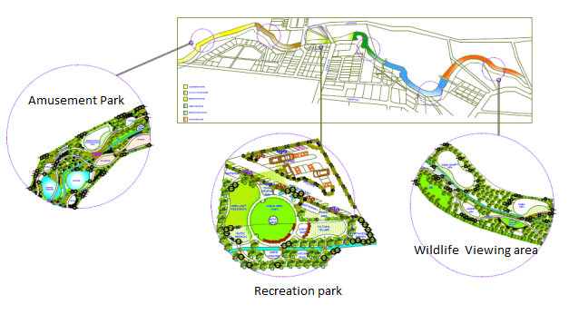
PROPOSED RIVER SOSIANI NATURE PARK
Landscaper’s impression of the Nature Park’s components layout along the River

Slide 8
EXPECTED BENEFITS
Improved Water and Sanitary conditions in the project area with over 80% connectivity by the fifth year.
Reduced ground water pollution and water borne diseases.
Sustainable water supply to the proposed African economic Zone, Eldoret town and its Environs.
Enhance social cohesion, urban greening, employment and urban safety.
Increased revenue collection.

Slide 9
Key Stakeholders
Uasin Gishu County Residents
Community Based Organizations
Kenya Association of Manufacturers
Chamber of Commerce and Industry
National Environmental Management Agency
Institutions of Higher learning
Government Agencies
Development Partners
Eldoret Water and Sanitation Co. Ltd (ELDOWAS)

Slide 10
PROJECT FINANCING
The project cost is $200m with the World Bank and local municipality providing 5% of the equity.
The project can be financed through loan, partnerships or Concession with a repayment plan of 15 years.
All regulatory frameworks have been put in place.

Slide 11
Thank you all and welcome to Eldoret city!

