Slide 1
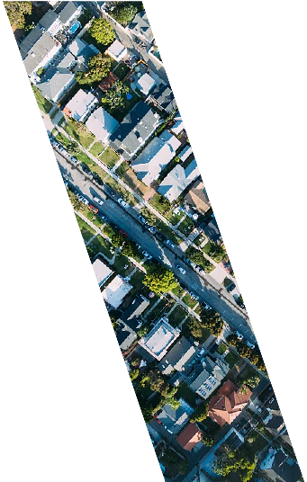
Nakuru City
Nakuru Agro City

Slide 2
AGRO-PARK
Nakuru City
BACKGROUND;
Nakuru County is one of the fastest growing Counties (of 47 total counties) in the Republic of Kenya over past decade and covers 7,498.8 Km². The County has an estimated population of 1.6 million as per 2009 census.
It is endowed by abundant Agriculture produces which include; maize, beans, Irish potatoes, sweet potatoes, vegetables, herbs, spices fruits and cut flowers.
However, Nakuru County has yet to capitalize on the full potential of its Agribusiness as most off the raw produce are exported to processing centers in other parts of Kenya
There is an expected ready market for products partly as a result of the rapid urbanization in the proposed Nakuru City as well as the rise in the size of middle class.
To address these this gap and unlock Nakuru County’s economic potential, the County has proposed the development of an Agro-park SEZ that will house industries providing value added products/services of selected variety of crops and livestock products.

Slide 3
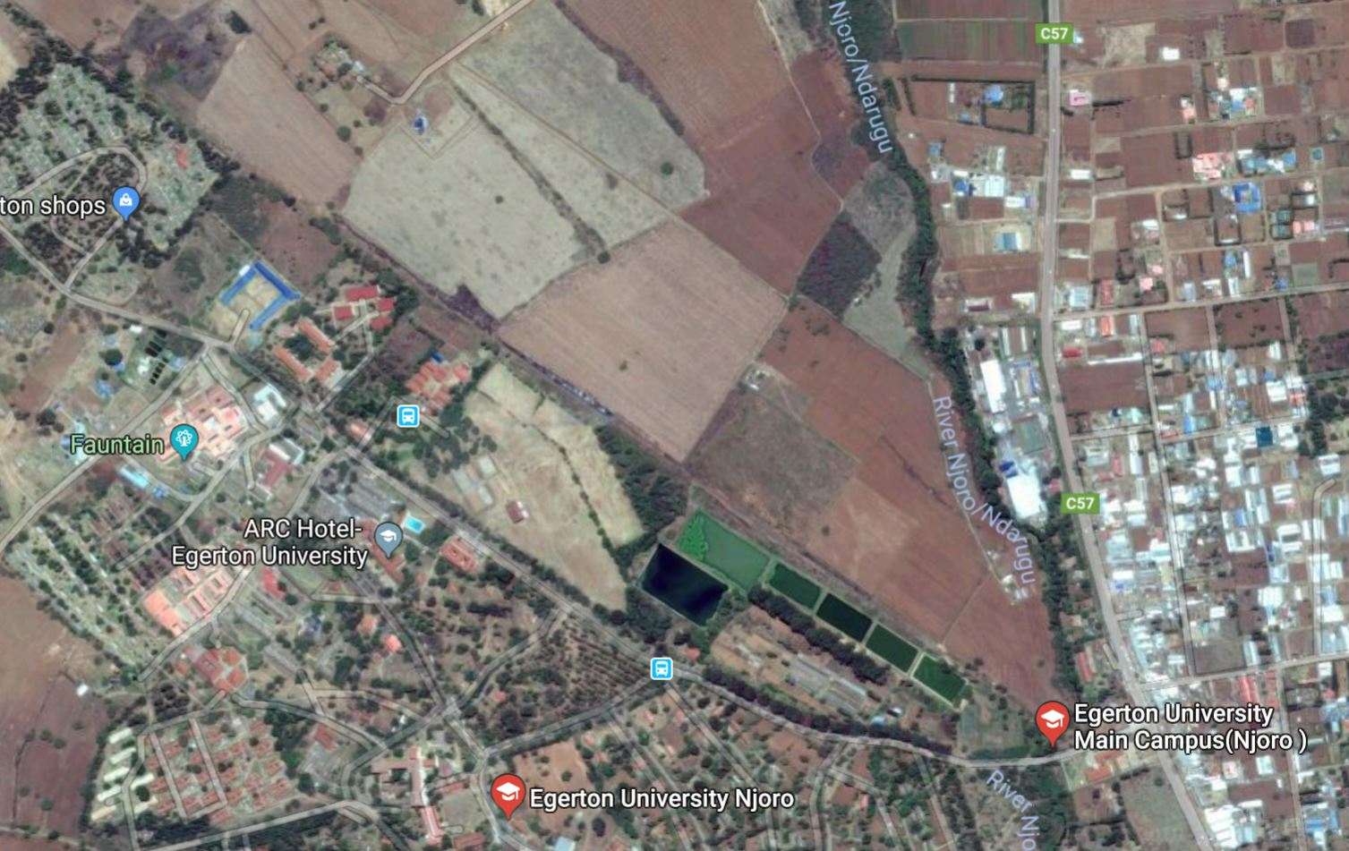
Project Concept
Nakuru City
Nakuru Agro Park Project:
The proposed project includes development of a 100 ha SEZ focused on Agri-business that will create linkages to local agricultural suppliers, enabling local producers to access attractive markets that demand high value, high quality and safe agri-food products.
The project concept note aligns to Nakuru County’s Medium Term Planning development planning objectives and is well positioned in terms of availability of infrastructure, bulk services, and workforce::
Strategic geographical location as a transit route to Western and Northern Kenya as well as land locked Countries .
Close proximity (<70 km) to newly developed 2nd Phase of the Standard gauge railway
The town is served by the direct Power Supply from Menengai Geothermal Energy Plant that is less than 20 KM away.
Egerton University locally situated alongside other International Partners will provide lead in technical assistance infeasibility studies and designing the project.
The SEZ designation will also cut investment cost by over 30% and save investors on income taxes for 10 years.
An initial prefeasibility study by the a local University has demonstrated the technical feasibility for the project.

Slide 4
Private capital opportunities
Nakuru City
RCA results
The city of Nakuru itself has notably two PPPs pipeline: the Nairobi – Nakuru- Mau Summit Highway project (in tender) and the Nakuru Integrated Solid Waste Management Project.
The County Government will work the County Assembly localize the National PPP Act through guidelines and regulations.
Nakuru County Spatial Plan 2014-2024 has been developed by the Lands Department. Any development plans being made within the county must be aligned to it.
PPP Track Record | Regulatory Frameworks | Procurement Capacity | Government Co-Financing
Real Estate Market Capacity | Land Use Regulations | Land Cadaster / Land Data Management | Security of property rights | Local Fiscal Powers | LVC track record
 | Subject to revision

Slide 5
Our Project, Our numbers
Nakuru City
Probable source of fund will come from development banks in form loans and grants.
Nakuru County balance sheet will be strengthened by potential cashflows from revenue share agreement with geothermal plant operator
Project stakeholders will include the National Treasury, the World Bank and other Development Banks, the Private Sector, International Consultants and Partners.
The public sector Stakeholders will carry mainly the security and political risk while the private sector partners will carry the technical and construction risk.
We therefore welcome for Investors to hedge their investments in the leading City of Choice in Kenya and arguable the face Kenya.
The County forecasts that the project will require USD 500 million to implement based on the initial estimated financial outlay

