Slide 1
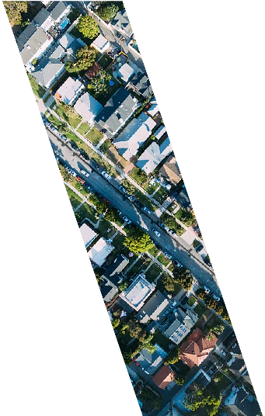
DANANG
Public Transportation System Project
Metro – Tramway

Slide 2
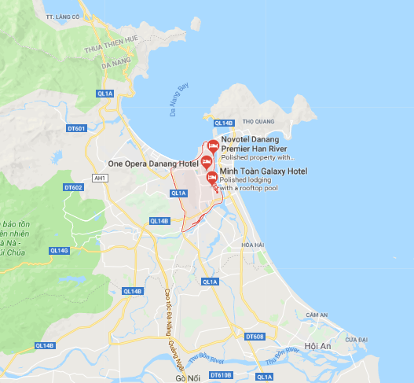
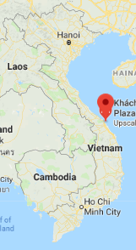
PUBLIC TRANSPORTATION CHALLENGES
DANANG
In the central of Vietnam
Population: 1.6m (2020)
Area: 1.28m km² (CBD: 250,000 km² )
Urban population density: 3,800 people/km²
Number of Tourists: 7m (2017)
Simple an inefficient existing public transportation (9 routes of bus inside CBD and from Danang to Quang Nam)
Challenges:
Traffic congestion
Out of capacity of transportation system
Environmental problems (lack people using public transportation)
Notes:
Credit: Flaticon.com

Slide 3
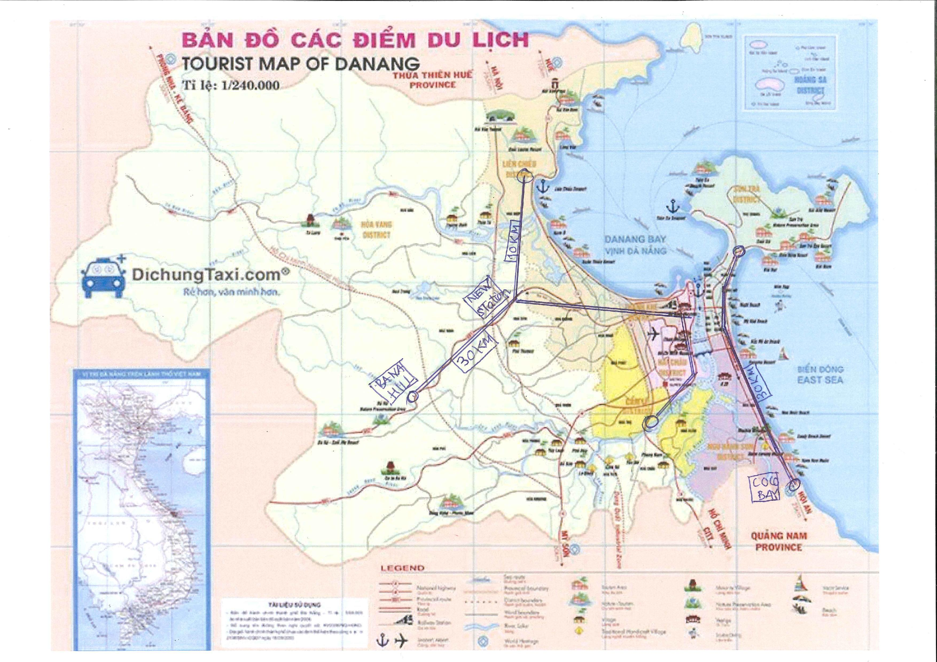
…. we can solve it!
DANANG
Project Description - Metro system links the North and South urban area through the city center (50km) with 15 stations - Tramway from Danang to Hoi An ancient town (30km) with 5 stations Estimated Project Value $8 billion Project duration: 20-30 years

Slide 4
Private capital opportunities
DANANG
DANANG RCA Results
Opportunities:
Experience in doing PPPs
Legal framework about PPP
Legal framework for Granting Land Use Rights.
Challenges:
Lack of experiences in PPP Procurement in Public Transportation and on this scale
Limited Budget of the local government for co-financing.
Uncertainty in Real Estate Market Demand.
A need for an approval of the national government for a big scale project.
Lack of accurate cadaster data.
Difficulties in Land Clearance and Resettlement.
PPP Track Record | Regulatory Frameworks | Procurement Capacity | Government Co-Financing
Real Estate Market Capacity | Land Use Regulations | Land Cadaster / Land Data Management | Security of property rights | Local Fiscal Powers | LVC track record

Slide 5
Our Project, Our Numbers
DANANG
The project structure
PPP
Design-Build-Operate-Transfer
Project duration 20-30 years
Local government:
Will provide land
Will regulate the ticketing policies
Will cover part of the capital expenditure (approx. 10%)
Private Investors:
Will provide financing for the project
Will Execute the project
Will collect tickets & other revenue
Development rights of the station area (included an area of land surrounding).
World Bank Participation
Supporting the city government in:
Technical advisory
Feasibility study
Project Planning
Procurement Procedures
Private capital acquisition
Lending, if necessary

