Slide 1
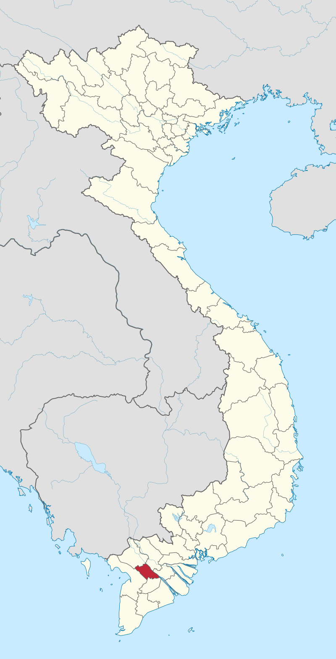
Can Tho, Vietnam
Leveraging private capital in response to Can Tho wastewater problem

Slide 2
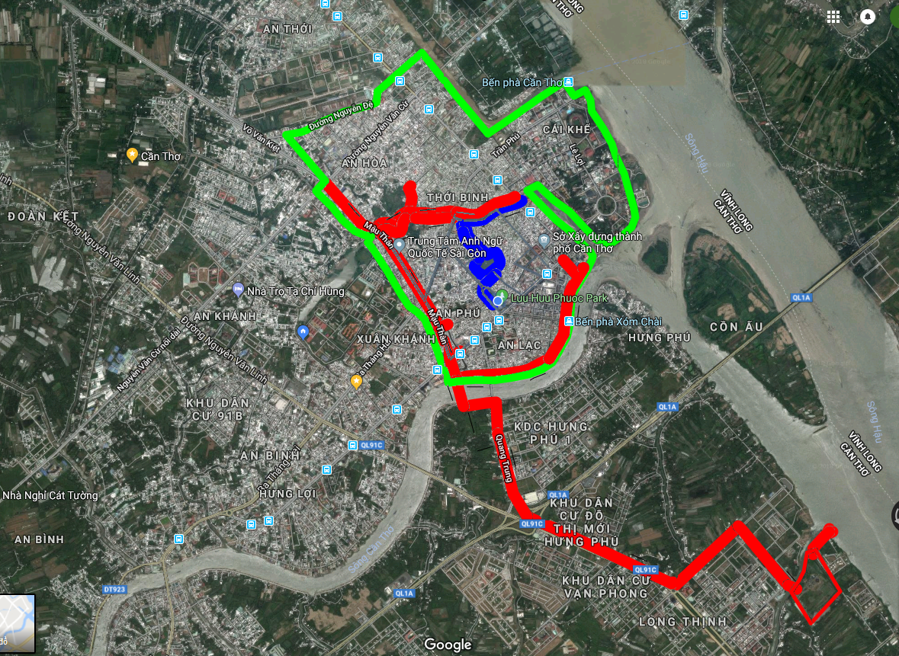



Lack of wastewater treatment
Can Tho
Only 50% of city core urban area is covered by current wastewater treatment system, which means:
almost 0.5 million people in the city center and 1 million people in agglomeration (70%) live without access to sewage treatment
70% sewage is not treated and discharged directly to the rivers polluting water sources which has other environmental and health implications.
Technology used in the existing plant is outdated and does not meet recently introduced national standard.
Notes:
Credit: Flaticon.com

Slide 3
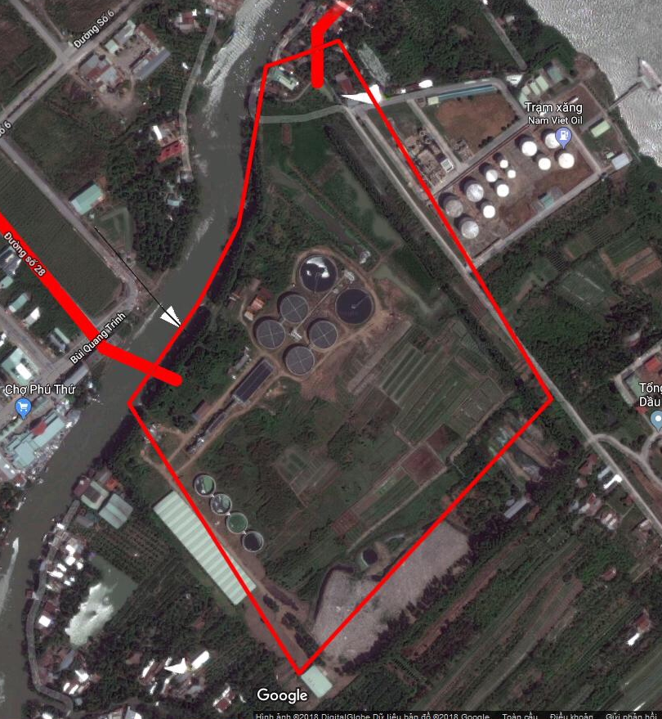
Wastewater Treatment Plant PPP
Can Tho
Leveraging private capital in response to
Can Tho wastewater problem
CAPEX: USD 60m
Project scope
Technology upgrade of the existing Wastewater Treatment Plant and 30,000m3 capacity expansion
Drainage network expansion
Operation and maintenance
Project status
Done to date: water drainage master plan 2030, socio economic plan 2016-2020 and preliminary assessment of water and drainage system by AFD
Next steps: City to issue REOI in 2019

Slide 4
Private capital opportunities
Can Tho
Challenges:
PPP Track Record | Regulatory Frameworks | Procurement Capacity | Government Co-Financing
Can Tho city limited PPP experience
existing tariff low; affordability if tariff increases
Opportunities:
Real Estate Market Capacity | Land Use Regulations | Land Cadaster / Land Data Management | Security of property rights | Local Fiscal Powers | LVC track record
good PPP track record in Vietnam and enabling PPP regulations
access to and support of institutions and professionals with strong PPP and transactional experience (i.e. WB CRP)
Can Tho city strong commitment to leverage private capital
City is committed to increase the tariff to be more market based

Slide 5

Financing Model
Can Tho
Financing model:
25-year design, build, finance, operate contract
What is asked from Investors?
Financial capacity
Commitment for timely delivery
Experience in technology and operation
Flexibility for renegociation
Stakeholders:
City Authorities:
secure land
regulate tariff
enforce environment standards
force majeure
Private partner:
design
construction
operation and maintenance
finance

