Slide 1
“EMEELT LIGHT INDUSTRY AND TECHNOLOGY PARK”

Slide 2
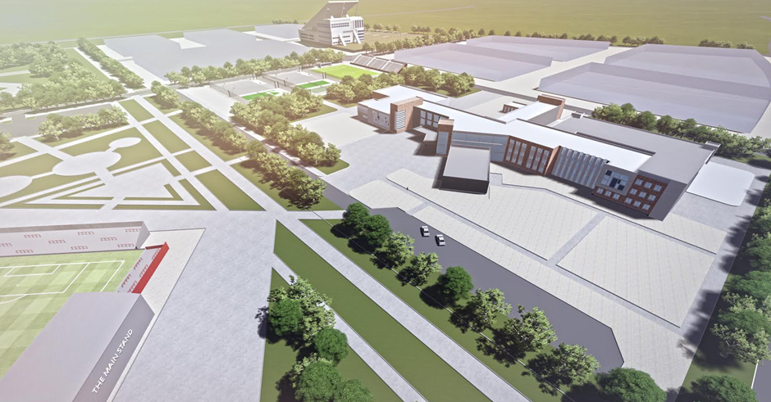
Emeelt light industry park highlights
Project founder:
Mongolian Government
Capital city citizen’s representative khural (City Council)
Mayor of Capital city (City Governor)
Requirement of project implement:
Tanneries in the Ulaanbaatar area have a negative impact on the environment especially related to air and environment pollution. This project aims to make tanneries more eco-friendly and use the latest available technology.
Project objective
Produce value added product, park tanneries will process 8.3 million hides and skins and 22 thousand ton wool and cashmere.
Decrease pollution of Tuul river
3500 direct job creation
Argalant- Emeelt will be developed over a period of 10 years from 2020 – It will be an important industrial park of Ulaanbaatar.
Purpose of the project:
The National program for the leather industry was developed with the objective to ensure the sustainable development of the livestock product processing industry. This is crucial for the economic development of the country in the achievement of the objectives of the Government to promote export-oriented industry.

Slide 3
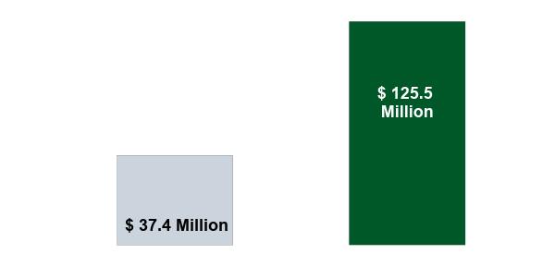
Economic analysis and benefits
Potential Value Creation in Leather Sector
Market Return and Product value creation
3x
Value Add
Current raw material export value
Finished leather export value at base price
Annual Sales revenue USD 125.5 millions
Net Profit: USD 21 millions
Total annual sales revenue would be MNT 307-450 billion (US$ 153 – 225 million) till deep processing stage and if final product will be manufactured, MNT 970 billion (US$ 435 million) would be earned.

Slide 4
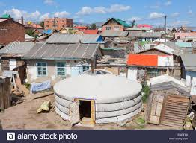
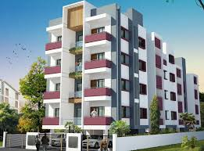
Social benefit

Slide 5
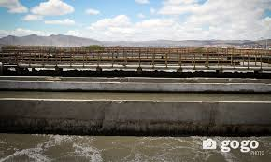
Environmental issue
Current Leather Processing
According to Ministry of Agriculture and Industry of Mongolia, 80% of total processing or 10 million hides and skins is just at first stage/ wet blue
Existing 36 Tanneries
1 сая ширхэг
4.5 сая ширхэг
Harmful to the Environment
Notes:
Нийт түүхий арьс ширний 80% гаруй хувийг дөнгөж анхболовсруулалт нь нийт боловсруулсан бүтээгдэхүүний ердөө ~ан шатны боловсруулалт хийж БНХАУ-руу экспортлож байна.
Арьс ширний салбарын нийт 1%-г эзэлж байна.
Үйлдвэрлэгчдийн хувьд эргэлтийн хөрөнгөгүйн улмаас Хятад худалдаачдын мөнгөөр үйлдвэрлэлийн түүхий эдээ худалдан авч байна.
Монгол улс жил бүр дунджаар 10,3 сая арьс шир бэлтгэгдэж байгаа бөгөөд 80-90% нь уламжлалт хөдөө аж ахуйн аргаар бэлтгэгдэж байна.

Slide 6
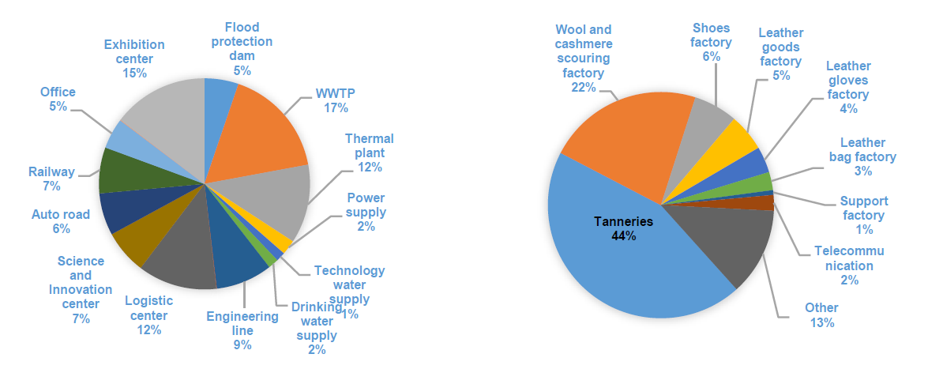
Financial summary
Million USD
Investment highlights
Total investment of project - US$ 322.1 million
Infrastructures investment - US$ 148.6 million
Factories investment - US$ 173.5 million
46 % of capital investment for infrastructure.
54 % of capital investment for factory.
Investment sources
Equity investment by private sector
Public private partnership
Economic estimation:
Profit rate of the estimated investment:
Net present value /NPV/ million - 736.7 US$
Rate of return /IRR/ - 19% (at 20 years)
DSCR- 1.4
Payback Period- 10-12 years
Emeelt park project requires preliminary investment of USD 322.1 million or MNT 787.3 billion.
Infrastructure investment structure Factory investment structure
Park income:
Heat income
Waste water income
Electricity income
Park admin fee

Slide 7
Emeelt light industry park highlights
Infrastructure
Flood protection dam ditch- 7.1 km length 98012,2294m2 volume, double water basin
Power supply system- 2.2km transmission line, 110/35/10kv sub station
Wastewater treatment plant- Factory capacity 12600m3/day, household capacity 7400m3/day
Thermal plant 100MW capability, 100t/h steam
Technology water supply- 6deep wells, 5.6km length line, with 2x2500m3 water basin
Drinking water supply- 5deep wells, 19km length line, 2x350m3 water basin
Communication- High speed fiber optic cable
Engineering line- 2.2km tunnel system, power, heating, communication, factory and household engineering line
Auto road- 18.38km
Railway- 8.6km railway from Songino branch railway

Slide 8
Project preparation
149th resolution “Emeelt light industry and Technology park” approved by Citizen Representative Council on Sep 08, 2014 about establishing industry area of local owned enterprise. The following steps will need to be carefully considered.
1. Feasibility study of “Industrial park”,
2. Initial general plan,
3. Blueprint of flood protection dam,
4. Blueprint of power supply,
5. Blueprint of technology water supply,
6. Blueprint of drinking water supply,
7. Technique and technology assessment,
8. Feasibility study regarding wastewater treatment in Ulaanbaatar
9. Power supply during the building phase
Some of the key advantages
A. Investors:
B. Factories :
1. Render policy support by setting up a light industry park, promoting collaboration among the manufactures and registering clusters according to ACTION PROGRAM OF THE GOVERNMENT OF MONGOLIA FOR 2016-2020.
2. To establish Emeelt light industry and technology Park which is to render policy support by setting up a light industry park, promoting collaboration among the manufactures and registering clusters according to ACTION PROGRAM OF THE GOVERNOR OF THE CAPITAL CITY AND MAYOR OF ULAANBAATAR FOR 2016-2020.
3. Investment allowance to investors according to law of investment.
4. This project will be implemented and funded on the public private partnership mode
1. Tax rebate and exempt:
- Free land charge according to law of free land charge,
- Free tax for real estate according to law of tax for real estate,
- An allowance for depreciation of fixed capital stock according to Income Tax Law,
- law about production support,
2. Law about export support
3. Socio-economic guidelines of industrialize light industry and technology park

Slide 9
PROJECT IMPLEMENTATION SCHEME
FINANCER
EMEELT LIGHT INDUSTRIAL PARK
Debt
Tax inceptives
Land fee
Corporate tax
Real estate tax
Debt service
EMEELT PROJECT JCS
UBDC
Equity
❶ Infrastructure
US$ 148.6 million
160 hectare
Project loan
Other service
IFIs
Service fee
Heat
Electricity
Waste water
Tenant fee
Service
Land
Total US$ 322.1 million
Service fee
Commercial bank
❶ Infrastructure
heat
water
WWTP
Electricity
Communication
Road
Loan
Construction material plant
Investment
Private sector
This project will be implemented and funded on public and private partnership mode.

Slide 10
THANK YOU FOR YOUR ATTENTION
“Ulaanbaatar development corporation” JSC
2017

