Slide 1
CITY OF KISUMU
Integrated Kisumu Lakefront Development proposal
Presentation to: CRP Conference in Bangkok- Thailand
By: Dixon Obungu- CECM-Kisumu County Government, Kenya
Date: 13/7/2018

Slide 2
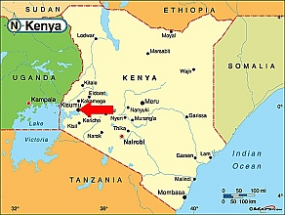
ABOUT KISUMU
-3rd largest city Kenya-
-Lies on the shores of Lake Victoria with borders to Tanzania and Uganda
-Population – I Million, more in hinterland
-Transportation hub for the western region and East African Countries via rail, road, water and air.
-The national SGR and Oil pipeline from Mombasa in the Kenyan coast terminates in Kisumu
-Has an ICD and oil jetty designed to serve East Africa

Slide 3
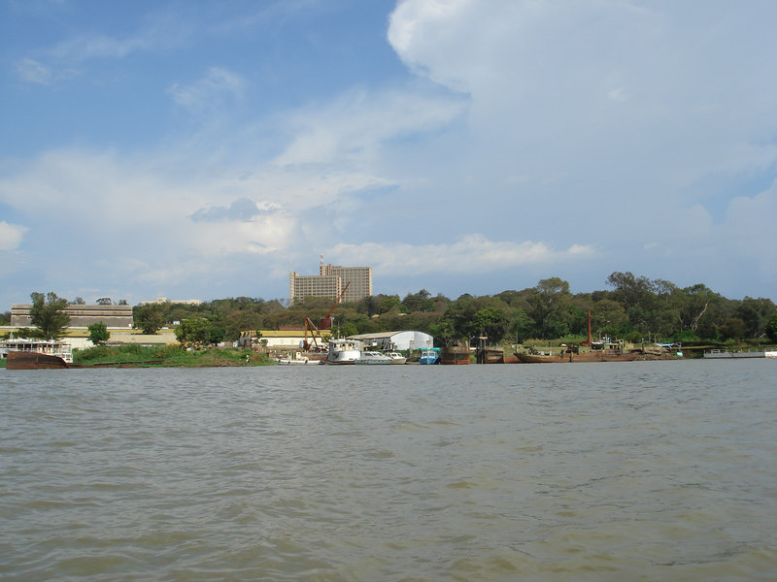
THE ISSUES
The city not facing thee lake
Large tracks of prime land immediately next to the lake lying idle or not being used optimally
City government not getting true value for prime land
Idle and unused land puts pressure on land due to rapid urbanisation and developmental needs
Exploitation marine industries and transport system rendered difficult
Government (county and national) with limited resources may not give the project a budgetary priority

Slide 4
RCA RESULTS FOR KISUMU
Comments
Improvements to be initiated in the identified areas with not so good scores
To address the unsatisfactory rating in LVC track record score a task force has been formed to look into and recommend solutions to myriad land issues bedevilling the city. The county government will implement the recommendations

Slide 5
LAKEFRONT DEVELOPMENT PROJECT PROPOSALS
REQUEST
Develop the lakefront areas for mixed use and recreational purpose. We are seeking a sum of $50 million through BOT arrangement for the infrastructure development covering the following:
Water management infrastructure, Roads, Pedestrian and cyclists Pathways, Raised boardwalk, Solar street lighting, green spaces development, public sports facilities , Piers for marine transport system, solar power generation, water and sewerage etc
Private developers to be allocated plots within the development to put up hotels, restaurants, offices and apartment blocks etc. This will be on a leasehold arrangement.
OTHER CONSIDERATIONS
Increased revenue to the city from property and business permit taxes
Promote urban sustainability both environmentally and economically
Eases pressure on demand for land for developments
Inhabitant and visitors able to enjoy the lake
Huge job creation opportunities during the development and when in use
Tourism potential in the region boosted
UN- Habitat already involved in the design of the project
The development identified in Integrated Strategy for urban development for Kisumu
Residents and business community supportive of the project

Slide 6
THE PROJECT DESIGN

Slide 7
THANK YOU

