Slide 1
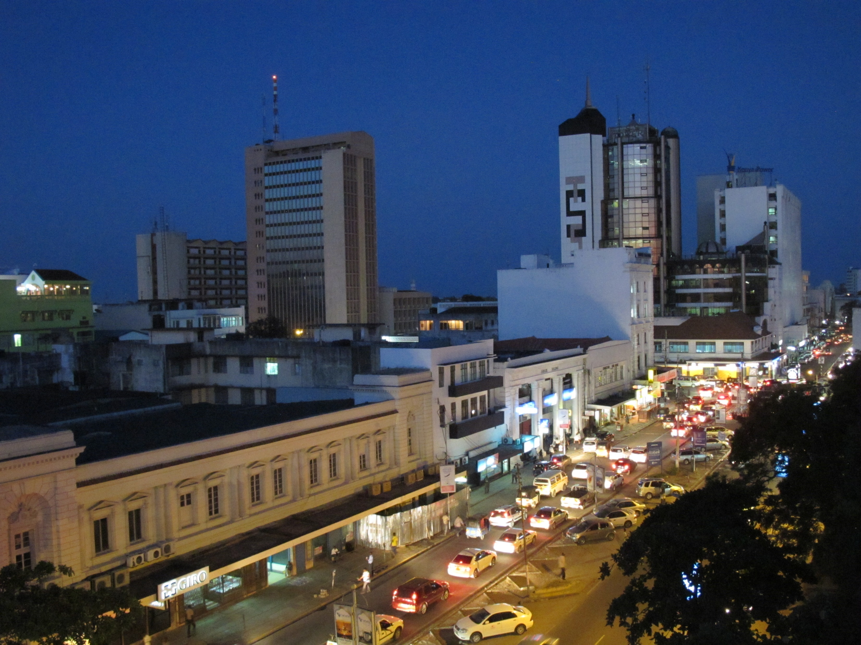

Mombasa Gate City
Land Resettlement programme
Mombasa County Government

Slide 2
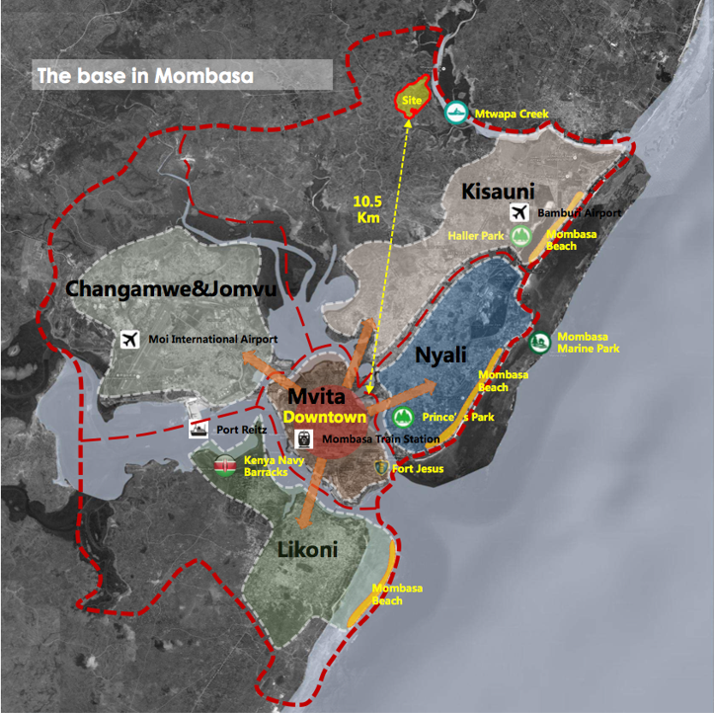
Land Tenure holding back city development
Mombasa City, Kenya
The
Problem
Problem Definition
The
Effect
Day population 1.2m, Night population 0.9m – 2.4m by 2040
380,000 housing demand gap
70+ informal settlements
60% labour participation rate
There’s urgent need to access long tenor funding to resettle Squatters and solve the land tenure challenges to unlock full value of the land and promote faster development of the city

Slide 3
Land Resettlement - The Numbers
Mombasa City, Kenya
Risk Mitigation Matrix
Risk Allocation
The
Cost
Repayment
Project at 95% self financing at 85% debt repayment ratio
In addition to the guarantee over the land tax revenues, the individual beneficiary land title will also act as collateral for the debt
Guarantee

Slide 4
The Opportunity
Private Capital
Mombasa City, Kenya
Long-term guaranteed stable returns on the resettlement programme
Expansion of the programme to include affordable housing for the beneficiaries
RCA Results – Mombasa City, Kenya
Track Record and Regulations in Structuring PPPs
Survey of Enabling Conditions for Land Value Capture (LVC)

