Slide 1
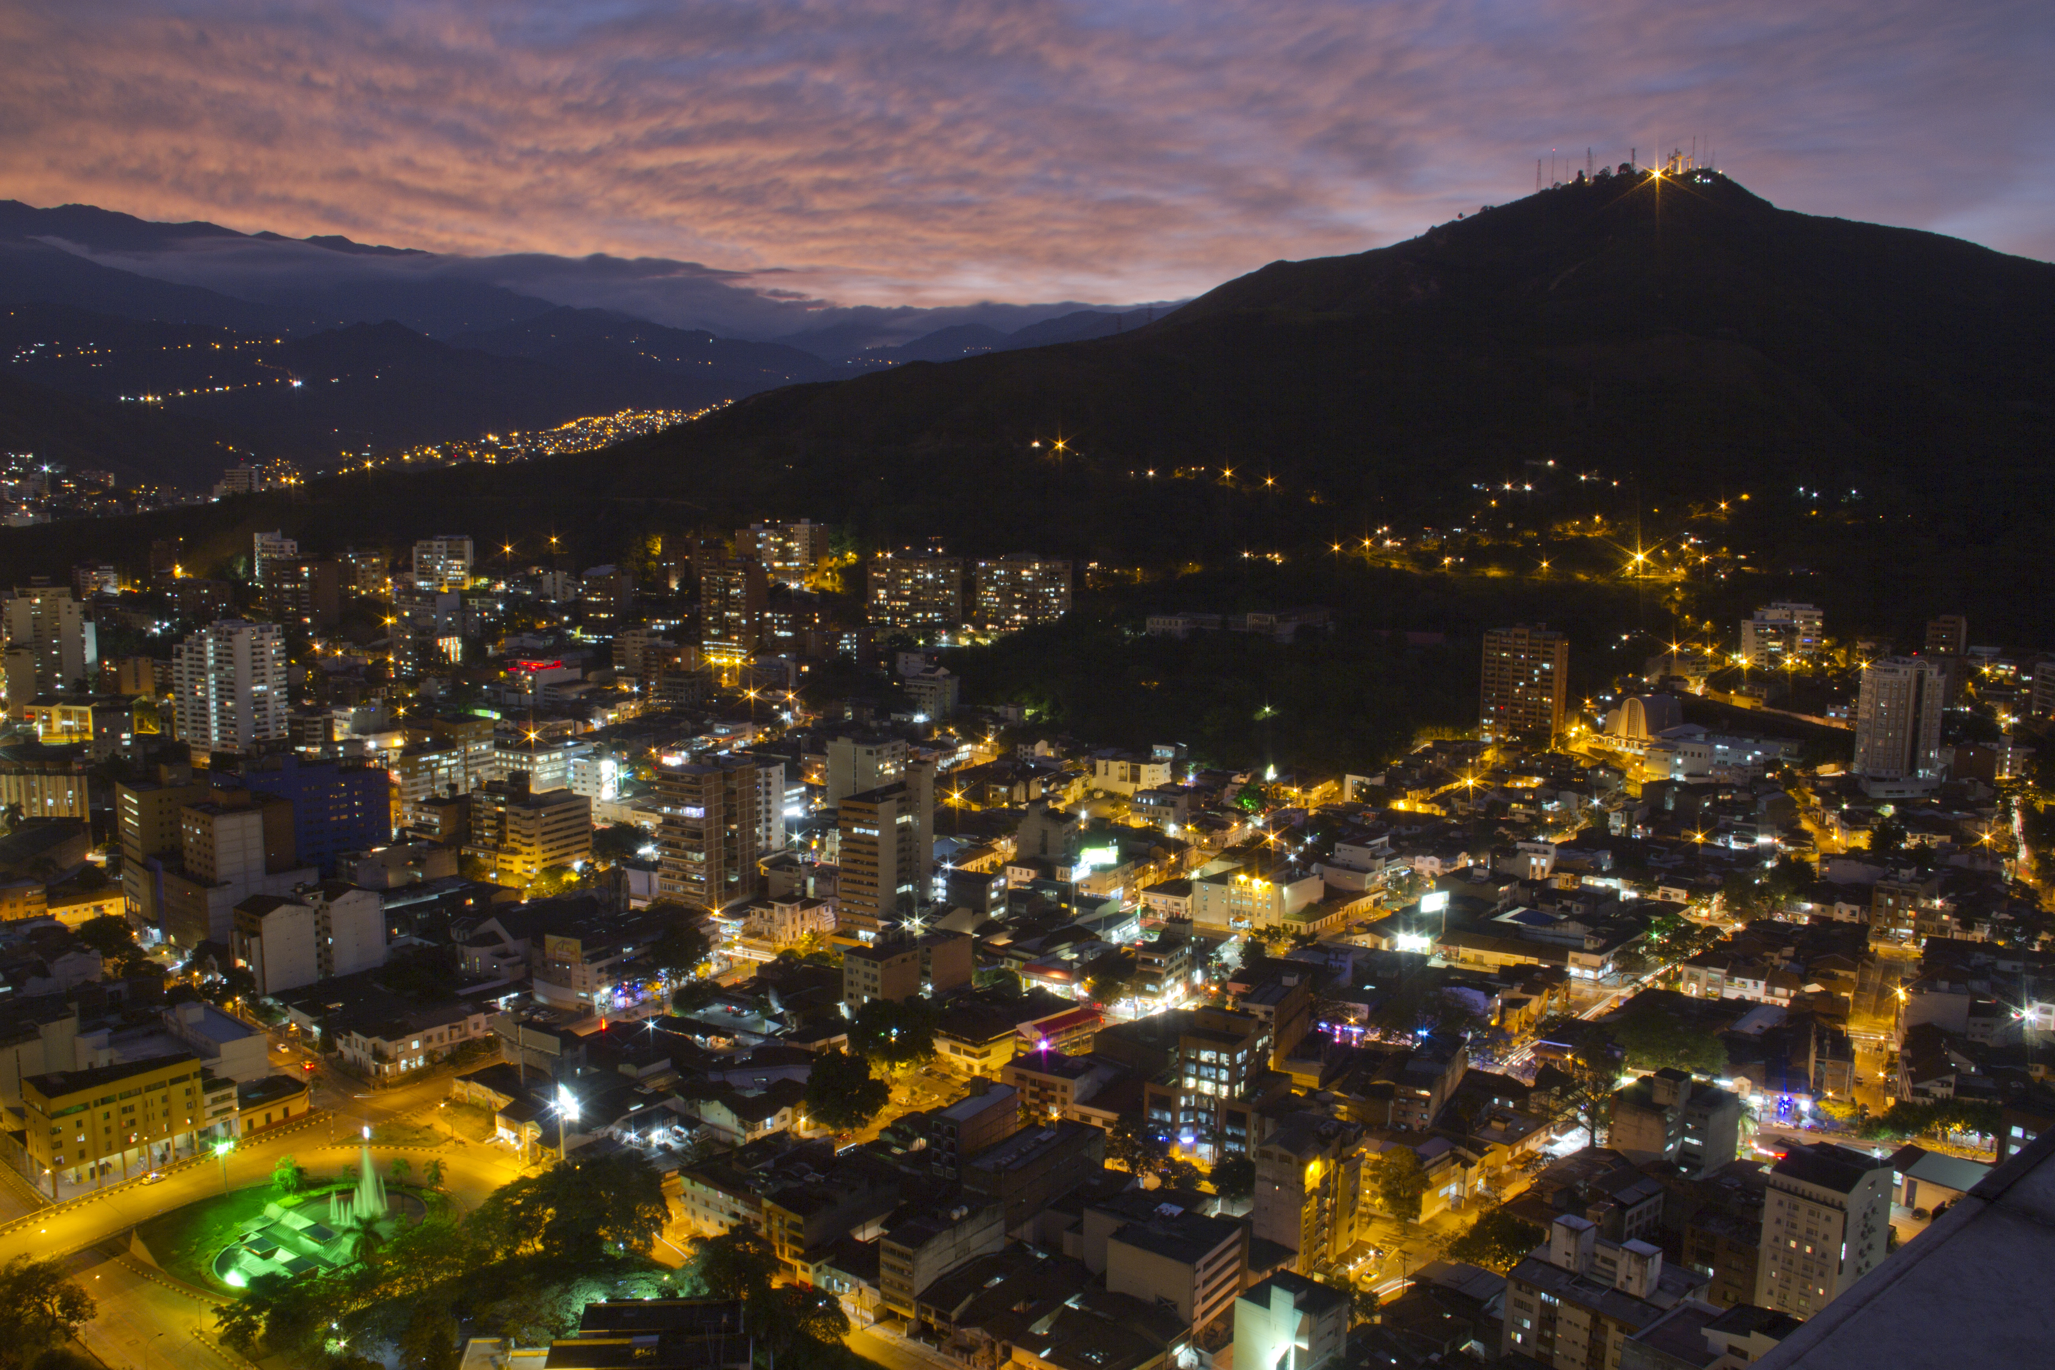
City of Cali
Water as the center for resilience development in Cali

Slide 2
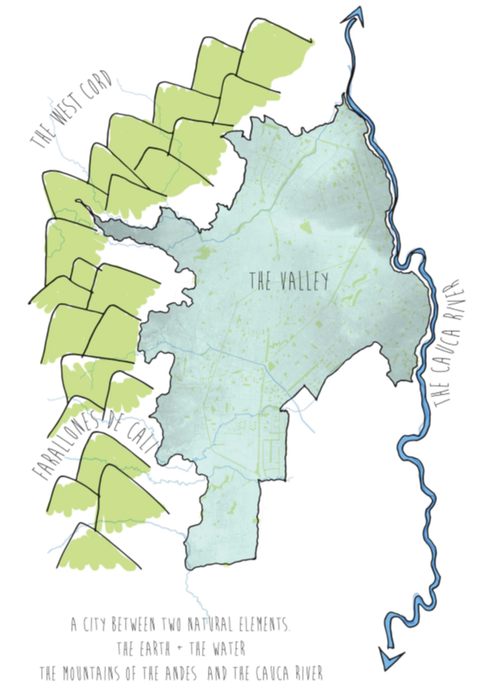
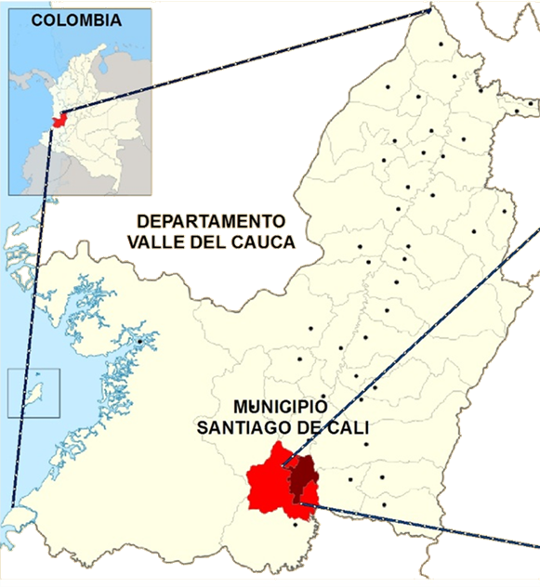
GENERAL INFORMATION
SANTIAGO DE CALI
3 27´21´´N, 76 32´0´´W
1.003 MSNM (Olgyay)
HABITANTES
2.344.703 CITY
2.959.384
METROPOLITAN AREA
HECTAREAS 12.090 HA
CENTRO. 367 (3.0%)
DENSIDAD 169 HAB/HA
CENTRO. 92 HAB/HA
TEMPERATURA MEDIA 24ºC
HUMEDAD MEDIA 70%-75%

Slide 3
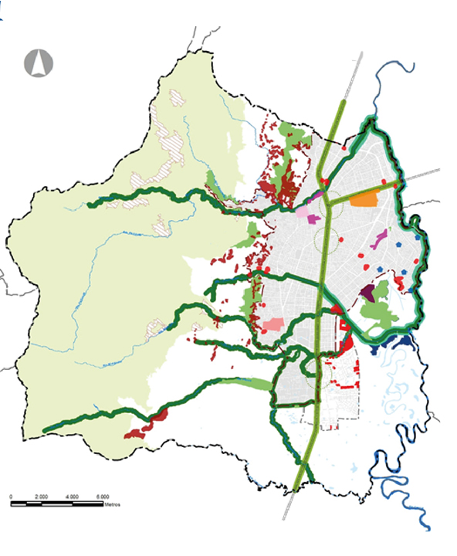
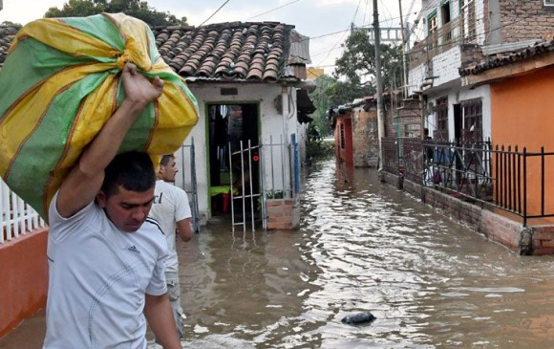
Problem as an opportunity
City of Cali
Notes:
Credit: Flaticon.com

Slide 4
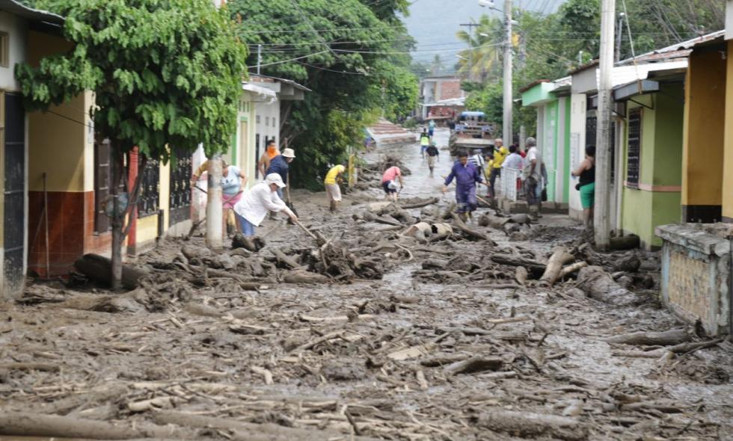

Slide 5
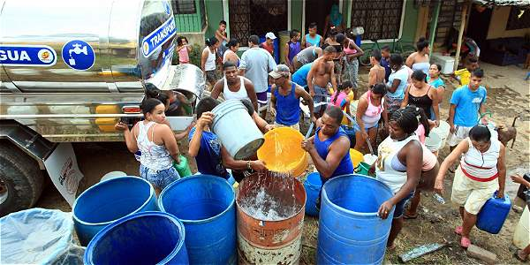

Slide 6
Comprehensive Watershed Management CWM
30 years City Master Plan
7 aspects
Comprehensive Watershed Management
Ensuring Quality and Quantity of Water Supply
Disaster Risk Reduction
Solid Wate Management
Urban Renewal
Real Estate Development
Sports and Recreation (linear parks)

Slide 7
Private capital opportunities
City of Cali
RCA results below
Track Record | Regulatory Frameworks | Procurement Capacity | Government Co-Financing
To be verified |  |  | to be verified
Real Estate Market Capacity | Land Use Regulations | Land Cadaster / Land Data Management | Security of property rights | Local Fiscal Powers | LVC track record
There is a low risk city scenario for the private investor.
Master Plan for the city has resources through projects at the Municipal Development Plan.
City has been working with the World Bank as a partner.

Slide 8
Our Project, Our Numbers
City of Cali
Project “0” for a City:
Comprehensive Watershed Management of the upper part of basin to guarantee quality and quantity of water.
$50 million dollars
Other phases of City´s Master Plan, depending on technical analysis.
Environmental fees as a counterpart
National fee guarantee by law of $1 peso per m3 consumption
Regional fee guarantee by law
Municipal fee guarantee by law of 1% of the City´s budget.
National fee+ regional fee + Municipal fee =
Estable Return

Slide 9
Gracias
FUENTE. BENOY ARCHITETS

