Slide 1
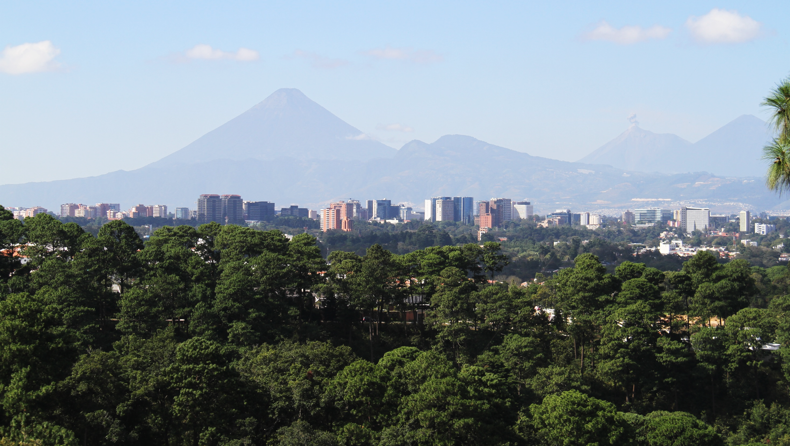
Guatemala City
Urban Clusters for Economic Development

Slide 2
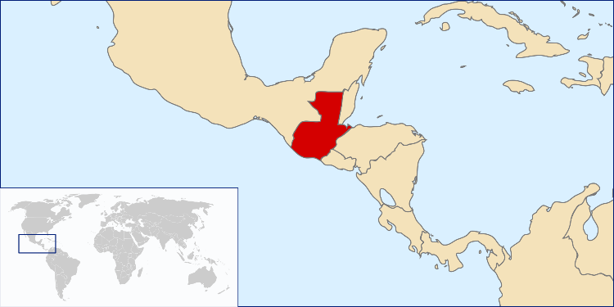
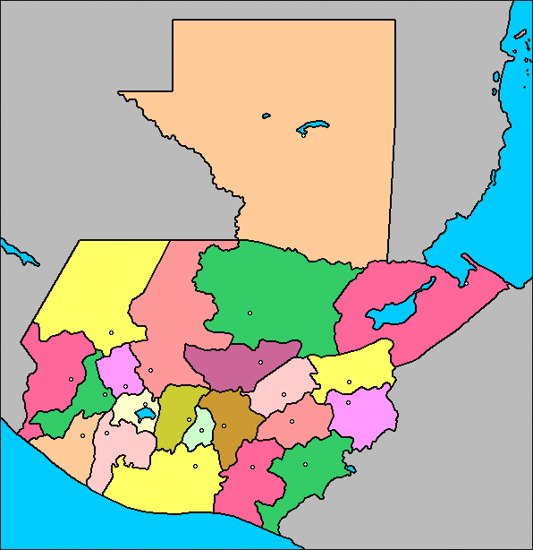
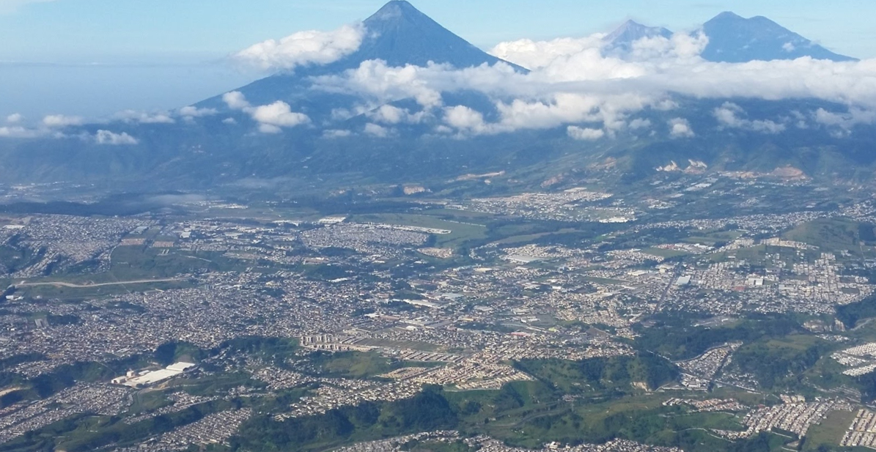
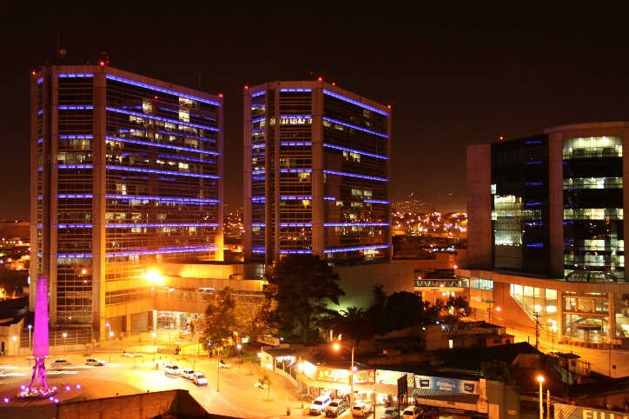
Population growth and urban sprawl are an issue
Guatemala City
Today: urban sprawl and low density development
1776
1821
2018
2032
2040
?
2,500
120,000
440,000
1.9 million
3.6million
Zone 4 District successfully redeveloped as a municipal experience through regulatory innovation
Notes:
Credit: Flaticon.com

Slide 3
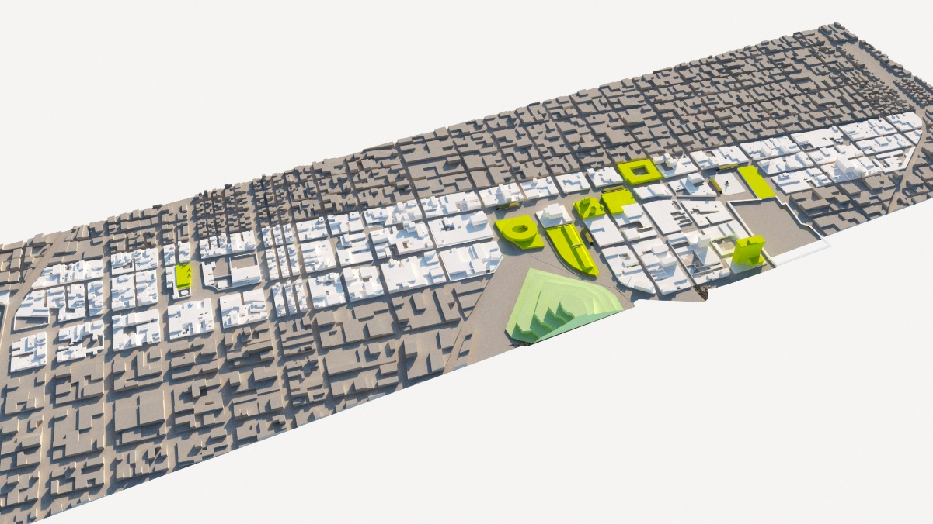
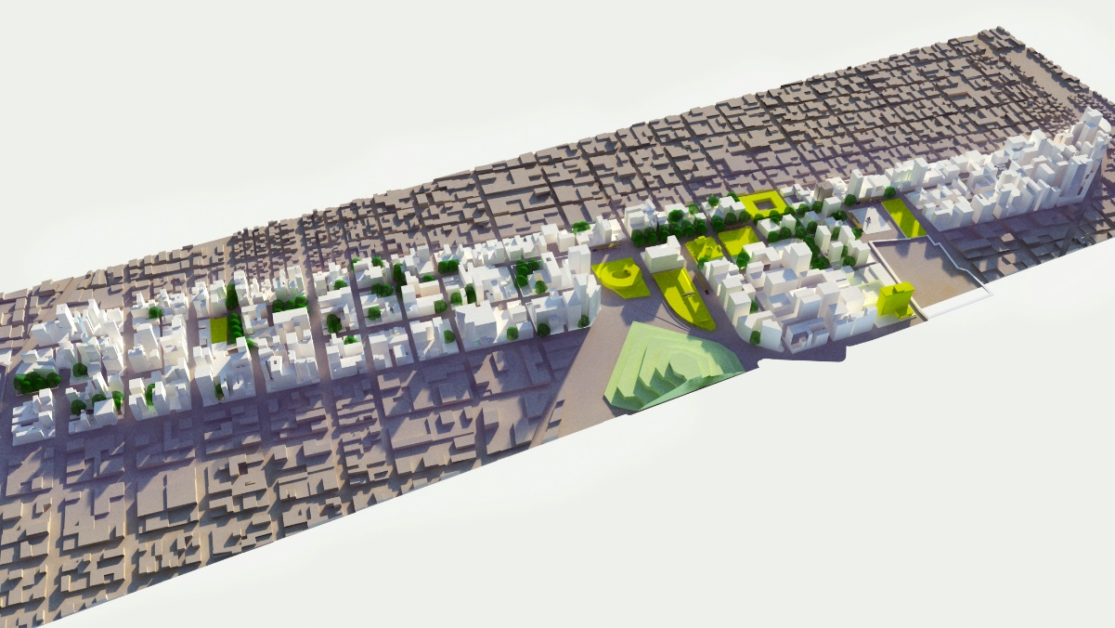
Through new urban tools we can solve the urban challenges!
Guatemala City
Urban Clusters for Economic Development
Calvario District
Project status: Master plan on design
480,800m2
Occupational footprint
Public Space = 23%
2,205
inhabitants
839,000m2
Occupational footprint
Public Space = 50%
118,000
inhabitants

Slide 4
RCA results
Private capital opportunities
PPP Track Record | Regulatory Frameworks | Procurement Capacity | Government Co-Financing
Guatemala City
Barriers:
Central government
Political problems and
Regulations
Challenges:
Economic special zone approval
Invest in infrastructure renewal
Identify the property owners
Attract investors and developers
Deals with informal Street vendors
Opportunities:
Low density area in prime location that can be developed in high rise buildings.
Same political party for the last twenty years.
Strong cadastrial instruments.
Succesful experience in property tax valuation and collection, urban renewal and land value capture (LVC)
City’s administration runs in SAP.
Real Estate Market Capacity | Land Use Regulations | Land Cadaster / Land Data Management | Security of property rights | Local Fiscal Powers | LVC track record
Track record diagnostic is underestimated:
We’re an island of efficency and transparency; model of institution and governance in the country

Slide 5
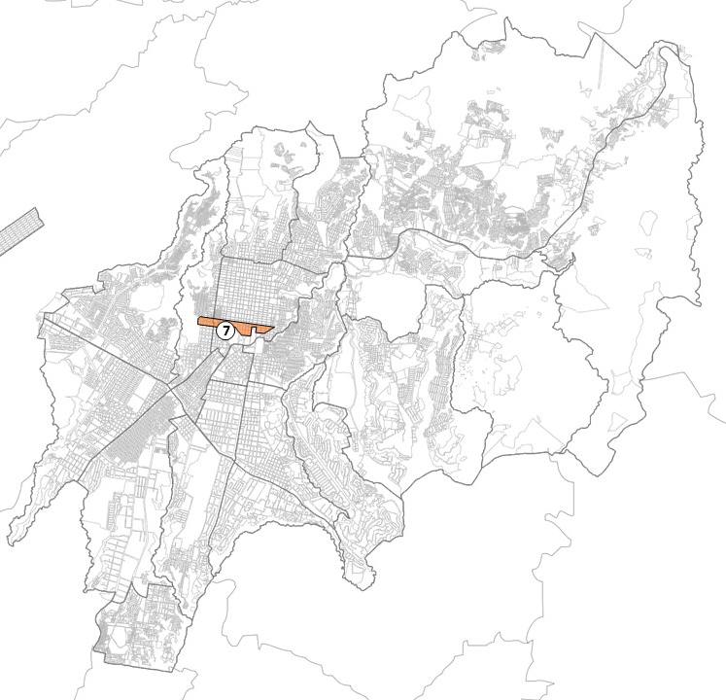
Cluster model financial strategy
Guatemala City
Year 1 | Year 2 | Year 3 | Year 4 | Year 5
Assessments: Legal and regulatory Financial Public and private infraestructure and services planning | Incentive and revenue instruments approval EX ANTE Rights selling for funding | Fund Rights release Phase 1 Execution Phase 1 Infrastructure investment | Fund Rights release Phase 2 Execution Phase 1 Infrastructure investment | Real Estate development Phase 1

