Slide 1


Slide 2


Send us your questions
Join at
slido.com
#GWEVision MHEWS
You can join the live Q&A by scanning the QR code or visiting slido.com.
Use event code #GWEVision.
Submit your own questions or upvote 👍 others.
We will answer them after the presentation.

Slide 3

A Vision for Numerical Weather Prediction in 2030
Presenter
Tim Palmer
Department of Physics
University of Oxford

Slide 4
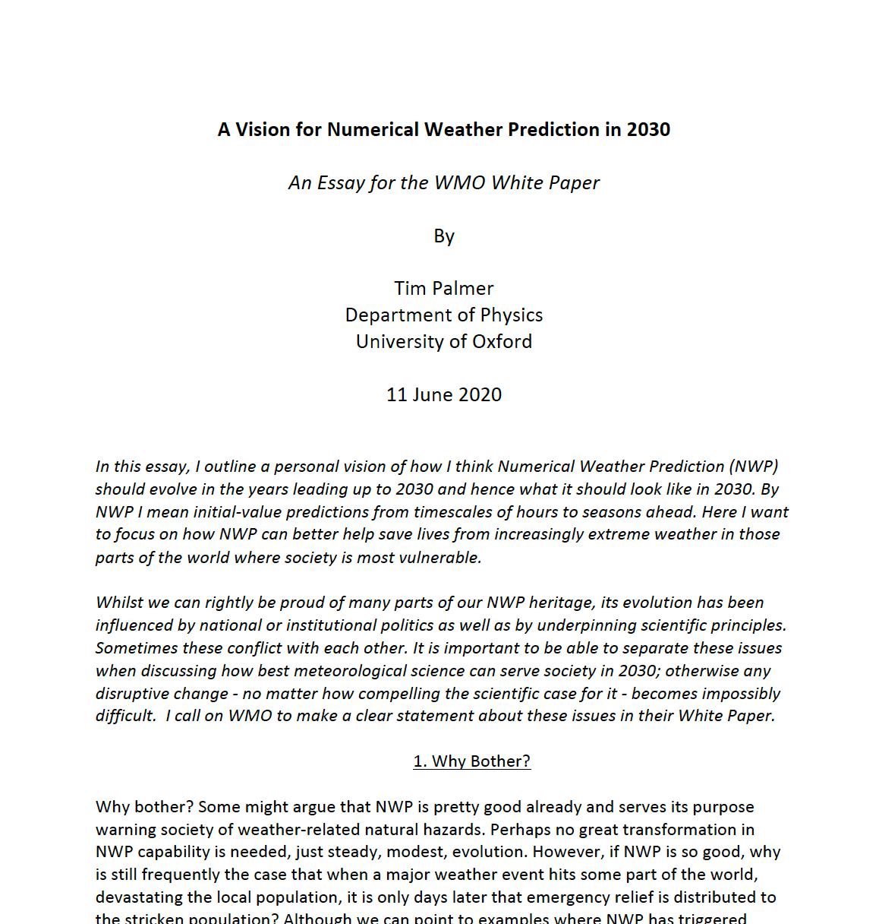
Avallable on request

Slide 5
Why Bother?
Kerala 2018

Slide 6
High-resolution (1-3km) global ensembles
Better representation of extremes
Better able to assimilate observations
No need for some key parametrisations – smaller systematic errors
How many such models to we need?
  Nb, a “model” should be seen as a piece of code where the inherent uncertainties in e.g. the parametrization process are represented stochastically.

Slide 7
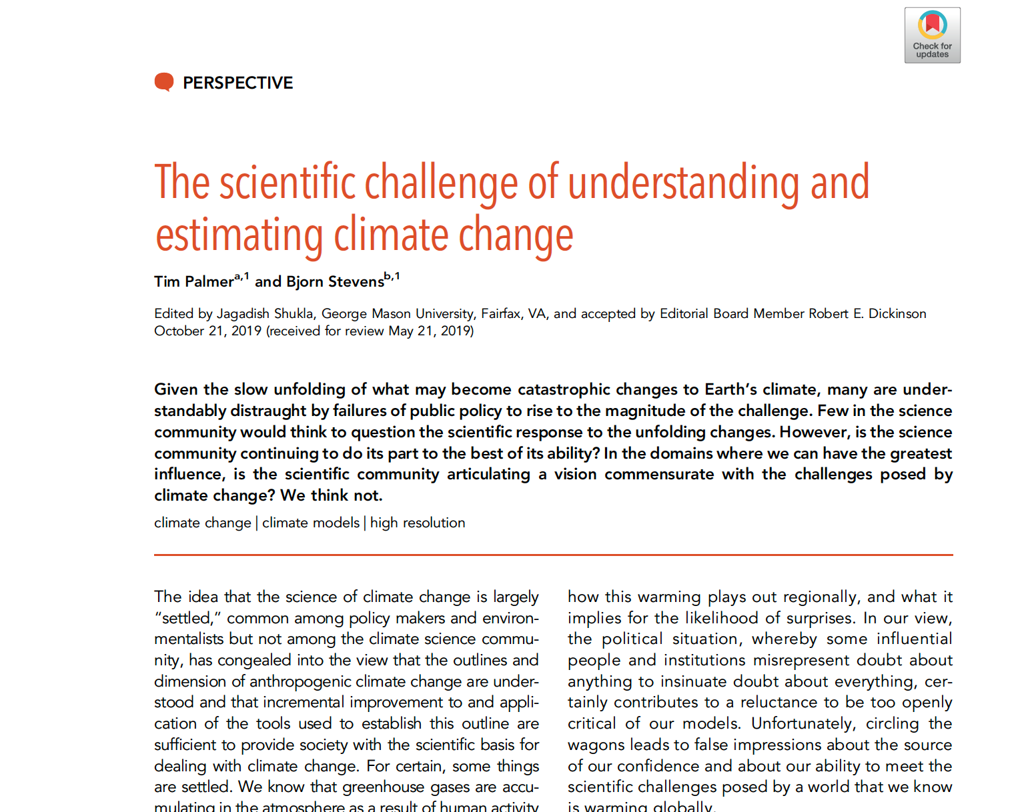

Slide 8
High-resolution (1-3km) global ensembles – a computational challenge even by 2030. since HPC also needed for running ensembles and making reforecasts.
Use of AI for parametrisations
Use of reduced-precision modelling
Domain-specific languages.
Pool national human and computing resources on the continental scale (c.f. ECMWF)

Slide 9
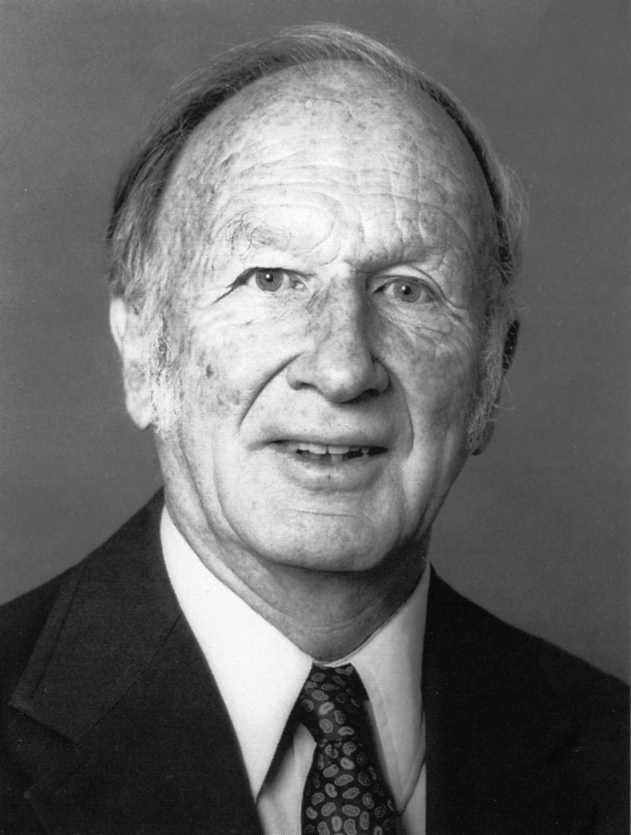
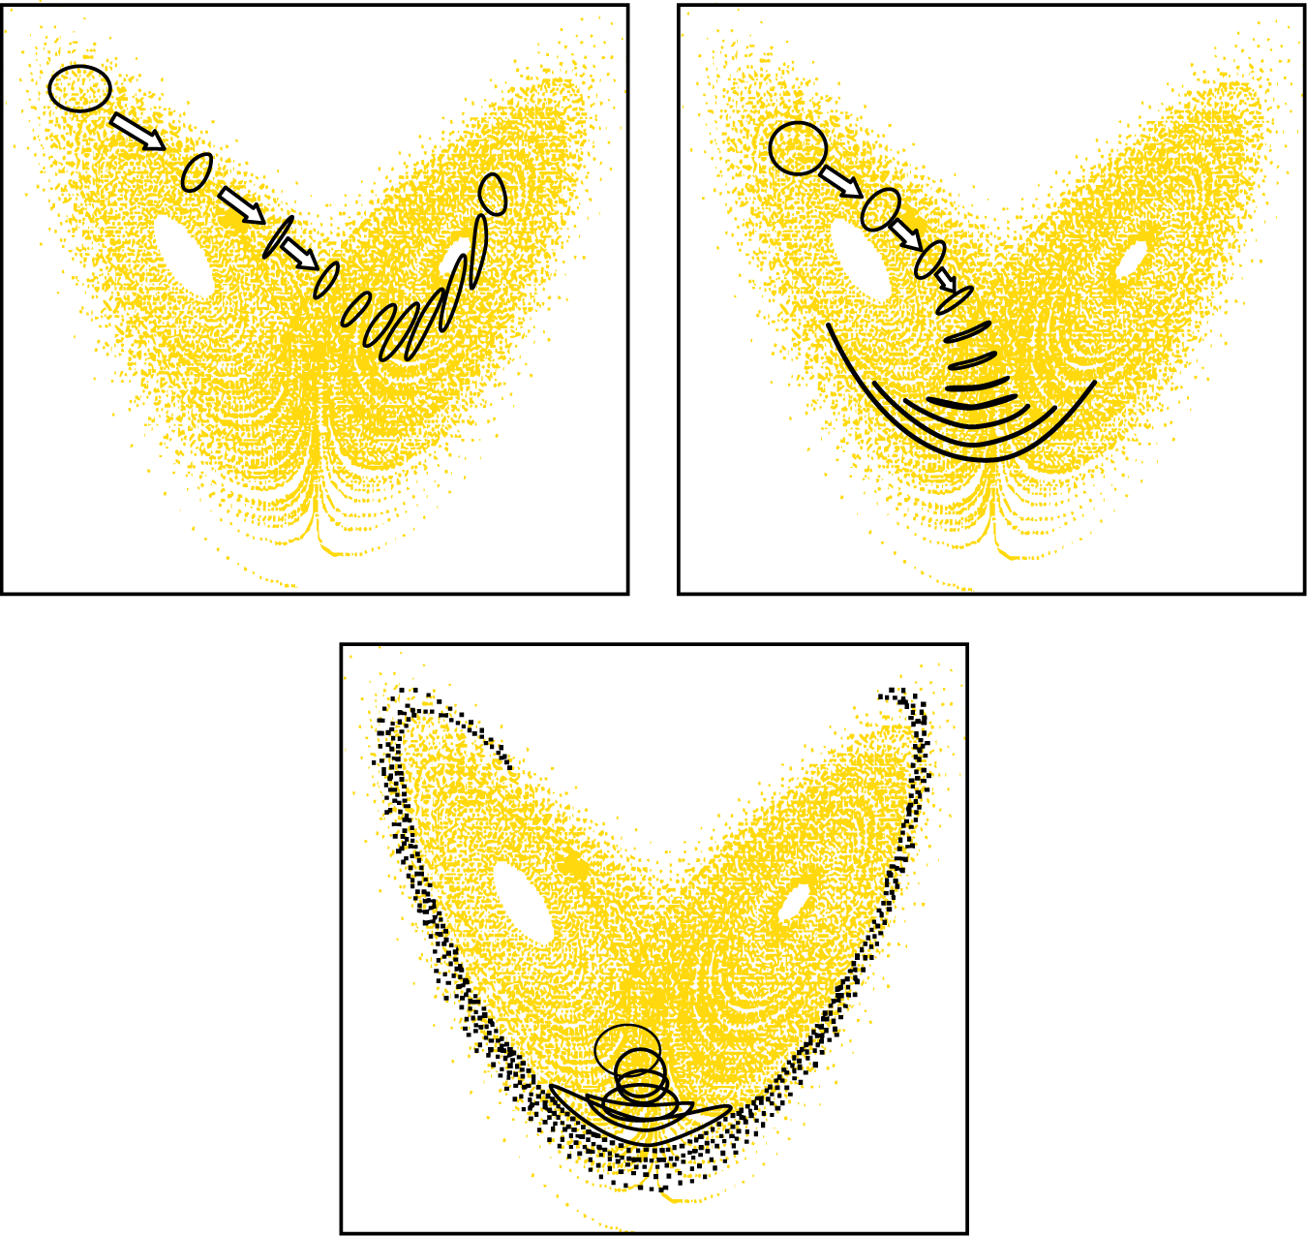
Ed Lorenz
Deterministic prediction (even in the short range) makes no scientific sense at all!

Slide 10
Cyclone Sidr : Predictable
Hurricane Katrina: Semi-Predictable
Hurricane Nadine: Unpredictable

Slide 11

Needs reliable probabilistic triggers.

Slide 12
Downscaling – Limited Area Models or AI?
Major challenge to run 50-member ensembles of say 100m-1km LAMs to 10-14 days over continental scales.
Much of the LAM effort is fragmented and in developing countries ensemble LAMs are almost non-existent.
Need hindcast/reforecast data to properly assess skill, e.g. when weather forecast ensembles drive impact models.
Is there an alternative?

Slide 13
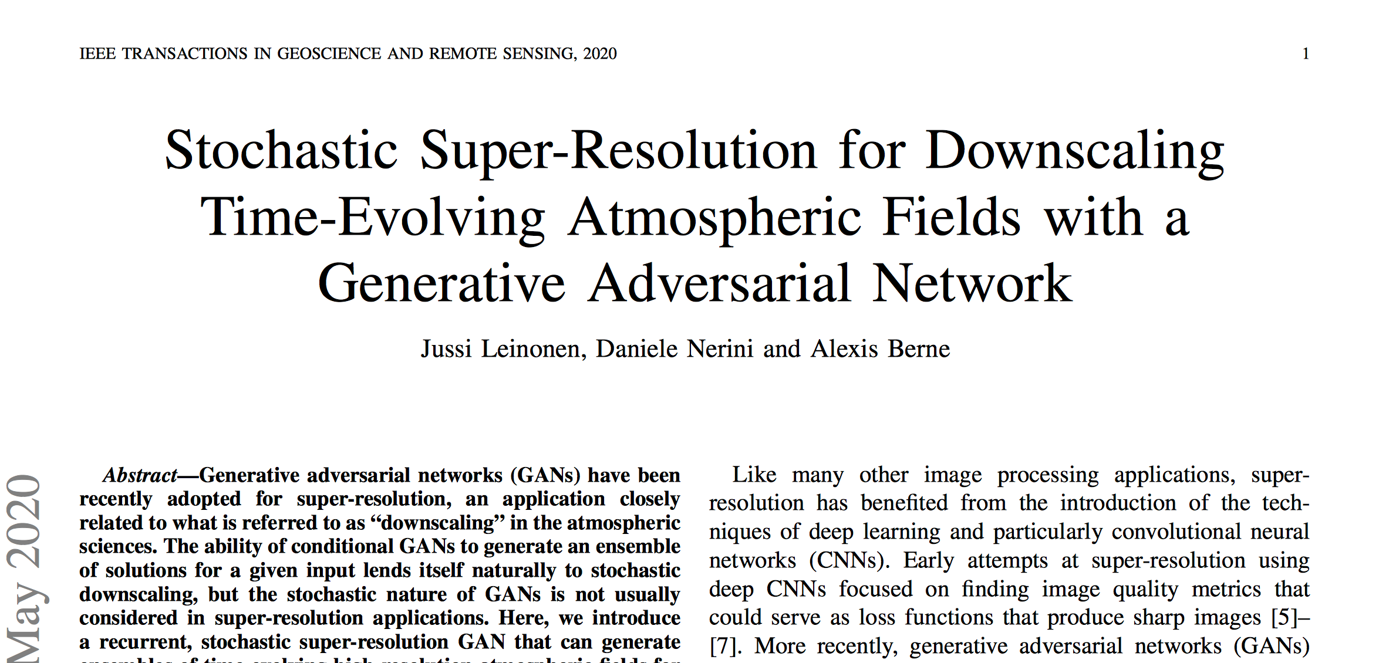
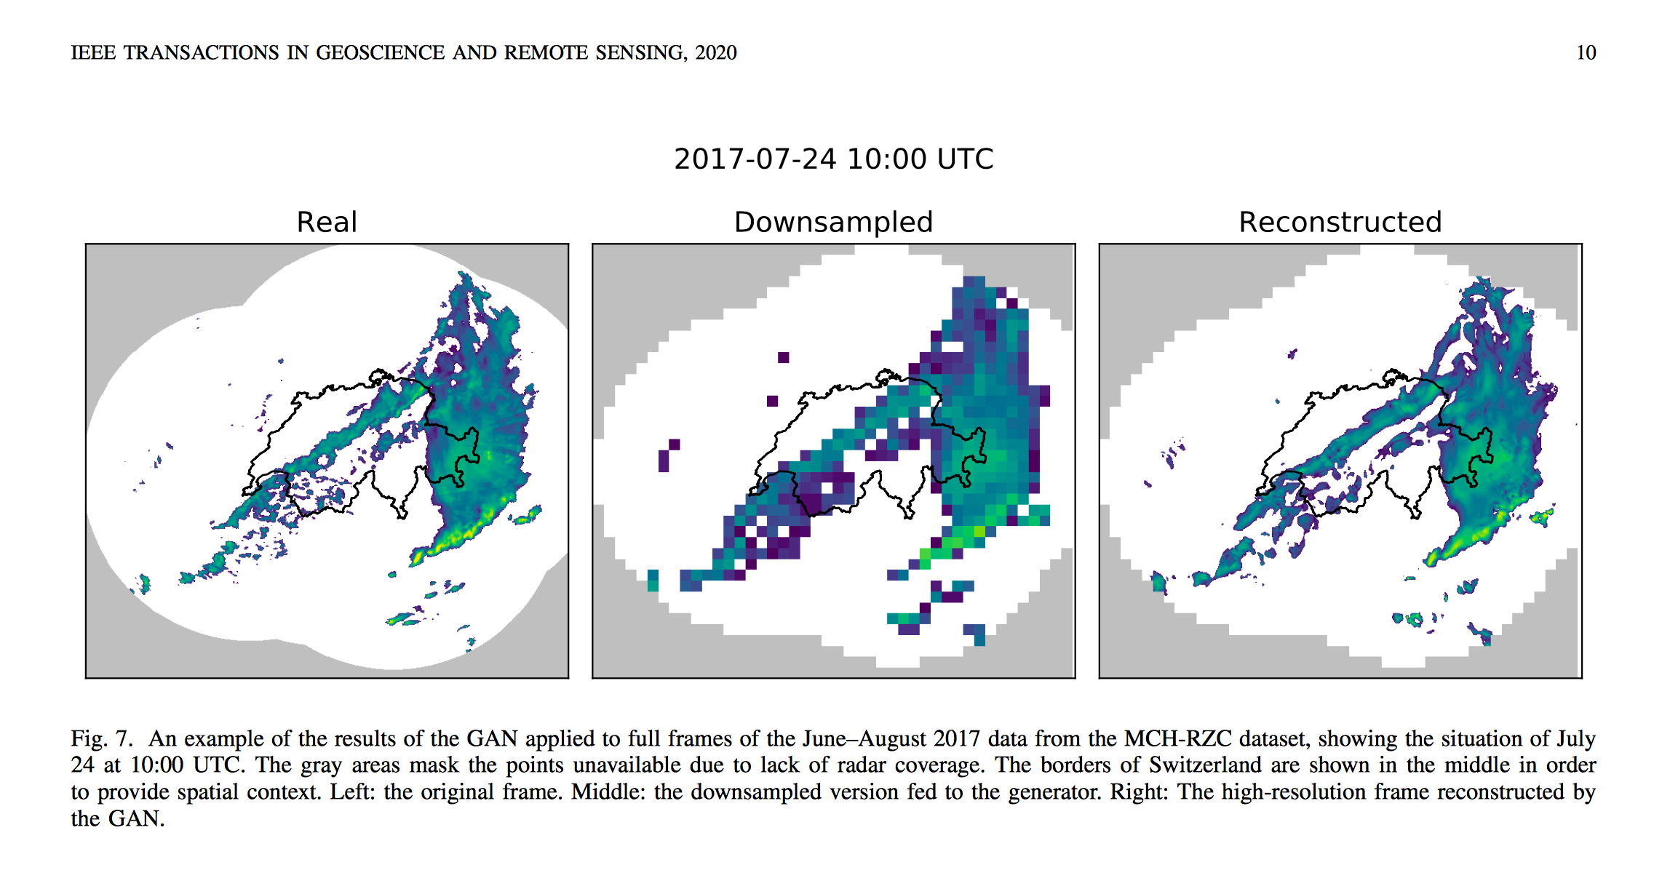

Slide 14
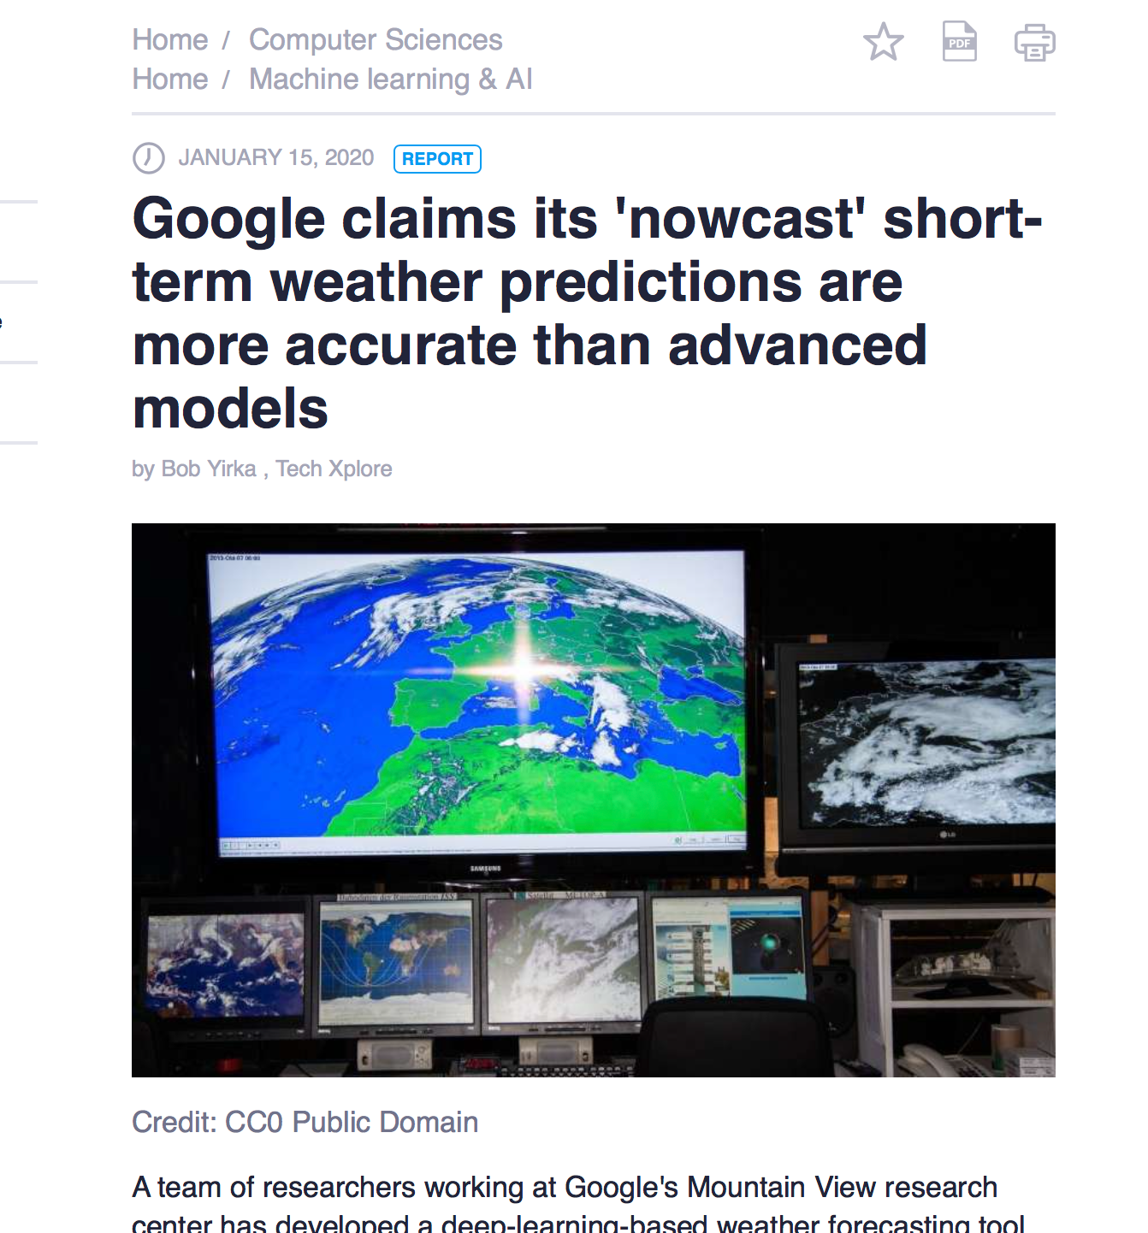

Slide 15
Could AI replace medium-range NWP?
Very unlikely in my view
Amount of training data needed to find analogues that agree to observational error bars would be astronomical and much greater than exists by orders and orders of magnitude
So-called adjoint sensitivity vectors show that data-driven methods are not likely to be successful in beating current NWP systems.

Slide 16
Private-Public Partnerships
Lots of AI experience in private sector. Should be tapped for such downscaling/calibration work
What about private NWP initiatives? Here I am much less enthusiastic.
Observations? Yes, but I think our inability to be able to assimilate observations is as much an obstacle (and perhaps even more of an obstacle) for improving forecast skill
Computing? I am a great believer in the the potential role of imprecise (potentially even stochastic) computing.

Slide 17
Scientific Collaboration
Need for enhanced scientific collaboration between developing country and developed country scientists to improve NWP.
Do we need an organization like ICTP Trieste, but focused on weather/climate research in developed world/ developing country?

Slide 18

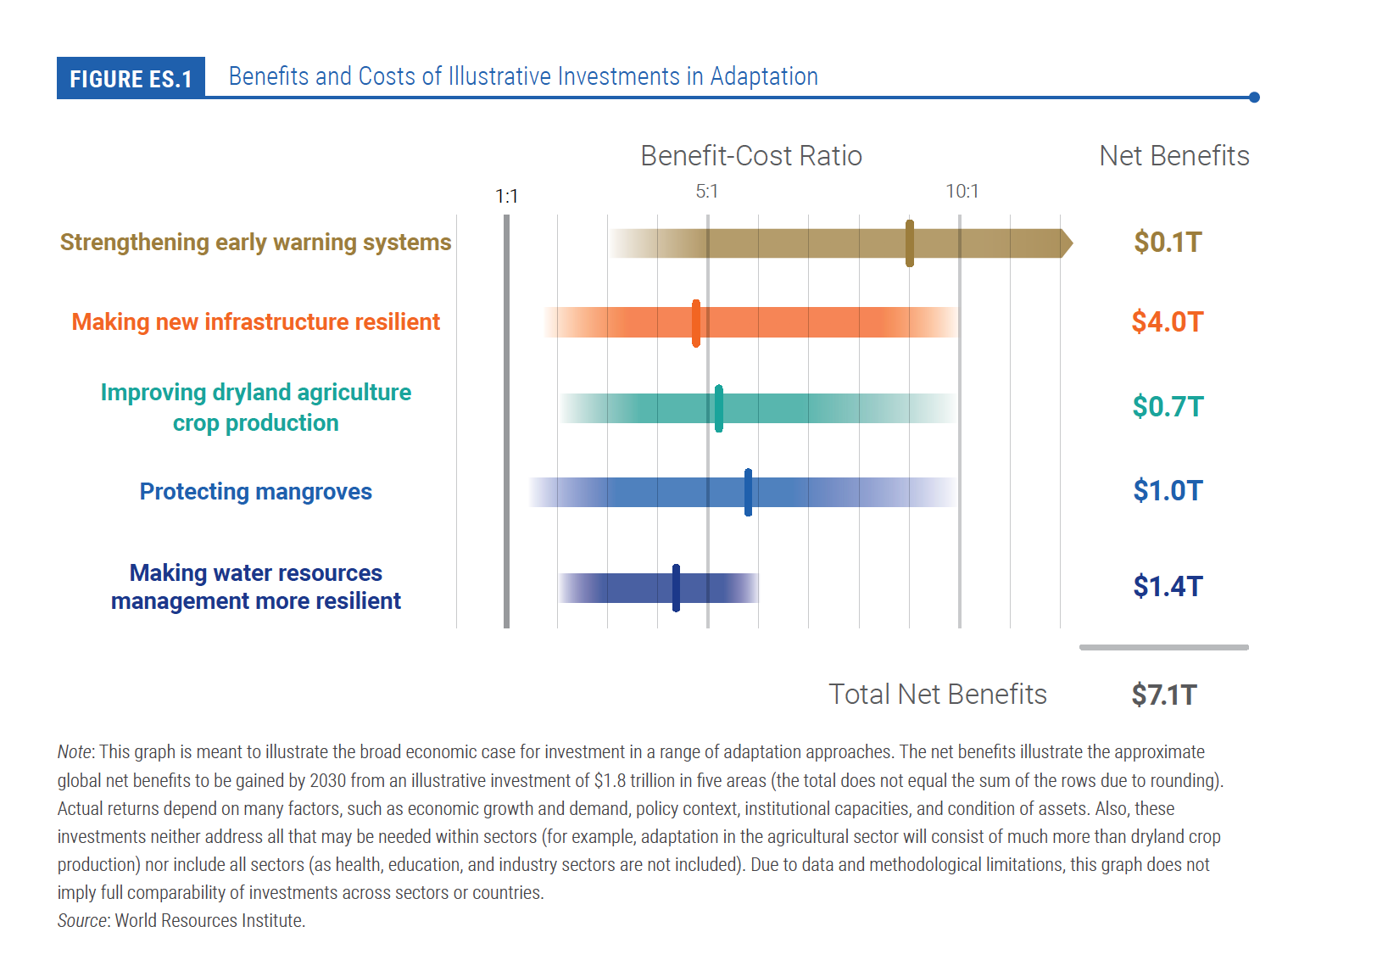

Slide 19
COP26
In view of the role of forecasts for improving societal resilience to extreme weather, we should be putting pressure on NWP centres to:
a) provide forecast data free of charge to developing countries
b) invest in AI-based downscaling/calibration so that the ensemble data is useable by developing country NMSs and disaster agencies.
c) something to be announced at COP26.

Slide 20
Mandate of NMSs in 2030
Not to make forecasts!
More to downscale AI-enhanced global ensemble forecasts (e.g. using local observations) for specific national needs
Forecasters do not need to forecast! Instead their main job should be interacting with forecast users so their decision processes can be guided by the most relevant probabilistic forecast products (and associated probabilistic forecast triggers).

Slide 21
Send us your questions
Join at
slido.com
#GWEVision MHEWS
You can join the live Q&A by scanning the QR code or visiting slido.com.
Use event code #GWEVision.
Submit your own questions or upvote 👍 others.
We will answer them after the presentation.

Slide 22

A Vision for Numerical Weather Prediction in 2030
Discussant
Alan Thorpe
Visiting Professor at the University of Reading
Non-Executive Director on the Board
of the Met Office
Weather science and policy adviser

Slide 23
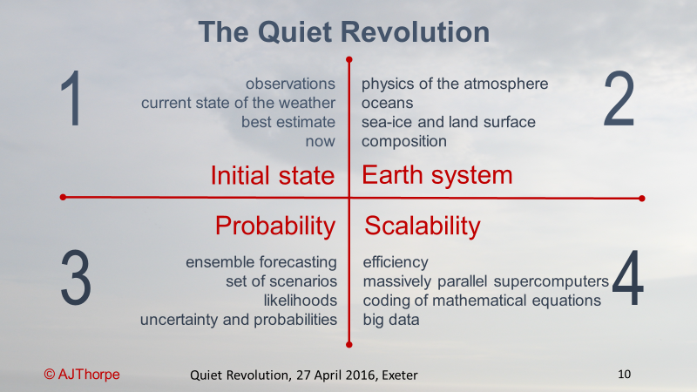
Building the 2030 Vision
Bauer, Thorpe and Brunet, Nature, 2015

Slide 24

Private sector: companies
Global Weather Enterprise
Public sector:
NMHSs
Government funding
Markets & regulations
Academic sector:
universities
Development agencies & banks
Private capital

Slide 25
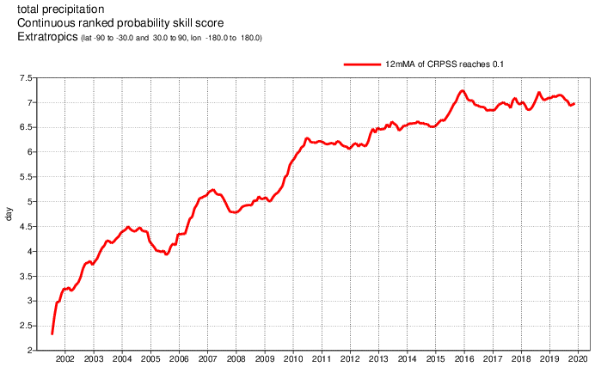
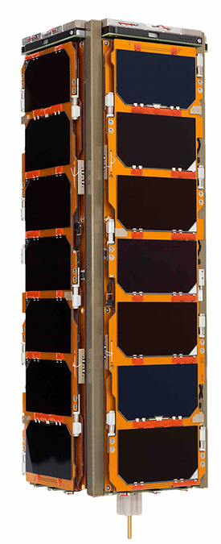
Delivering the Vision
By mobilising resources for global (and regional) NWP with high resolution, delivered to those who need it
By satisfying the increasing need for more observations
By noting: growth of private sector capabilities and NMHSs are under funding pressures
Thorpe and Rogers, BAMS, 2018

Slide 26
And by enhanced cross-sectoral co-operation
No one country or organisation can operate alone
Local weather depends on global interactions
Maximise value of research, modelling, observations, & weather predictions by sharing as widely as possible
Relies on a “business model” supporting all sectors
Public investment acts as a vital stimulus but is not enough on its own

Slide 27
Send us your questions
Join at
slido.com
#GWEVision MHEWS
You can join the live Q&A by scanning the QR code or visiting slido.com.
Use event code #GWEVision.
Submit your own questions or upvote 👍 others.
We will answer them after the presentation.

Slide 28

Global NWP in WMO Context
Discussant
Lars Peter Riishojgaard
Director of the Earth System Branch
WMO Secretariat

Slide 29
WMO’s role in global NWP
Global NWP requires continuous, real-time access to observations from the entire global domain; only WMO has the reach and the authority to coordinate this;
  New initiative: Global Basic Observing System (GBON)
Global NWP has progressed immensely thanks to worldwide exchange of analysis and forecast fields and assessments based on common metrics of skill; GDPFS of the World Weather Watch;
Coordination of downstream activities;
  Help ensure ability of all Members to receive, ingest, understand and use NWP output;
  Issue guidance on relevant national activities;

Slide 30
The need for global exchange of weather and climate observations is well understood, codified in international agreements, and in principle uncontroversial
WMO Convention (1947):
  (a) To facilitate worldwide cooperation in the establishment of networks of stations for the making of meteorological {…}
  (b) To promote the establishment and maintenance of systems for the rapid exchange of meteorological and related information;
Paris Agreement (2015):
  Article 7 (Systematic Observation): Parties should strengthen their cooperation on enhancing action on adaptation, taking into account the Cancun Adaptation Framework, including with regard to:
  {…} strengthening scientific knowledge on climate, including research, systematic observation of the climate system{…}
The WMO Convention and the Paris Agreement imply that responsibility for making observations is purely national; in parts of the world this is not working (and it probably never will);
Satellite data are important, but they cannot do the job alone: Surface pressure and detailed vertical wind profiles are currently available only via conventional observations.

Slide 31
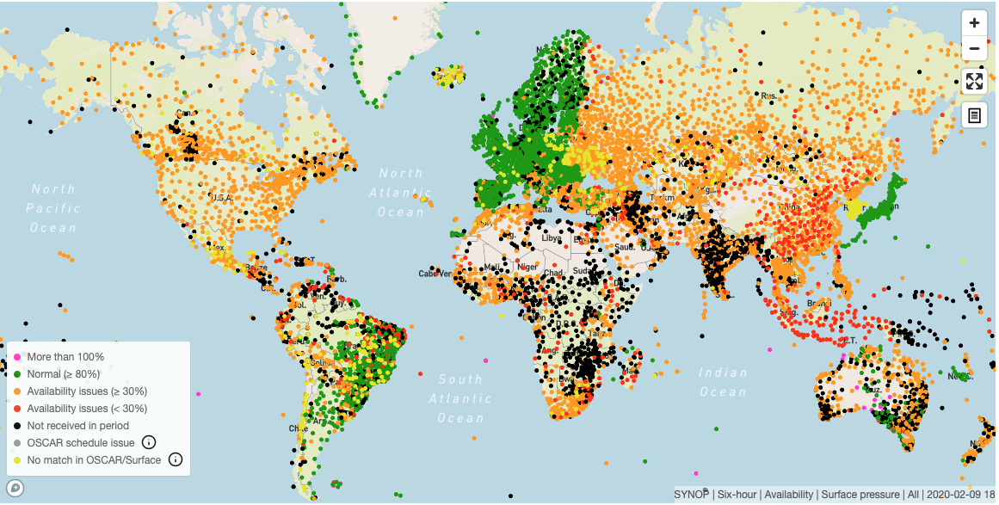
Which observations are currently exchanged?
(Example: surface pressure observations)
Sample plot from WDQMS; WMO system monitoring international exchange of observations 24/7
Green: Fully reporting (hourly)
Orange: Partly reporting (mostly 3-hourly)
Red: Few reports; day time only
Black: Silent stations
(Purple or yellow: metadata problems)
Current international exchange of data for global NWP less than optimal (Example: Surface pressure observations received by global NWP Centers on Feb 9 2020, 18Z)

Slide 32
Why is observational data exchange falling short, and how do we improve it?
Current data exchange practice is largely based on WMO Publication 540 (Manual on the Global Observing System) and on WMO Resolution 40 (Cg-11);
  Resolution 40 was adopted in 1995; NWP has made immense progress since that time, and current requirements are vastly different;
  Congress resolutions define policy and do not contain sufficient technical detail to allow for consistent implementation by all Members;
  Additional material is available in guidance documents such as CBS recommendations, implementation plans, etc.; many Members will, as a matter of principle, base their practice only on regulatory material;
  Current WIGOS monitoring data show unacceptable gaps in data coverage over many areas (previous slide);
    In many cases additional observations are being made, but not currently exchanged, due to a lack of clarity from WMO regarding the obligation of the Members.
Three typical causes of missing data
Data policy issues;
Missing technical capabilities;
Lack of financial resources.
Compounding fact:
Unlike the space sector, there is no significant lobby backing conventional observing systems and no substantial investments in improving impact;

Slide 33
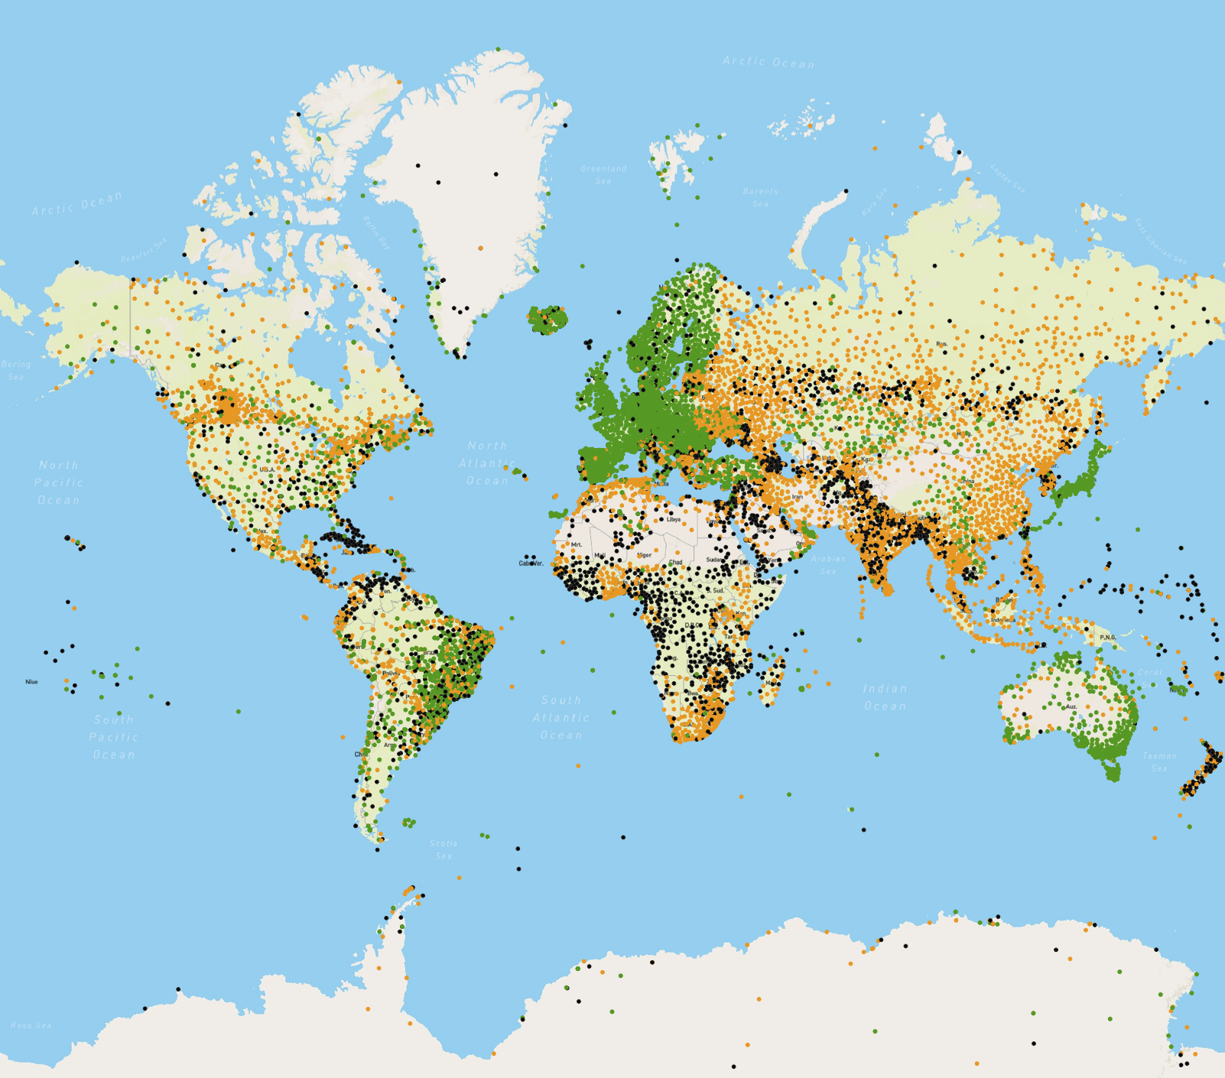
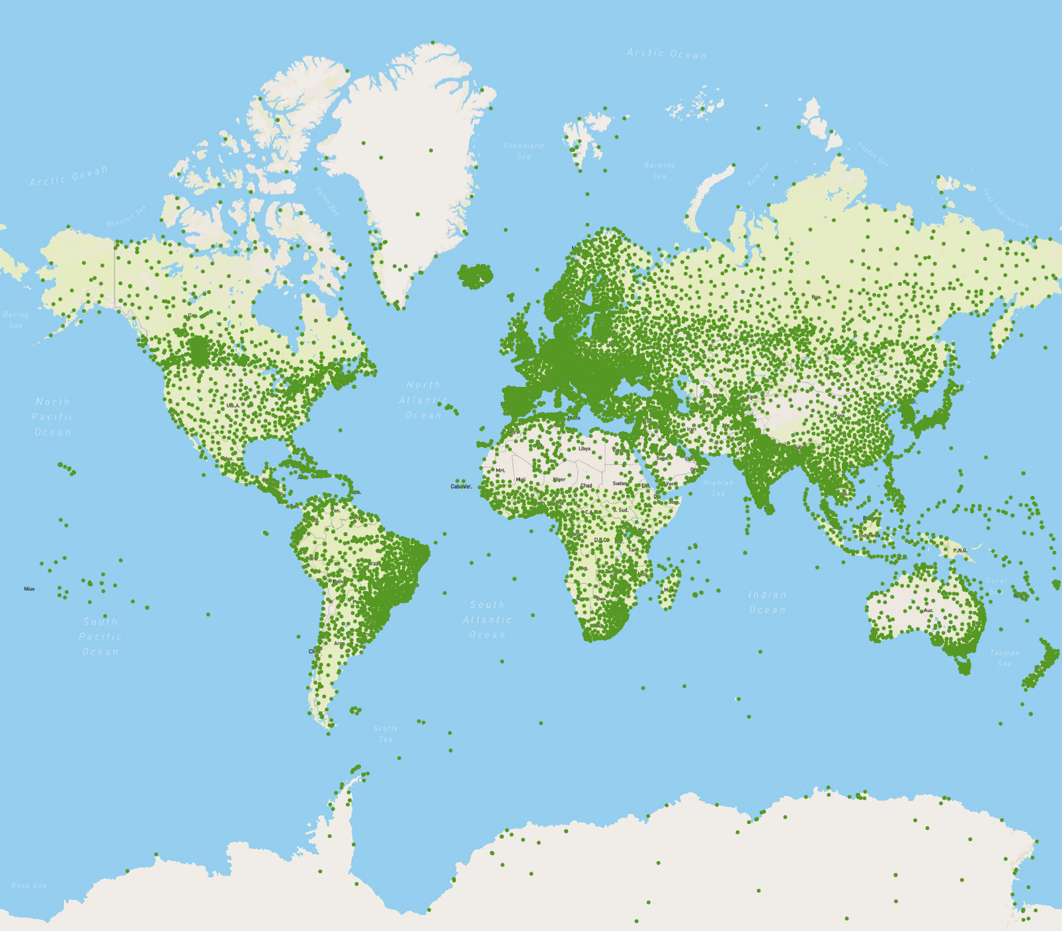
Global Basic Observing Network (GBON)
GBON: Congress-approved WMO policy initiative that will help to turn data coverage map green;
Regulatory material will specify the obligation of WMO Members to exchange certain observations at set minimum horizontal resolution and at set minimum frequency;
Once approved, GBON can be implemented immediately in the developed world;
Developing Members will need help; GBON provides benchmarks for assessment of investment in meteorological infrastructure;
WMO working with close to 30 development partners on establishing a Systematic Observations Financing Facility (SOFF) to help pay for GBON in LDCs and SIDS.
Estimated additional funding needs to implement GBON, (USD):
Capital investment: 350 M
Annual operating costs: 150 M
(estimated cost of existing Global Observing System: 2-5 B/yr)

Slide 34
Downstream coordination activities
Role of WMO
Message from the industrialized WMO Members to developing Members: “Do not bother developing your own NWP capabilities; it is a waste of money and effort” is rarely well received and does not resonate.
  National sovereignty and security;
  Concerns about guaranteed open access to NWP output; economic impacts of seasonal prediction; reanalysis as a driver of policy initiatives;
  Capacity development of NMHS; an “own” national NWP capability perceived as a key milestone;
Could we (WMO) set up a globally coordinated system that would
  Be economically efficient;
  Guarantee access to NWP output, also in times of conflict;
  Avoid contributing to further widening the technology gap between developed and developing Members;
Maybe yes, but it would require much closer collaboration and less reliance on “volunteerism” than what is typical for WMO activities.

Slide 35
Role of NMHS in the future
Turbulent times for many WMO Members;
  Many NMHSs have marginal capabilities and are under heavy pressure from both the private sector and their own governments;
Regardless of delivery agent, the most important role of a national weather/climate service will be to ensure that the model guidance (in whatever form it takes) is available, translated, understood and acted upon by national and regional decision-makers;
  Relevant expertise will be required to help translate and interpret the guidance to local conditions (and to help improve it in the future);
  Even more importantly; Expertise required to frame the guidance in the context of national and local vulnerabilities and communicate accordingly;

Slide 36
Final remarks
GBON reflects a recommitment of WMO Members to free and open international exchange of observations in support of Global NWP, the basis for all weather and climate-related products;
The SOFF is being designed as a unified financial mechanism to fund the GBON in areas with insufficient local resources, based on the principle that the burden of financing a global public good should fall to those who have the ability to shoulder it;
WMO is (has been) active in the development of the Global Data Processing and Forecast System (GDPFS), which has been instrumental to the progress and success of global NWP;
Like the field of NWP in general, the GDPFS is arguably at a watershed moment;
By taking on a role as global coordinator, similar to its role in GBON and SOFF, WMO has the opportunity to make an important contribution to this field.

Slide 37
Send us your questions
Join at
slido.com
#GWEVision MHEWS
You can join the live Q&A by scanning the QR code or visiting slido.com.
Use event code #GWEVision.
Submit your own questions or upvote 👍 others.
We will answer them after the presentation.

Slide 38

Building the Pathway for the Hydromet Modernization (NWP) in 2030
Discussant
Alice Soares
International Advisor

Slide 39
Typical NWP issues in client countries nowadays
Limited use of global and regional NWP
Limited understanding of EPS products
Run low resolution deterministic NWP (~15-30km), with no data-assimilation, nor the optimal parametrizations
No objective verification
No post-processing
Few NWP and ICT staff, but often talent staff

Slide 40

Current Hydromet Modernization:
Usual requests by WB client countries
High Performance Computer (HPC)
Capacity building to run deterministic NWP at higher resolution (~3-7km) with data assimilation
Typical results:
Experiments
Building the capacity
No operational capacity due to limited number of staff

Slide 41
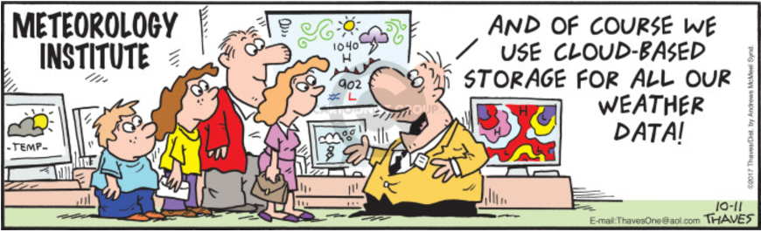
We can’t expect overnight changes... need a Transition Path!
Current investments are important for building the capacity, allowing:
Creation of a pool of experts
Migration from deterministic to probabilistic solutions
Replacement of national LAM with AI-based downscaling and calibration

Slide 42
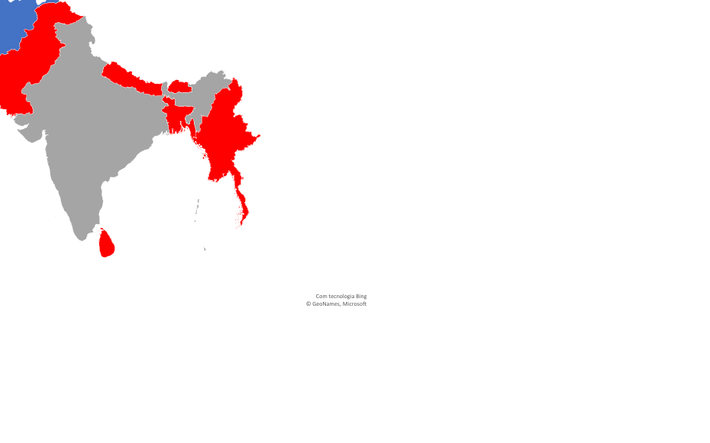

Slide 43
Transition Path:
Regional modelling platform
NMHSs modellers and Universities in the region cooperate on model development and model calibration (moving from full ensemble system to AI-based downscaling and calibration)
Ownership
Continuous development and improvements – sharing expertise
Sustainable

Slide 44

Governance
RIMES Council
All PRs of Africa & Asia
South Asia Committee
All PRs of South Asia + Myanmar
South Asia Working Group on NWP
Modellers of all South Asia countries + Myanmar & representatives from global centers

Slide 45
Fundamentals
Use available global and regional model products and guidance rather than develop national limited area models (LAM)
(i) Replacing deterministic modelling systems with ensemble prediction systems
(ii) Replacing national LAM with AI-based downscaling and calibration
Critical national observations are those that impact the performance of global and regional models and need to be shared (introducing 'open data policies’) – critical for model calibration
Changing mind sets - at the national level:
(a) shifting focus from capital-based infrastructure to a service-oriented approach
(b) aligning organizational change with the technology innovation

Slide 46
Send us your questions
Join at
slido.com
#GWEVision MHEWS
You can join the live Q&A by scanning the QR code or visiting slido.com.
Use event code #GWEVision.
Submit your own questions or upvote 👍 others.
We will answer them after the presentation.

